Slide 1
Assessment
Creanga Oxana

Slide 2
Assessment vs. Testing
Continuous assessment is like a mirror - it allows you to keep checking what you look like, and you can make changes based on what you see.
A test, on the other hand, is like a photograph - it captures one moment.
Continuous assessment - assessment is ongoing throughout the duration of a course, rather than all at the end of a course. It is often informal and formative, although it may sometimes also contribute to students’ grades.

Slide 3
Washback
is the influence of testing on teaching and learning
it can be positive or negative
In language education, positive washback encourages language learning.
A test has positive washback when test-preparation activities are the same as language learning activities. E.g., doing a pairwork speaking activity before a speaking test.
In practice, we often try to test communication, because this encourages teachers and students to practise communication.
Negative washback limits students’ learning. Teachers and learners sometimes do activities which are not helpful for learning the language.

Slide 4
Test’s Construct - a test construct is the set of student abilities that the test measures
There are two main problems with test construct that can produce negative washback:
1) The construct can be too narrow, so only a small number of specific skills or abilities are tested. This may cause teachers and learners to restrict what they learn.
For example, if speaking is not tested, teachers and learners may choose not to practise speaking in class, even though it would be a useful skill in real-life. To avoid this kind of negative washback, we need to include a wide range of skills and abilities in our test construct.
2) Sometimes language skills and abilities are tested, but they are not connected to real-life abilities which we need to learn. When the test is not relevant in this way, negative washback can happen.
E.g., if a speaking test includes a memorised speech, students may spend more time trying to memorise the speech than developing their speaking skills. To avoid this kind of negative washback, it is important for tests to focus only on the language ability being tested.

Slide 5
Formats, tasks and settings - ways in which we can try to reproduce the conditions of real life language use
Formats
Common formats for speaking tests include:
Interview: This has the advantage of being interactive, but is not like a real conversation because one person usually asks all the questions and the other answers them.
Oral presentation: Presentations can be useful in business or academic situations, but they are not very interactive.
Interactive task: When two or more students work together, it encourages natural student interaction and genuine communication. However, one student’s performance might affect the other’s.
Group discussion: This can work well with large classes because it saves time by assessing students together. However, teachers need to be careful not to allow any students to dominate while others say very little.

Slide 6
Tasks
Speaking tasks commonly used in assessment include:
Describing something: For example, describing a picture. This gives students something to talk about, and it doesn’t require students to read anything.
Comparing things: This is similar to describing something, but can be more demanding. It encourages students to compare and contrast two different things.
Telling a story: This is a very natural speaking activity. Stories can be based on pictures. Alternatively, students can tell their own stories, but some students might find it difficult to think of a story to tell.
Giving some personal information: This is also a natural speaking activity, and focuses on personal topics that students are familiar with. As well as basic information, it can include talking about personal experiences and opinions.

Slide 7
Settings
Live: This doesn’t require any technology, but it means that the assessment has to be completed in real-time.
Recorded: This allows lots of students’ speaking performances to be recorded at the same time, and it also means that markers can listen more than once. However, it means that markers need time to listen to the recordings after the test.
Face-to-face: This might be considered more realistic, but it means that the marker and the students need to be in the same place for the test.
Remote (via phone or internet): This may feel different from face-to-face communication, but it can make tests easier to access, especially for students in remote locations.

Slide 8
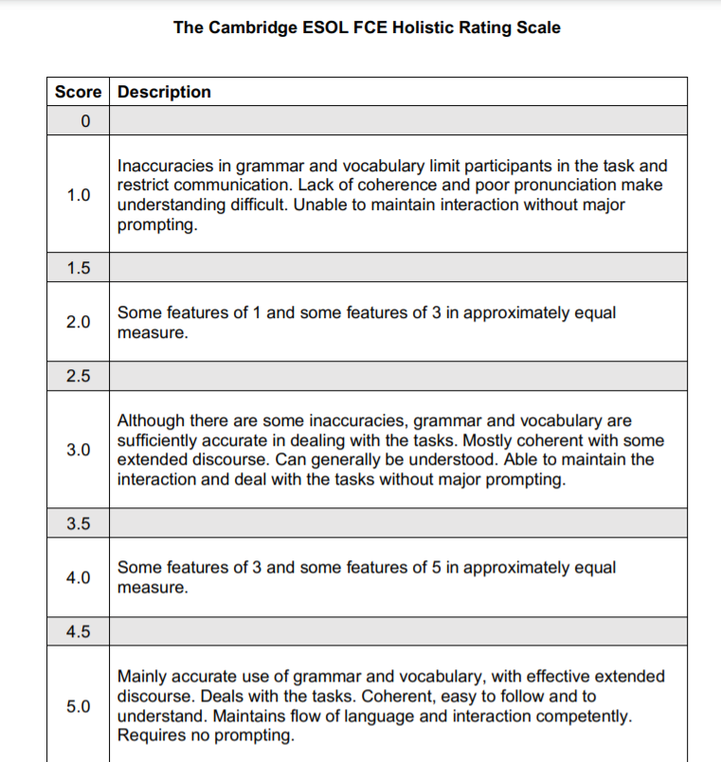
Scoring speaking:

Slide 9
Writing
Like speaking, writing is usually assessed using a rating scale.
Rating scales give students credit for what they do well, rather than penalising them for making mistakes. This approach can feel more positive and motivating for students.
Holistic (global) rating scales give one overall score for a piece of writing or speaking. Holistic scales are often easier for teachers to use, and can produce more consistent marking.
Analytic rating scales give separate scores for different aspects of writing or speaking, such as task achievement, vocabulary, and grammar, for example. Analytic rating scales can be useful for formative assessment, because they give learners more detailed information about the strengths and weaknesses of their writing.
https://ugc.futurelearn.com/uploads/files/a9/da/a9dacc3a-4fd1-4dcb-8841-6da3a4f72d5f/Aptis_writing_rating_scales.pdf
Aptis is an English test for adults (16+), which can be used to assess ability in all four English skills - speaking, listening, reading and writing.

Slide 10
Reading in the CEFR
Looking at the Overall Reading Comprehension Scale, we can see the progression of reading skills, which means that students will move:
from individual words (Pre-A1) to texts (A1 - C2)
from very short (A1) and short (A2) to long texts (C1 - C2)
from simple (A1 - A2) to complex messages (C1 - C2)
from concrete information (A2) to abstract concepts (C2)
from standard high-frequency language (A2) to idioms (B2) and colloquialisms (C2)
from familiar matters (A2) to topics of interest (B1) and specialised subjects (C1).

Slide 11
Tasks for assessing reading:
Multiple choice questions normally consist of a short text (usually a sentence or part of a sentence), known as the ‘stem’, and a list of options or alternatives, which includes the correct answer or answers (the ‘key’) and a few incorrect ones, called ‘distractors’. One of the challenges of this task type is to come up with distractors that are credible enough, but not too challenging for our students.
True/False questions are similar to multiple choice questions, but have only two options (generally True/False, Yes/No). This means that test takers have a 50% chance of getting them correct, regardless of their understanding. To limit the guessing, we might add a third option (e.g. Not mentioned), although sometimes it can be difficult for students to distinguish between ‘false’ and ‘not mentioned’, so it is important to train our students in this type of task if we want to use them in a test. Alternatively, we might ask them to locate the answer in the text (i.e. write the number of the paragraph where the answer is located), although this doesn’t work very well if we are testing global reading.
Matching tasks are also often used to test reading skills. These tasks often take the form of matching texts with appropriate headings (or paragraphs within a text with appropriate subheadings) or matching the first part of a text with its second part. It is good practice to include a few extra distractors in the list of options (e.g. to have 7 subheadings and only 5 paragraphs), in order to limit guessing.

Slide 12
Gap fill and cloze are tasks where a few words have been taken out and substituted with blanks. Test takers are expected to fill in the blanks with the missing word(s). This type of task requires not only reading skills, but also textual and language skills, as test takers are expected to fill in the blanks with a word that fits within the text and is grammatically correct. Common variants of this task include the ‘banked cloze’, where students have to choose the right answer from a list of options, and the ‘cloze elide’, where students have to put whole sentences back into a text.
Short answer questions can be considered a variant of open questions where test takers are required to use a specific number of words. They usually pose less of a challenge when it comes to scoring because it is easier to predict the answers test takers will come up with, and decide in advance which are acceptable and which are not.
Information transfer are tasks where candidates are expected to fill in charts, tables or diagrams based on the information they read in a text. This kind of task is often used in academically oriented language tests.
Ordering tasks are tasks where candidates need to put sentences or paragraphs of a text in the right order. It is particularly important to pilot this type of task because they are apparently easy to build from authentic texts, but often students come up with different solutions we had not thought of (and which are also perfectly acceptable).
Integrated tasks: These are tasks that require the use of a different skill (usually a productive one, like speaking and/or writing). Examples can be summary tasks, making notes from a text, paraphrasing, etc. They can be very challenging to score because it can be hard to build a scale of criteria that takes into account both reading and writing (or speaking) skills, and sometimes it’s not so straightforward to determine whether an error depends on poor reading or on the lack of productive ability. However, these tasks can be more authentic than non-integrated tasks.
Some of the task types will require the test takers to use only their reading skill: multiple choice questions in all their different forms, matching tasks, banked gap fill, and ordering tasks. Others will involve another skill, for example, writing. Sometimes, the amount of writing might be very small, such as short answers or gap fill and cloze tasks. In other tasks, candidates might be required to produce a certain amount of text, such as open questions, summaries, editing and paraphrasing tasks. In both cases, we’ll need to think about how this second skill might affect the students’ performances.
It’s important to keep in mind that each task type will have advantages and disadvantages, therefore, including a number of different task types is probably our safest approach.

Slide 13
Here are some more tips on assessing reading
Decide which sub-skills you wish to test e.g. skimming, scanning, making inferences.
Choose suitable reading texts and task types. Ideally your texts will be interesting and similar to the reading your students need to do in real life.
Make sure you test a range of reading skills and include a variety of tasks.
Give the test to someone else to try first. Did you expect the same answers? Can you improve the test?
Make sure your questions do not test general knowledge. Ask someone to try your questions without giving them the text.
Write tests in teams of people wherever possible. Two heads are better than one, as they say!

Slide 14
Different types of listening (listening behaviours)
Each of these different listening behaviours is generally called a listening sub-skill, and we commonly distinguish five of them.
Listening for gist - Gist is a general understanding. Students do not have to understand every word because the idea is clear enough.
Listening for specific information - Listening for keywords and important ideas. Students focus more on the main points and should be ready to note down answers.
Listening for detail - Listening to someone speaking and trying to get as much information as you can.
Listening for inferred meaning - Students guess the real meaning from what someone has said. The answer may not be clear, so they are paying attention to cues.
Listening for attitude - Focusing on the tone and on some keywords, listeners try to work out the behaviours and feelings of the speakers (e.g. whether they are enthusiastic or annoyed, bored or interested, kind or aggressive, etc.).

Slide 15
Listening skills in the CEFR
The progression of listening skills can be observed as learners move up through the levels:
from the individual word level (Pre A1) to extended speech (C1 - C2)
from very short questions (Pre A1) to short narratives (B1) to any kind of spoken language (C2)
from needing visual aids or gestures to support understanding (Pre A1) to understanding with ease any kind of language live or broadcast (C2)
from very slow delivery and careful articulation (Pre A1 - A1) to clear standard speech (B1 - B2) and dealing with unfamiliar accents (C1) and fast natural speed (C2)
from understanding concrete information on everyday topics (A2) to the main points of complex lines of argument on familiar (B2) and unfamiliar subjects (C1)
from standard high-frequency language (A2) to a wide range of idioms and colloquialisms (C2).

Slide 16
The most common task types to assess listening:
Multiple choice questions and True/False questions normally consist of a ‘stem’, and a list of options, which includes the correct answer(s) (the ‘key’) together with a few ‘distractors’. Two common variations of this type of task are matching tasks (e.g. tasks that require candidates to identify who says what) and ordering tasks (e.g. tasks where candidates need to order information or parts of a dialogue).
Gap fill and cloze are texts where a few words have been taken out and substituted with blanks. Test takers are expected to listen to a text and fill in the blanks with the missing word(s). In this case, textual and language skills might compensate for a lack of listening skills (e.g. even if a student hasn’t listened properly, he might still be able to fill in the blank with an appropriate word).
Short answer questions can be considered a type of open question where test takers are required to use a specific number of words. This type of task can be difficult to score because we’ll need to decide in advance how to deal with grammatical and spelling mistakes.
Information transfer are tasks where candidates are expected to listen to a text and fill in a table, or label charts and diagrams based on the information they receive.
Integrated tasks require the use of a different skill (usually a productive one, like speaking and/or writing). Examples can be summary and note-taking tasks, etc. When scoring this kind of task, we’ll need to take into account to what extent productive skills are required and how they can impact the students’ performances.
Dictation is a task that nowadays is often frowned upon, although, it can have its merits, especially if used in combination with other tasks.
The choice of tasks will depend on lots of things. Why do the students need English? What kind of listening will they be doing? How do you use that information to produce a task that they can do?
It is very important to try and mimic a real-life activity and to include a variety of task types and of listening sub-skills (listening for specific information, listening for detail, etc.), targeting both higher and lower level processing so that we can really get a picture of what students can do with their language skills.
It’s worth mentioning that, when designing a test, we should always consider going from easier to more difficult (and finishing off with something slightly easier). Students often need some time to start listening properly and concentrate, so having a difficult item at the beginning might be problematic. As the test progresses, the students concentrate more and will begin to listen better. Towards the end, again, they might be a bit tired, or they might not have enough time to listen properly, so it’s better to have something slightly easier again.

Slide 17
Monitoring and evaluating a test
After using a test, it is a good idea to analyse the results.
To find out how easy a question was, we can calculate the proportion of students who got a question right. Simply divide the number of students who got it right by the total number of students who took the test.
0.0 means that nobody got the question right, so this question was very difficult for these students.
1.0 means that everybody got the question right, so this question was very easy for these students.
For example, if 32 students take a test, and 24 of them get it right:
24/32 = 0.75
If your test is an achievement test to check students’ learning on the course, you might expect most students to get questions right.
If, on the other hand, your test is an end-of-year test to decide students’ grades, questions that are too easy or difficult are not very helpful. Values in the range of 0.25 - 0.75 are probably the most helpful for this sort of test. Below 0.25 is too difficult, and above 0.75 is too easy.

Slide 18
Good test questions contribute to the reliability of the test because they produce consistent results. Another way we can evaluate test questions is to look at who answered correctly and incorrectly.
If a test question is working well, we would expect stronger students to answer correctly more often than weaker students. We can find out whether this is happening by comparing the top third of the class with the bottom third.
First, calculate students’ test score for the whole test component (e.g. all grammar items) and put them in order from highest total score to lowest total score.
Now, split the class into thirds (approximately), so that the highest scoring students are in the top third and the lowest scoring students are in the bottom third. If the total number of students cannot be divided by three, make sure that the top and bottom thirds have equal numbers.
For the top third and bottom third of the class, calculate the facility value for each question, the same way we did in the previous step: number of students who answered correctly divided by the total number of students in that group.
For example, in a class of 30, there would be 10 students in each third.
In the upper third of the class, 8 students answered Question 1 correctly, so the facility value is 8/10 = 0.80
In the lower third of the class, 5 students answered Question 1 correctly, so the facility value for this third is 5/10 = 0.50
More students answered correctly in the upper third than the lower third. This is what we would expect, so Question 1 seems to be working well.
If the values are the same for both groups, it may mean that students are guessing.
If more students answer correctly in the lower third, it may mean that there is a problem with the question. For example, the answer key might be wrong, or the question might be confusing.

