Slide 1
Evolution of Approaches and Methods
Oxana Creanga

Slide 2
Methods
Natural methods
Linguistic methods
Communicative methods
Visionaries/designer methods
Self-study methods
Scott Thornbury, 30 Language Teaching Methods. Cambridge UP 2017

Slide 3
Natural methods
Total Immersion
The Natural Method/Approach
The Direct Method
The Oral Method
The Reading Method
Total Physical Response
The Audiolingual Method
These methods replicate/ aim to replicate
  the processes by which first languages are acquired, or by which
  second languages are picked up without any formal instruction.

Slide 4
Linguistic methods
These methods are based more on theories of language, than theories of learning.
  Language is seen as a property of the mind, and as such is best learned by engaging mental faculties, such as reason, attention, memory, and by the application of rules,
  Learning is an intellectual exercise with a strong focus on the formal features of the language - especially its grammar.
  Doesn’t ignore a concern for its communicative functions.
Explication de Texte
Text Memorization
Grammar-Translation
The Lexical Approach
Text-based Instruction
The Comparative Method

Slide 5
Communicative methods
These methods share a concern for the situated and social nature of language use.
Based on the view of language that foregrounded its communicative purposes.
This shift in perspective led to the shift in methodology, which culminated in Communicative Approach.
The Situational Approach
Communicative Language Teaching
Task-based Language Teaching
Competency-based Teaching
Whole Language Learning
Content-based Instruction
Dogme ELT/Teaching Unplugged

Slide 6
Self-study methods
Orientalists
Prendergast’s ‘Mastery System’
Programmed Instruction: Duolingo Online Polyglots
Students direct all of the main aspects of their study, such as the objectives, methods, materials, and evaluation.

Slide 7
Visionaries/designer methods
Developed by one person, who had a unique, even mystical vision of teaching, often combined with a charismatic teaching style.
Some of the practices associated with these methods have been co-opted into more mainstream methodology, even if the beliefs underlying them have not.
Community Language Learning
Suggestopedia
The Silent Way
Total Physical Response
Crazy English (developed by Li Yang in China during the 1980s. It is designed to help learners overcome fear and inhibition when speaking English)

Slide 8
The Grammar Translation Method
  the earliest approach in language teaching, accepted until the 1950s.
  called Classical Method as it was first used in the teaching of the classical languages, Latin and Greek.
  belongs to the cognitive approach to language teaching.
  Aim/Objectives:
  to be able to read literature written in the target language;
  to provide students with good mental exercise which helps develop their minds;
  to give the learners grammatical rules and examples to memorize them;
  to make them apply the rules to other examples;
  to teach the students to write in both their native and the target languages through translation.

Slide 9
The Grammar Translation Method
The basic principles of the method:
characteristic interaction in the teaching process is a Student – Teacher interaction;
teacher’s roles are very traditional, the teacher is the authority in the classroom;
literary language is considered superior to spoken language, culture is considered as consisting of literature and the fine arts;
passive vocabulary and grammar are emphasized at the cost of pronunciation;
reading and writing are the primary skills, less attention is given to speaking and listening;
the language that is used in class is mostly the students native language;
the meanings of new words are made clear by translating them into the students’ L1;
evaluation is accomplished on the basis of written tests in which students are expected to translate from their native language into the target one or vice versa, questions about the foreign culture have to be answered as well;
error correction is very important, the teacher always supplies the students with the correct answer.

Slide 10
The Grammar Translation Method
The syllabus is structure-based:
linguistic notions: rules and exceptions
morphology of words
syntax: parts of the sentence
simple and complex sentences.
Materials: the grammar book, the dictionary
Procedures
explanations in the mother tongue by the teacher
meta-language used for grammatical notions
practice exercises to apply the notions in a deductive way
memorization of long vocabulary lists
reading comprehension and vocabulary exercises of a text
translation of literary texts
compositions
Activities characteristic of the method:
translation of a literary passage
reading comprehension
finding antonyms and synonyms
gap-filling exercises
memorization
using words in sentences
compositions

Slide 11
The Direct Method
  Emerged as a reaction to the ineffectiveness of the Grammar Translation Method to prepare students to use the target language communicatively.
  Receives its name from the fact that meaning is to be connected directly with the target language without going through the process of translating into he students’ native language. It belongs to The Natural Approach of language teaching.
  Francois Gouion began to publish his work on the direct method in 1880, advocating exclusive use of the target lge in the classroom. He was influenced by the German philosopher-scientist Alexander von Humboldt who considered that a lge cannot be taught, one only can create conditions for learning to take place.
  The goal is communication. In order to achieve this goal, students should learn to think in the target language.
  The syllabus is based on situations or topics not on linguistic structures.

Slide 12
The Direct Method. Principles:
Interaction goes both ways, from teacher to students and from students to teacher, the latter is often teacher-directed, student-student interaction is used as well;
the native language should not be used in the classroom; students should make a direct association between the target language and meaning;
actions and pictures are used to make the meaning clear;
the teacher should demonstrate not explain or translate;
the teacher and students are more like partners in the teaching/learning process;
vocabulary is acquired more naturally if students use it in full sentences rather than memorizing word lists;
pronunciation should be worked on right from the beginning of language instruction;
lessons should contain some conversation activity – some opportunity for students to use language in real contexts;
students should be encouraged to speak as much as possible;

Slide 13
The Direct Method. Principles:
grammar should be taught inductively; there may never be an explicit grammar rule given;
learning a language involves learning the behaviour culture of the people living in the target country;
culture consisting of the history of the people who speak the target language and the geography of the country or countries where the language is spoken and information about the daily lives of the speakers in the target language are studied;
vocabulary is emphasized over grammar;
work on all four skills (reading, writing, speaking and listening) occurs from the start, oral communication is seen as basic;
there is no formal evaluation in the class, students have to use the language using both oral and written skills;
the teacher tries to get students to self-correct whenever possible.

Slide 14
The Direct Method
Activities characteristic of the method:
  reading aloud
  conversation practice
  gap filling exercise
  dictation
  map drawing (The students are given a map with the geographical features unnamed. Then the teacher gives the students directions. Following the teacher’s instructions, the students have to label the map of a country.)
  paragraph writing.

Slide 15
The Audio-Lingual Method
The Audio-Lingual Method (1950's) is based on conditioning and on behaviorism (stimulus-response-reinforcement)
was developed in the United States (Ch. Fries) for military purposes.
Language mastery=acquisition of a set of appropriate language-stimulus-response chains.
The goal - enable students to use the target language communicatively, language proficiency (ultimate goal - knowing the lge like a native speaker)
The syllabus - structure-based: phonology, morphology, syntax.

Slide 16
The Audio-Lingual Method. Principles:
language learning = a process of mechanic habit formation through drills, dialogue memorization;
the oral/aural skills - prioritized, pronunciation - taught from the beginning, students working in language laboratories;
foundation of language learning is analogy, not analysis;
the target language is used in the classroom not the students’ native language;
there is student-student interaction in chain drills or when students take different roles in dialogues, but this interaction is teacher-directed because most of the interaction is between teacher-student and is initiated by the teacher;
new vocabulary and structures are presented through dialogues learnt through imitation and repetition, grammar is induced from the examples given: explicit grammar rules are not provided;
cultural information is contextualized in the dialogues or presented by the teacher;
student errors are to be avoided through the teacher’s awareness of where the students will have difficulty.

Slide 17
The Audio-Lingual Method
Teacher’s role:
the teacher is like an orchestra leader, directing and controlling the language behaviour of the students;
a good model for imitation;
Learners’ role:
organisms that can be directed by skilled training techniques to produce correct responses;
teaching focuses on the external manifestations of learning rather than on the internal processes;
not encouraged to initiate interaction because this may lead to mistakes.
Activities characteristic of the method:
  dialogue memorization
  drill (repetition drill,
    expansion drill,
    completion drill,
    multiple-slot substitution drill,
    transformation drill, etc.)
  use of minimal pairs (pairs of words which differ in only one sound e.g. ship – sheep)
  gap-filling.

Slide 18
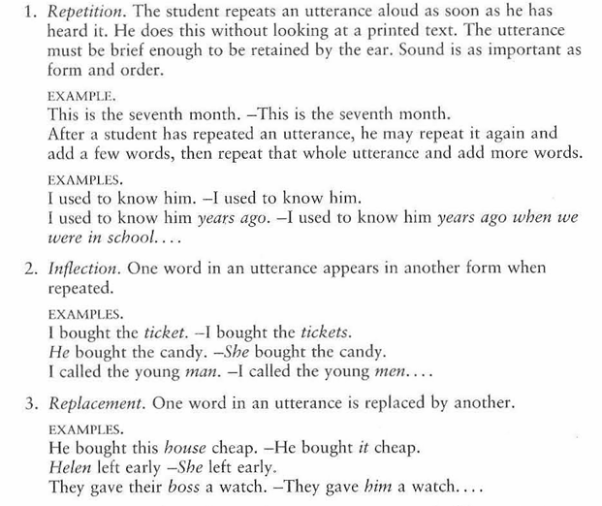
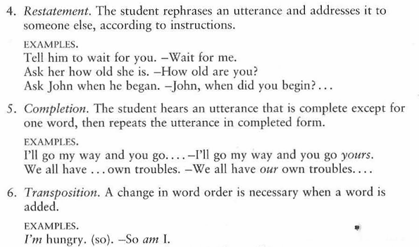
The Audio-Lingual Method
RICHARDS, J. C., RODGERS, T. S. Approaches and Methods in Language Teaching, p.54-55.

Slide 19
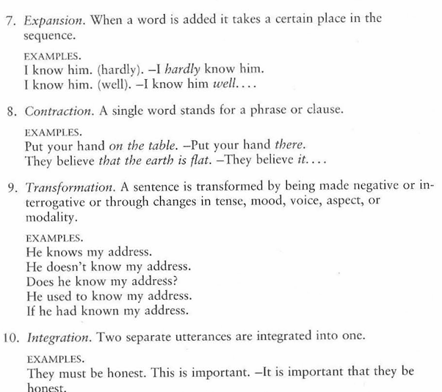
The Audio-Lingual Method
RICHARDS, J. C., RODGERS, T. S. Approaches and Methods in Language Teaching, p.55.

Slide 20
The Cognitive Approach
Appeared as a reaction to the behaviorist features of the audiolingual method;
Influenced by cognitive psychology and Chomskyan linguistics;
Language is not learned as habit formation, but through the acquisition of patterns and rules that can be extended and applied to new circumstances;
Language acquisition=the learning of a system of infinitely extendable rules based on meaningful exposure, with hypothesis testing and rule inferencing.

Slide 21
The Cognitive Approach
Language learning is viewed as rule acquisition, not habit formation;
Instruction is often individualized, learners are responsible for their own learning;
Grammar must be taught (either inductively or deductively);
Pronunciation is deemphasized, perfection is viewed as unrealistic;
Reading and writing are as important as speaking and listening;
Vocabulary learning is stressed especially at intermediate and advanced levels;
Errors are viewed as inevitable, to be used constructively for enhancing the learning process;
The teacher is expected to have a good general proficiency of the target lge as well as an ability to analyze the target lge.

Slide 22
The Comprehension-Based Approach
L2 learning is very similar to L1 acquisition;
extended exposure and comprehension (listening with understanding) must precede production;
Krashen and Terrell’s Natural Approach stems from the Comprehension-Based Approach.

Slide 23
The Comprehension-Based Approach. Characteristics:
Listening comprehension- the basic skill that would allow speaking, reading, and writing to develop spontaneously over time, given the right conditions;
Learners should begin with a silent period by listening to meaningful speech and by responding nonverbally before they produce lge themselves;
Learners should not speak until they feel ready to do so; such delayed oral production results in better pronunciation;
The input provided to learners should be one step beyond their level of proficiency;
Rule learning may help learners monitor what they do, but it will not aid their lge acquisition;
Error correction is regarded as unnecessary and counterproductive; it is important that learners can understand and make themselves understood;
If the teacher is not a native (or near-native) speaker, appropriate audiovisual materials must be used in the classroom or lab to provide the appropriate input for the learners.

Slide 24
The Communicative Approach
Lge is viewed as a meaning-based system for communication
Serves as an umbrella term for a number of designs and procedures:
  task-based language teaching,
  project work,
  content-based instruction,
  cooperative learning, etc.

Slide 25
The Communicative Approach
“…A communicative methodology will therefore encourage students to practice language in pairs and groups, where they have equal brand opportunity to ask, answer, initiate and respond. The teacher assumes a counselling role, initiating activity, listening, helping and advising. Students are encouraged to communicate effectively rather than merely to produce grammatically correct forms of English.”
Abbs & Freebairn 1979, after S. Thornbury, p.61, 2017

Slide 26
The Communicative Approach. Characteristics:
  The goal of lge teaching is learners’ ability to communicate in the target lge.
  The content of a lge course: semantic notions and social functions that are as important as linguistic structure; the use of authentic texts (brochures, instructions, cookery books, etc. ).
  Importance is given to learners’ personal experiences and situations which are considered as an invaluable contribution to the content of the lessons.
  Sts regularly work in groups or pairs transfer and negotiate meaning in situations in which one person has information that the others lack.
  Use of target language/some mother tongue.

Slide 27
The Communicative Approach. Characteristics:
  Presentation by teacher of new functional lge, vocabulary or structure;
  Practice by learners moving from controlled to spontaneous.
  Sts often engage in role-play or dramatization to adjust their use of the target lge to different social contexts.
  Classroom materials and activities often consist of authentic tasks and projects presented and practiced using segments of preexisting meaningful discourse, not materials primarily constructed for pedagogical purposes.
  Skills are integrated from the beginning; a given activity might involve reading, speaking, listening, and writing.
  The teacher’s role is primarily to facilitate communication and secondly to correct errors.

Slide 28
The Communicative Approach. Characteristics:
  Functional communication activities:
    comparing sets of pictures and noting similarities and differences;
    ordering the sequence of events;
    discovering missing features in a map or picture;
    following directions;
    solving problems.
  Social interaction activities:
      conversation,
      discussions
      dialogues and role plays,
      simulations,
      debates.

Slide 29
The Communicative Approach. Procedure:
Presentation and Discussion: Introducing a dialogue or mini-dialoguess with motivation related to learners' experiences and discuss the context, including language formality and roles. (In beginner levels, this can be done in the native language.)
Oral Practice: Practising each utterance of the dialog with the whole class, groups, or individuals, using the teacher’s model.
Contextual Questions: Engaging students with questions and answers about the dialog's topic and situation.
Personal Connection: Asking questions related to students’ personal experiences, aligned with the dialog theme.
Study of Expressions and Structures: Focusing on basic communicative expressions or structures in the dialog, providing additional examples with familiar vocabulary.
Discover Generalizations: Helping learners identify rules for the expressions or structures, including their forms, positions, levels of formality, and grammatical functions.
Recognition and Interpretation: Conducting activities to recognize and interpret the target language elements, tailored to learners' proficiency levels.
Oral Production: Moving from guided to more independent communication activities.
Homework Assignment: Assigning written homework, if applicable.
Evaluation: Assessing learning through oral questions, such as how students would use the language in various scenarios. RICHARDS, J. C., RODGERS, T. S. Approaches and Methods in Language Teaching, p.55

Slide 30

The Communicative Approach. Characteristics:

Slide 31
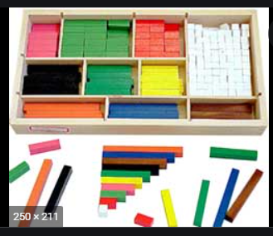
The Silent Way (Caleb Gattegno)
Learning is more effective when students discover things by themselves, rather than remember or repeat and perform solving activities in which physical objects are used.
The goal - to enable students to use the language for self expression, i.e.,
  to express their thoughts, perceptions and feelings;
  to develop independence from the teacher,
  to develop their own inner criteria for correctness.
Characteristics:
  Using an array of visuals (rods of different shapes and colours, and charts with words and colour-coded sounds, the teacher gets the students to practice and learn a new language while saying very little in the process (the teacher must be as silent as possible in the classroom).
  Language is presented to students as structural patterns, students learn the rules.

Slide 32

The Silent Way (Caleb Gattegno)

Slide 33
Designer Methods: The Silent Way (Caleb Gattegno)
Language is learned through inductive processes, only the target lge is used.
On the basis of teachers models of words, structures and patterns, student create their own utterances.
All four skills are worked on from the beginning of the course, although there is a sequence in that students learn to read or write what they have already produced orally.
Sts’ errors are seen as a natural, correction is minimal, students are allowed to correct themselves, thus developing autonomy and responsibility for their own learning; the teacher uses student errors as a basis for deciding where further work is necessary.
There is no fixed linear, structural syllabus, instead the teacher starts with what the students know and builds from one structure to the next; the previously introduced structures are continually being recycled.

Slide 34
Total Physical Response (TPR) (James J. Asher)
adults’ second or foreign language learning could have similar developmental patterns to that of children’s language acquisition;
based on coordination of speech and action, lge taught through physical motor activity;
linked to comprehension-based approach:
  comprehension abilities precede production;
  teaching speaking should be delayed until comprehension abilities are established;
  teaching emphasize meaning not form; teaching should minimize learner stress.

Slide 35
Total Physical Response (TPR) (James J. Asher)
Theory of lge – structuralism (verb in the imperative the main element of the lge).
Theory of learning – stimulus-response view.
The goal – to ensure that students enjoy their experience in learning to communicate in a foreign language (comprehension – a means to an end (speaking)).
Syllabus – sentence-based, grammar taught inductively, item selected according to situation they can be used in the classroom, in accordance with the ease of assimilation.

Slide 36
Total Physical Response (TPR) (James J. Asher)
Teaching activities:
  drills to elicit physical activity,
  conversational dialogues introduced after 120 hours of instructions,
  role-play,
  slide presentation for teaching narration followed by questions and commands,
  reading and writing used to consolidate structures and vocabulary,
  action sequence (Teacher gives three connected commands. As students learn more and more of the target language, a longer series of connected commands can be given which together comprise a whole procedure.)

Slide 37
Total Physical Response (TPR) (James J. Asher)
Learners roles – listeners/performers who respond through movement individually and collectively.
Teacher roles – decides what to teach, models, presents, classroom interaction and turn taking decided by the teacher.
Instructional materials – no textbooks at the initial stages, gestures, speech, common classroom objects, pictures, realia, and wall charts.
Teachers should be tolerant of errors and only correct major errors, even these should be corrected gently.

Slide 38
Suggestopedia (Georgi Lozanov)
Developed to help students eliminate the feeling that they cannot be successful and to help them overcome the barriers to learning.
Lozanov suggests that the human brain could process great quantities of material if simply given the right conditions for learning, among which are a state of relaxation and giving over the control of the teacher. Music is central to this method. He claims that about 200 to 240 new words may be introduced each lesson. The teachers' role is to create situations and then to introduce the linguistic material.
Learning is facilitated in an environment that is as comfortable as possible, e.g. soft cushioned seating and dim lighting.
The teacher assumes a role of complete authority and control in the classroom.
Infantilization
  In the child's role the learner takes part in role playing, games, songs, and gymnastic exercises that help "the older student regain the self-confidence, spontaneity and receptivity of the child" (Bancroft 1972, p. 19).
Music is played softly in the background to increase mental relaxation and potential to take in and retain new material during the lesson.

Slide 39
Suggestopedia (Georgi Lozanov)
  Students work from lengthy dialogs in the target language, with an accompanying translation into the students' native language.
  The teacher presents the dialogue during two concerts;
    the first phase of this presentation is the receptive phase. In the first concert the teacher reads the dialogue, matching his voice to the rhythm and pitch of the music. In this way, the “whole brain” of students becomes activated. The learners follow the target language dialogue as the teacher reads it out loud. They can also check the translation.
    In the second concert the students simply relax while the teacher reads the dialogue at a normal rate of speed.
  Errors are tolerated, the emphasis being on content and not structure.
  Grammar and vocabulary are presented and given treatment from the teacher, but not dwelt on.
  The syllabus used in the method is functional.

Slide 40
Suggestopedia (Georgi Lozanov)
Activities characteristic of the method:
- peripheral /pəˈrɪf(ə)r(ə)l/ learning
  Is based on the idea that we perceive much more in our environment than that to which we consciously attend. By putting posters on the classroom walls students will absorb the necessary facts effortlessly. Posters are changed from time to time to provide grammatical information that is appropriate to what the learners are studying.
- choose a new identity
  Learners choose a target language name and a new profession or trade. In someone else’s shoes the learners will be less inhibited while using the target language.
- role play.

Slide 41
The Natural Approach
developed by Tracy Terrell and supported by Stephen Krashen,
it claims that lge learning is a reproduction of the way humans naturally acquire their native lge.
the naturalistic features of L1 acquisition are utilized in the L2 acquisition.
emphasis on activities based on comprehensible input and meaningful communication rather than on grammatical mastery of language.
Theory of learning : The Acquisition-Learning Hypothesis

Slide 42
The Natural Approach
Acquisition
developing competence by using language for real communication;
a natural way of developing the ability to speak a language;
an unconscious process that involves the naturalistic development of language proficiency through under­standing language and through using language for meaningful com­munication.
Learning
formal knowledge of a language;
the process in which conscious rules about a language are developed;
results in explicit knowledge about the forms of a language and the ability to verbalize this knowledge.

Slide 43
The Natural Approach
The Monitor Hypothesis
  Learners may use learned knowledge to correct themselves when they communicate. Three conditions limit the successful use of the monitor:
  time (sufficient time for a learner to choose and apply a learned rule),
  focus on form (focus on the correctness or on the form of the output),
  knowledge of rules (knowing the rules is a prerequisite for the use of the monitor).
The Natural Order Hypothesis
  The acquisition of grammatical structures proceeds in a predictable order. Certain grammatical structures or morphemes are ac­quired before others in first language acquisition, and the Natural Order Hypothesis claims that the same natural order is found in second language acquisition.
The Input Hypothesis
  People acquire language best by understanding input that is slightly beyond their level of competence. Comprehension precedes the emergence of speaking as fluency appears only as a result of the provision of sufficient comprehensible input.
Affective Filter Hypothesis
  There are three types of emotional attitudinal factors that may affect acquisition: motivation, self-confidence, and anxiety. Acquirers with a high affective filter are less likely to develop competence.

Slide 44
Teaching according to the Natural Approach involves the following principles:
Teaching focuses on communicative abilities.
One of its objectives is to help beginners become intermediate.
Vocabulary is considered prior to syntactic structures.
A lot of comprehensible input must be provided.
Use of visual aids to help comprehension.
The focus is on listening and reading. Speaking emerges later.
Reducing the high affective filter by focusing on meaningful communication rather than on form and providing interesting comprehensible input.
The technique used in this approach are often borrowed from other methods and adapted to meet the requirement of the approach:
  Total Physical Response (command drills),
  The Direct Method (mime activities, gestures and context are used to elicit questions, and answers, Communicative Language Teaching (group work activities where learners share information to complete a task).

Slide 45
Postmethod Era
The widespread dissatisfaction with the conventional concept of method has lead to a postmethod condition.”
Kumaravadivelu, B. (1994). "The Postmethod condition: (E) merging strategies for second foreign language teaching" TESOL Quarterly, 28, p. 43.

Slide 46
Postmethod Era
Questioning the idea of the best method:
  Different methods are good for different teaching/learning circumstances.
  All methods have some truth or validity.
  Designer-methods seem distinctive at the initial stage of learning, but soon come to look like any other learner-centered approach.
  It has proven impossible to empirically (quantitatively) demonstrate the superiority of one method over another.
“Methods can be studied not as prescriptions for how to teach but as a source of well-used practices, which teachers can adapt or implement based on their own needs.”
Richards, J. C. and Rodgers, T.S. (2014) Approaches and methods in language teaching (3rd edition). Cambridge: Cambridge University Press, p. 16.

Slide 47
Eclectic Method
a language teaching method that combines various approaches and methods to teach language depending on the objectives of the course and the abilities of the learners (mixed methods).
it gives a chance to the teacher for selection, it takes and uses the useful parts of each method according to the need and purpose.
  E.g., cognitive method in the teaching of the rules of linguistic knowledge, and communicative method could be used to gain the skill of speaking and listening.

Slide 48
Eclectic Method
Principles of the Eclectic Method
  Language should be taught in the target language. The native language of the student should also be included when necessary.
  Word usage should be started early and words should be used in sentences. Vocabulary items should be taught in context.
  Communication-oriented activities should be conducted, less time spent on mechanical repetitions.
  Four language skills should be included together/integrated.
  Teaching should be from easy to hard and from concrete to abstract.
  Individual differences among the students should be taken into account.

Slide 49
Post-Method Era
Principles/10 guiding macro strategies teachers should apply in the post-method era:
Maximize learning opportunities – teachers should not only transmit knowledge, but to create and manage as many opportunities as possible.
Facilitate negotiated interaction – learners should actively engage in classroom discussions by asking for clarification, confirming information, and reacting, not just responding to the teacher’s prompts.
Minimize perceptual mismatches – reduce mismatches between what the teacher and the learner believe is being taught or should be taught as well as how learner performance should be evaluated.
Activate intuitive heuristics /ˌhjʊ(ə)ˈrɪstɪk/ – teachers should provide enough data for learners to infer underlying grammatical rules, since it is impossible to explicitly teach all rules of the L2.
Foster language awareness – get learners to attend to and learn the formal properties of the L2 and then to compare and contrast them with those of the L1.
  Kumaravadivelu,1994

Slide 50
Contextualize linguistic input – meaningful discourse-based activities help learners see the interaction of grammar, lexicon, and pragmatics in natural language use.
Integrate lge skills –As in real world, learners should integrate skills: conversation (listening and speaking), note-taking (listening and writing), self-study (reading and writing), and so on.
Promote learner autonomy – teachers should help learners become independent by teaching effective strategies and providing tasks that encourage planning and self-monitoring.
Raise cultural awareness – teachers should allow learners to become sources of cultural information so that knowledge about the culture and the L2 and other cultures (those represented by the students) becomes part of classroom communication.
Ensure social relevance – acknowledge that language learning is influenced by social, political, economic, and educational factors, which affect motivation, language use, and the required skills and proficiency.
Teachers should have the independence to design situation-specific micro strategies, or materials and procedure, to achieve their desired learning objectives.

Slide 51
Topics for Individual Project Assignemts
Communicative Language Teaching
Task-Based Language Teaching
Cooperative Learning
Competency-Based Language Teaching
Multiple Intelligences
Project-Based Learning
Lexical Approach

Slide 52
References
CELCE-MURCIA, M. Teaching English as a Second or Foreign Language, 4th edition, Massachusetts: Heinle & Heinle Thomson Learning, 2014. 533p.
Larsen-Freeman D. Techniques and Principles in Language Teaching. Second Edition. Oxford University Press, 2000. 189.
RICHARDS, J. C., RODGERS, T. S. Approaches and Methods in Language Teaching. Cambridge: Cambridge University Press, 1986. 170 p.; third edition, 2014.
Scriviner, J. Learning Teaching The Essential Guide to English Language Teaching. Oxford: Macmillan Third Edition, 2011. 414 p.
Thornbury, S. 30 Language Teaching Methods. Cambridge UP, 2017.
https://www.youtube.com/watch?v=1Mk6RRf4kKs

