Slide 1
Teaching Reading
Oxana Creanga

Slide 2
Principles behind teaching reading
The overall purpose in teaching reading is to develop students' awareness, attitudes, abilities and skills needed for obtaining information, developing interests, and finally driving pleasure for reading through understanding.
The goal of teaching reading is to help students become efficient readers.
The reading process involves: the text, the reader, and the interaction between the two.
the text
the reader

Slide 3
The psycholinguistic perspective of reading
Although reading has been characterized as “passive” or “receptive”, psychological studies have established that reading is an active process related to the process of problem-solving.
Reading involves cognitive processes, efficient readers develop predictions about the content of a passage based on the textual clues, knowledge and experience. While reading, the efficient reader rapidly confirms or refutes these predictions. If hypotheses are confirmed, the reader continues with an increasing store of information on the topic. If they are not confirmed, the reader returns and rereads more carefully.

Slide 4
The psycholinguistic perspective of reading
Fluent readers simultaneously employ:
Lower level skills – skills that allow them rapidly and automatically recognize words and grammatical forms, involve rapid and unconscious processing.
Higher level skills – skills allow readers to comprehend and interpret.
In contemporary approaches to reading, meaning is not seen as being fully present in a text; it is created through the interaction of reader and text.

Slide 5
Schema theory
Schema theory - emphasizes the role of preexisting knowledge (“reader’s schemata”) in providing the reader with information that is implicit in the text.
Schemata (pl.) – information, knowledge, emotions, experience and culture that readers bring to the printed word.
Content schemata - involves knowledge of the world beyond texts, i.e. people, world, culture, universe.
Formal schemata - involves knowledge of rhetorical structures and convention.

Slide 6
Bottom-Up vs. Top-Down Models
Bottom-up processing
Text-based Data driven processing The reader processes each letter that is encountered; these letters or graphemes are matched with the phonemes of the lge; these phonemes are blended together to form words; the derivation of meaning is the end process in which the lge is translated from one form of symbolic representation into another.

Slide 7
Bottom-Up vs. Top-Down Models
Top-down processing
Knowledge-based Conceptually-driven information processing The reconstruction of meaning rather than the decoding of form It relies on the interaction between the reader and the text. The reader brings to this interaction their knowledge of the subject, knowledge about how the lge works; motivation and interest towards content of the text. Rather than decoding each symbol of the text, the reader forms hypotheses about the text elements and then samples the text to determine whether these hypotheses were correct or not: inferring cause and effect relationships, anticipating outcomes, inferring the topic of the discourse, inferring sequence between events, inferring missing details.

Slide 8
Reading skills that students should acquire
To predict (content, relationships, etc.) and guess (meaning of the words, grammatical relationship, infer implied meaning).
To scan the text – to read the text for particular bits of information they are searching for (name, address, fact, price, number, date, etc.).
    This skill means that they shouldn’t read every word and line, such an approach would stop them scanning successfully.
    E.g. of a typical scanning task: What time does the Birmingham train leave? What does Cathy take with her to the meeting?

Slide 9
Reading skills that students should acquire
To skim the text (reading for general understanding) – to read quickly to get the gist of the passage (to discover key topics, main ideas, overall theme, basic structure, etc.). A typical skimming task : Is this passage about Jill’s memories of summer or winter? Is this story set in a school or in a restaurant? The learners attempt to find the answers quickly without reading every word of the passage, by “speed reading” through some portions of the text.
Skimmimg involves:
  Reading the title, the headings and the subheadings;
  Reading the introduction or the first paragraph;
  Reading the topic sentence of each paragraph;
  Looking at pictures, charts, or graphs;
  Paying attention to italicized or boldface words or phrases;
  Reading the concluding paragraph.
!Skimming and scanning are both “top-down” skills.

Slide 10
Reading skills that students should acquire
Reading for pleasure – a slower, closer kind of reading usually of literary texts (extensive reading – reading at length, often at pleasure and in a leisure way.
  Extensive reading materials should be appropriate for sts’ level, sts should be reading texts which they can understand.
  If sts are struggling to understand every word, they can hardly be reading for pleasure.

Slide 11

Build regular reading time into your lessons by using graded readers. Try and build up a collection of readers about similar topics with different word levels. Then your students can sometimes discuss the same topics as each other and read together at their own level.

Slide 12


Slide 13
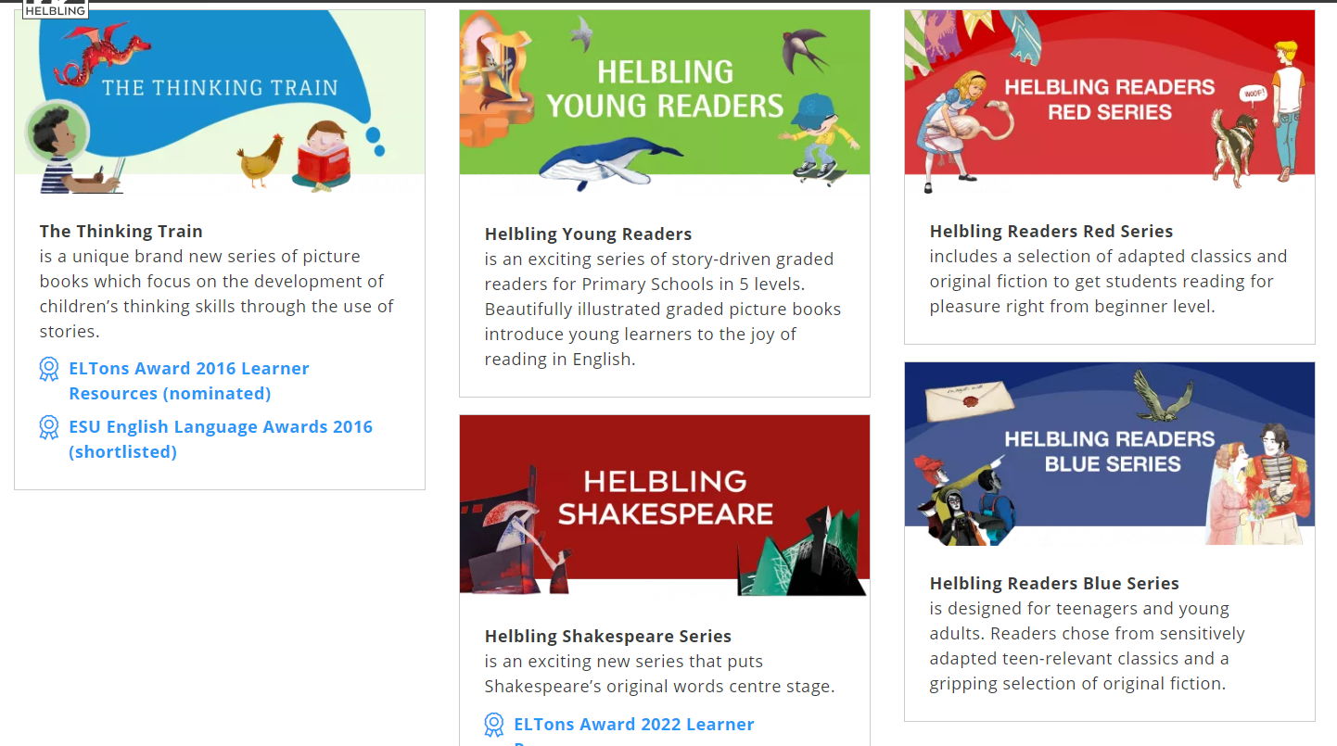
https://www.helbling.com/int/en/helbling-readers

Slide 14
Reading skills that students should acquire
Reading for detailed comprehension (reading for specific information) – practiced while looking for detailed information or language.
  Students are expected to concentrate on the minutiae /mɪˈnuː.ʃi.aɪ/ (small, precise, or trivial details) of what they are reading /intensive reading - is more concentrating dedicated not so much to pleasure as to the achievement of a study goal.

Slide 15
Reading skills that students should acquire
Interpreting the text (critical reading) – students draw inferences and recognize implicit relationship, which allow them to create meaningful discourse.
  Making generalizations;
  Making analogies;
  Making assumptions;
  Making inferences;
  Understanding implicit information.

Slide 16
Reading skills
The reading skill is taught in close relation with all other skills, it helps introducing and practicing phonetics, vocabulary and grammar, as well as language functions.
Reading involves a wide range of competences:
  linguistic competence
  discourse competence
  sociolinguistic competence
  strategic competence.

Slide 17
Reading Skills
Reading also activates mental structures and develops a series of micro-skills, such as:
  discriminating between: orthographic patterns, main idea and specific information, literal and implied meaning, relevant/non-relevant information;
  understanding of: layout, use of headings, implied info, attitudes and behavior, causes/effects;
  recognition of words at first sight, grammatical classes, communicative functions of the written text;
  anticipating or predicting effects, analyzing characters, behavior, attitudes and facts, synthesizing, appreciating, evaluating, linking information with real life.

Slide 18
Stages
Choosing text, interesting, within their grasp (right level).
! Teenagers love the unexpected, the extreme, the absurd, and the surprising.
Activate schemata, raise interest.
! It is easier to understand something when you know what it is about.
Pre-teaching blocking vocabulary. Choose the words they need to dot he task (1-2 items, 6 too much). Teach vocabulary in a clear context.
Set a gist task. (Checking predictions. Choose the correct title. Qs checking overall meaning)
! It is easier to read when you know what you are reading for.
! Don’t worry about understanding everything!
Do the gist task! Sts read. Set a time limit.
! If you read twice at a moderate speed, = sts read once quickly.
Peer check. Extra-speaking practice
Feedback. Elicit answers from the learners, move on to the next task.

Slide 19
Stages
Set a second task, finding specific information. Specific questions. Avoid using in the question the same word they will find in the text.
Learners do the task. Teacher monitors.
Peer check.
Feedback. Nominate students for answers.
Follow-up questions. Why this is the correct answer? Find in the text!
Follow-on work. Productive skills. Use the text as a model to write sth similar, or the subject of the text to discuss sth related.
Mine the text for lge structures, i.e. grammar or vocabulary.

Slide 20
Top-down reading
As with listening lessons, many reading lessons move from “big” to “small”, i.e. top-down – from overview to details.
Possible route map for a reading lesson
Pre-Text | 1 | Introduction and lead-in, e.g. get the learners interested in the topic, initial discussion of key themes, make an explicit link between the topic of the text and students’ own lives and experiences, focus on important language that will come in the text.
 | 2 | First task (pre-reading), e.g. predict from some extracted information (illustration, key word, headlines), read questions about the text, sts compose their own questions.
https://pixabay.com/
https://unsplash.com/images

Slide 21
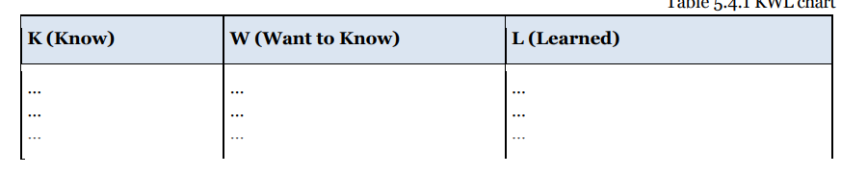
KWL chart

Slide 22
Pre-text/before reading
– to arouse students’ interest
Students answer questions about the topic (based on fact, opinion, personal experience).
Agree or disagree with statements.
Students predict what they will read (using the title, the first sentence or paragraph, pictures).

Slide 23
Pre-text/before reading
­activating relevant schemata
Exploring the theme
  individually (lists, clusters of related words and ideas, freewriting in relation to the topic)
  together - KWL charts, sets of questions, data, pictures, realia, audio, video recordings, brainstorm, etc.
Explaining the task so that students know what appropriate approach to choose (skimming, scanning, critical reading, etc.); sets the time limits, whether they can use dictionaries or not, etc.
Presenting relevant background information (facts, setting, events relevant to the content)
Presenting key words, phrases, and structures used in the text (limited number of items, otherwise they will not remember them) in clear linguistic contexts or definitions, etc.
Explaining relevant cultural references made in the text (people, places, events, or included in a glossary for while reading)

Slide 24
Text | 3 | Tasks to focus on fast reading for gist (skimming), e.g. check text against predictions made beforehand, e.g. guess the title from a choice of three options, put events or illustrations in the correct order.
 | 4 | Tasks to focus on fast reading to locate specific information (scanning).
 | 5 | Tasks to focus on meaning (general points), e.g., answer questions about meaning, make use of information in the text to do sth. (make a sketch, fill out a form, find out which picture is being described), discuss issues, summarize arguments, compare viewpoints.
 | 6 | Tasks to focus on meaning (finer points of detail, more intensive comprehensive understanding)
 | 7 | Tasks to focus on individual lge items, e.g. vocabulary or grammar exercises, use of dictionaries, work out meaning of words from context.

Slide 25
While-reading
Guiding students through the text, exploring meaning, checking comprehension
Sustained silent reading – if the text is relatively easy, the sts should read it through once on their own to pick up the gist.
Silent reading of segments – for longer texts, with pauses to check comprehension.
Oral reading – students should never be asked to read a text aloud before they have understood it.
Checking comprehension
Answering questions about the text – on gist, details, meaning, implications, interpretation, guessing the meaning of the word from the contexts (have sts compare answers).
Note-taking
Translation only for checking comprehension of isolated segments if other procedures have been exhausted.

Slide 26
While-reading
Facilitating comprehension
Simplifying – restatement using simple syntax and familiar lexis.
Guiding through difficult segments with questions, hints, suggestion, etc.
Explaining – reordering information or adding further information in order to clarify the meaning (illustrations, diagrams, etc.)

Slide 27
Post-text | 8 | Follow-on task, e.g. role-play, debate, writing task (write a letter in reply), personalization (Have you ever had an experience like this one?)
 | 9 | Closing, e.g. draw the lesson to a conclusion, tie up loose ends, review what has been studied and what has been learned
Follow up - to find out more about something, or take more action connected with it.
Follow on - to happen or exist as the next part of something.

Slide 28
After reading
Summarizing – from memory or from notes, sts may need to skim each paragraph
Comparing several texts
Resequencing scrambled texts (jumbled paragraphs)
Discussions
Transformation (e.g. stories to dialogues, etc.)
Jigsaw reading (while and post-reading) - is a series of procedures at the while-reading and after-reading stages which is designed to stimulate information exchange.
  First, students are divided into groups, each working with a separate text or a separate segment of the text.
  After reading the text, answering comprehension check questions and comparing answers, students form new groups, each consisting of one member from the original groups.
  They then explain their text to the group.

Slide 29
Some specific ideas for reading tasks
  Put these illustrations of the text in the correct order.
  Put these cut-up paragraphs in the correct order.
  Find words in the text that mean the same as the words in this list. Read the text and find the mistakes in this illustration (or draw your own).
  Read the text and make a list of particular items (e.g. jobs that need doing, the author's proposals, advantages and disadvantages, etc).
  Give a headline to each section of the article (or match given headlines with the sections).
  Find appropriate places in the text to reinsert some sentences that have previously been separated from the text.
  Look at the title and the illustrations (but not the text). Predict which of the following list of words you will find in the text.
  Discuss (or write) the missing last paragraph of the text.
  Discuss interpretations of, reactions to, feelings about the text.
  Make notes under the following headings: ...

Slide 30
Some specific ideas for reading tasks
  Before you read this text, make notes about what you already know about the subject.
  Act out the dialogue, story, episode, etc.
  Put this list of events in the correct order.
  Think of an alternative title for the text, and justify it.
  In pairs, students devise their own comprehension questions, exchange them with other pairs and answer;
  List 7/10 key words or phrases in the text that they think are the most essential for understanding the content;
  Say which they think is the most important sentence in the text, and why.
  Re-write the text in simple English for a less proficient learner.
  Re-write the text in a different style (more formal/more informal);
  Re-write the text as a different type of text (e.g. an email, an interview).

Slide 31
Types of written Authentic texts
Non-fiction: reports, essays and articles, dictionaries, encyclopedias
Fiction: novels, short stories, jokes, drama, poetry
Letters: personal, business
Diaries, journals
Announcements
Newspapers
Forms, applications
Questionnaires
Directions
Labels
Signs
Recipes
Maps
Manuals (a book giving instructions, e.g. computer manual)
Menus
Schedules
Advertisements
Invitations
Comic strips, cartoons

Slide 32
Types of reading
Guided Oral Reading – a teaching strategy that assists students in improving their reading fluency, comprehension, and vocabulary. The teacher reads with the student by modeling fluent reading and then asking the student to read the same passage aloud with the teacher. The teacher provides guidance and feedback to the student as they read to improve their reading skills.
Oral reading performance is used as an indicator of students’ overall reading ability. It is used to measure three components of reading - accuracy, rate, and fluency, which have been shown to relate strongly to comprehension. It is generally practiced with beginners, as it gives students the possibility to hear themselves and acquire correct and fluent reading skills. Students follow the model offered by the teacher, trying to use correct pronunciation, accent, and intonation.

Slide 33
Types of reading
Choral Reading - a group of students read a passage together, with or without a teacher. It can be done in small groups, or as a whole class. Choral reading is useful for beginners.
Independent Reading - refers to reading short texts thoroughly and with clear goals, such as to answer reading comprehension questions or to identify how sentences are linked; the goal of intensive reading is to read a shorter piece of text to gain a deeper understanding of that text, i.e. to completely deconstruct a text, with the goal of absorbing as much meaning from it as possible. This is done by taking a text, and systematically looking up every word, phrase, or collocation that students do not understand. This is an activity that requires great mental effort and focus.

Slide 34
Shadow reading
  Teacher reads the text aloud and students follow, marking the text for stress
  Teacher reads the text a second time and the students mark for linking
  Individual chunks that show good examples of linking or problematic pronunciation can then be drilled
  Students practise these aspects of pronunciation by reading the text to themselves before the teacher reads the text aloud again and they listen
  Then the students read the text with the teacher and they have to start and finish at the same time as the teacher, who reads the text at normal speed
  This works well after some exposure to the rules of pronunciation - connected speech, stress and intonation.

Slide 35
Practical Tips for teaching Reading comprehension
Read aloud while students follow!
When you read the text, you intuitively use appropriate prosody:
  group the words into sense-patterns,
  insert pauses in the right places,
  and add appropriate intonation.
Stop every now and again to explain new words as you feel necessary.
Keep an eye on your students, pick up any expressions of incomprehension and respond as necessary.
Make sure that students are fact following the text!
You need to keep glancing at your students, make sure they are reading, and move to help ones who have lost their place.

Slide 36
Practical Tips for teaching Reading comprehension
Don't make students read aloud!
If a student is reading aloud a text they encounter for the first time, his or her attention is necessarily on pronunciation and phrasing, not on comprehension.
Often students who have just read a sentence aloud cannot immediately tell me what it was about, as they had been concentrating on decoding and pronunciation, and had no attention to spare for understanding meanings.
Reading aloud is useful at the early stages of learning, to make sure students are pronouncing letters or letter combinations appropriately. But later we should mostly focus on silent reading, which allows the full attention of the reader to be directed towards understanding, and is eventually much faster than reading aloud.
However, if it's a text they are already familiar with and understand, reading aloud may be useful.

Slide 37
Practical Tips for teaching Reading comprehension
Read and re-read!
The simple act of re-reading a text improves comprehension, even without any further instruction or explanation on the part of the teacher.
In case of pre-taught vocabulary, the re-reading enables students to re-encounter the items in context and reinforce the learning.
It contributes to reading fluency. Students are able on second and third readings to get through the text, with understanding, a lot more successfully and faster than they could at the beginning.

Slide 38
Practical Tips for teaching Reading comprehension
Read and re-read!
Suggestions to avoid boredom while re-reading:
Give students time in class to re-read the text silently. They ask you for help if there's anything they still don't understand.
Give students some extra, more challenging questions to try to answer as they re-read.
If there is an audio recording of the text available, have students listen to it as they re-read.
Call out a phrase or sentence, and challenge students to scan through the text to find it.
Call out a phrase or sentence in the students' mother tongue and challenge them to find it in English.
Give different students different bits of the text to prepare either at home or in class. Then have students read the texts aloud.

Slide 39
References
Ur P. Penny U’s 100 Teaching Tips. Cambridge University Press
Shadow reading | ELT-Training | Jo Gakonga
Teaching Teens Reading And Listening Skills | Cambridge English
The Ultimate Guide to Jigsaw Reading | ELT-Training | Jo Gakonga
https://www.bigmarker.com/oxford-university-press/Breakout-Room-3-df049b76aa9a0187fd7e508f?dm_i=1Q48,7KLU2,7LEBSR,UTRJO,1
ELT Together - Primary with Nina Lauder: Bringing language to life through literature (bigmarker.com)
ELT Together 2021: Literature and Extensive Reading (bigmarker.com)
ELT Together - Adult with Nick Cherkas: Teaching with literature and extensive reading for adults (bigmarker.com)
https://www.teachingenglish.org.uk/professional-development/teachers/managing-resources/articles/interacting-texts-directed-activities
https://www.cambridge.org/elt/blog/2022/03/10/five-things-know-about-teaching-your-teens-reading-listening-skills/?u

Slide 40
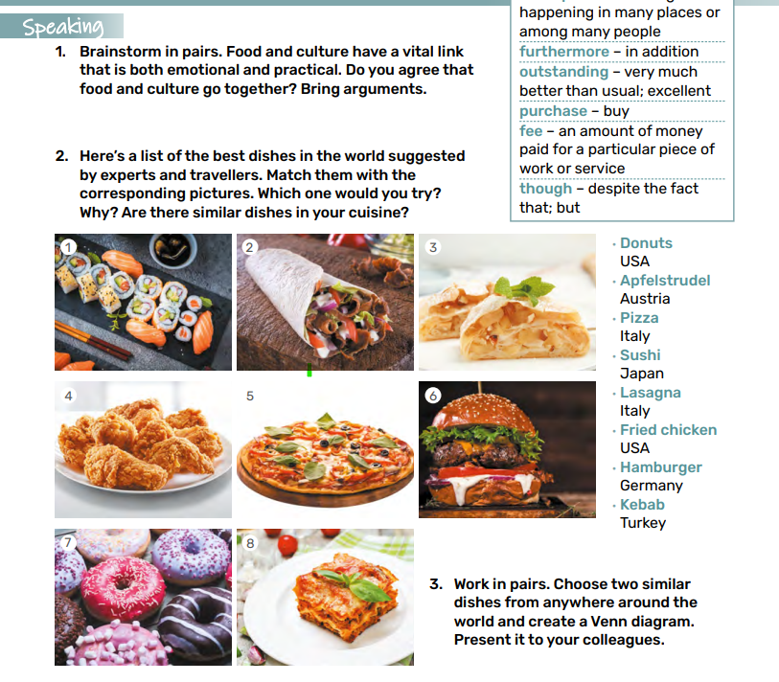
Analyze the reading sequence.
English: Level A 2.4: Form 8

Slide 41
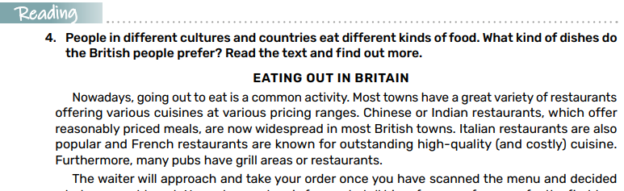
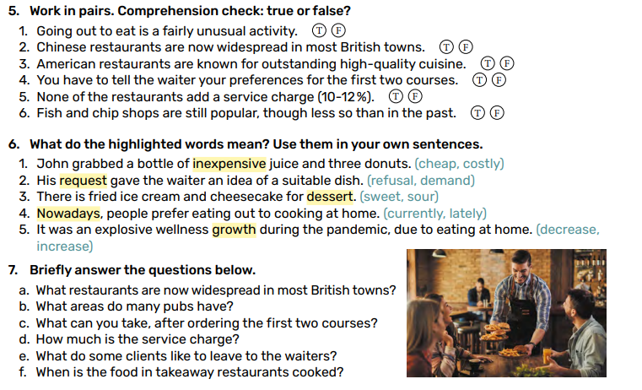
English: Level A 2.4: Form 8

