Slide 1
Teaching Writing
Oxana Creanga

Slide 2
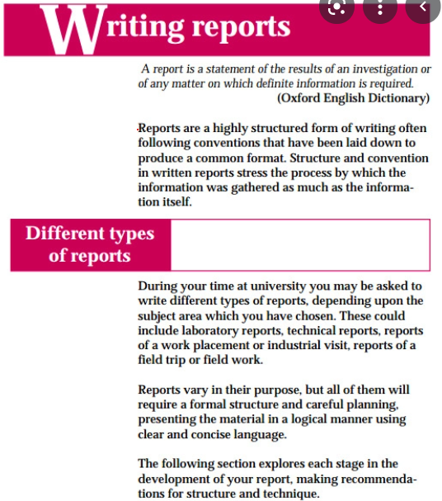
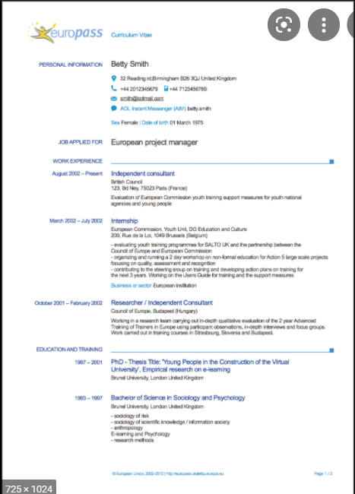
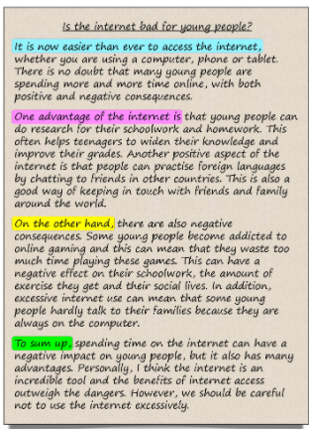



a) project work products/reports
b) CV/resume
c) essays
d) review of a product on an online feedback forum
f) note-taking
e) writing a blog post/ feedback on a blog post

Slide 3
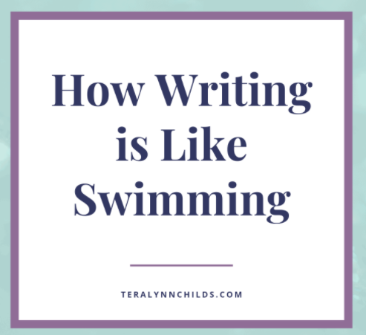
How is writing like swimming?
The psycholinguist Eric Lenneberg noted, in a discussion of "species -specific" human behavior, that human beings universally learn to walk and to talk, but that swimming and writing are culturally specific, learned behaviors. We learn to swim if there is a body of water available and usually only if someone teaches us. We learn to write if we are members of a literate society, and usually only if someone teaches us (1967).

Slide 4
How is writing like swimming?
Just as there are non-swimmers, poor swimmers, and excellent swimmers, so it is for writers.
Why isn't everyone an excellent writer?
What is it about writing that blocks so many people, even in their own native language?
Why don't people learn to write "naturally," as they learn to talk?
How can we best teach second/foreign language learners of English how to write?
What should we be trying to teach?

Slide 5
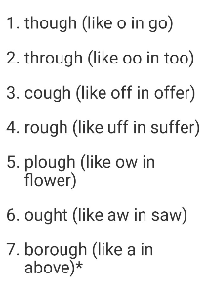
Challenges to writing
The handwriting challenge - Roman cursive or 'joined-up' lettering presents a number of problems.
Spelling challenges:
Correspondence/ non-correspondence between the sound of a word and the way it is spelled;
One sound (phoneme) – different spellings: paw, pore, pour, daughter, Sean;
The same spelling – different sounds (phonemes): or, word, information, worry;
Homophones: threw /through, sun/son, sew/so;
Different varieties of English spell the same word in different ways: analyse/analyze, traveler/traveller, licence/license, theatre/theater, etc.
Punctuation Challenges:
Capitalization of months, days of the week, the personal pronoun I
Quotations marks, direct speech.

Slide 6
Challenges to writing
Layout: indentation/ non-indentation of the first paragraph, different genres of writing are laid out differently.
Complexity
Students must learn how to remove redundancy, how to combine sentences, how to make references to other elements in a text, how to create syntactic and lexical variety, etc.
Vocabulary
Written language places a heavier demand on vocabulary use than speaking does. Good writers will learn to take advantage of the richness of English vocabulary.
Formality
Whether a student is filling out a questionnaire or an essay, the conventions of each form must be followed. The most difficult and complex conventions occur in academic writing where students have to learn how to describe, explain, compare, contrast, illustrate, defend, criticize, and argue.

Slide 7
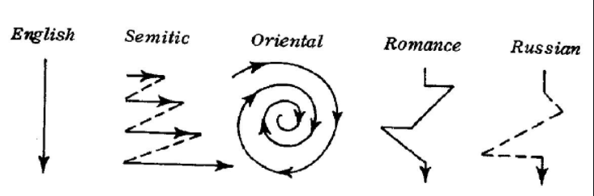
Challenges to writing
Robert Kaplan’s model of “contrastive rhetoric” - a generic typology of cultural writing patterns
Different languages (and their cultures) have different patterns of written discourse.

Slide 8
Microskills for writing
Produce graphemes and orthographic patterns of English.
Mastering spelling, punctuation, sentence construction, referential words (he, who).
Produce writing at an efficient rate of speed to suit the purpose.
Use acceptable grammatical systems (e.g., tense, agreement, pluralization), patterns, and rules.
Express a particular meaning in different grammatical forms.
Use cohesive devices in written discourse.
Linking sentences, using connecting words, relations, etc.
Connecting paragraphs.
Being aware of different demands of written English (contrast with spoken) (use the rhetorical forms and conventions of written discourse).
Organizing information logically and clearly with a specific type of reader in mind. (Aimed at producing a writing piece).
Convey links and connections between events and communicate such relations as main idea, supporting idea, new information, given information, generalization, and exemplification.
Develop and use a battery of writing strategies, such as accurately assessing the audience's interpretation, using prewriting devices, writing with fluency in the first drafts, using paraphrases and synonyms, and using feedback for revising and editing.

Slide 9
TYPES OF CLASSROOM WRITING PERFORMANCE
1. Imitative /ˈɪmɪtətɪv//writing down
Level: the beginning level
Activities:
- "writing down" English letters, words, and possibly sentences in order to learn the conventions of the orthographic code.
- various forms of dictation.
Dictations typically involve the following steps: a. Teacher reads a short paragraph once or twice at normal speed. b. Teacher reads the paragraph in short phrase units of three or four words each, and each unit is followed by a pause. c. During the pause, students write exactly what they hear. d. Teacher then reads the whole paragraph once more at normal speed so students can check their writing. e. Scoring of students' written work can utilize a number of rubrics for assigning points. Usually spelling and punctuation errors are not considered as severe as grammatical errors.
Disguised word copying: give students a list of words randomly organized which they then have to rewrite in alphabetical order; give students a list of words they have recently met and ask them to write down their five most favorite and five least favorite words from the list; give students sentences which they have to write in appropriate boxes or columns.

Slide 10
2. Intensive, or controlled
- used as a production mode for learning, reinforcing, or testing grammatical concepts;
- used in controlled, written grammar exercises;
- does not allow much, if any, creativity on the part of the learner.
Parallel writing is the kind of sentence writing that is often used for grammar reinforcement. Students are given one or two model sentences and then have to write similar sentences based on information they are given or on their own thoughts.
E.g.: A common form of controlled writing is to present a paragraph to students in which they have to alter a given structure throughout. So, for example, they may be asked to change all present tense verbs to past tense; in such a case, students may need to alter other time references in the paragraph.
Paragraph construction (elementary): 'substitution-drill' style of procedure to encourage students to write a paragraph which is almost identical to one they have just read. This is used within a set pattern or patterns.
Dicto-comp: a paragraph (100 words) is read at normal speed, usually two or three times; then the teacher asks students to rewrite the paragraph to the best of their recollection of the reading. In one of several variations of the dicto-comp technique, the teacher, after reading the passage, puts key words from the paragraph, in sequence, on the board as cues for the students.
Guided writing – students are guided to write longer texts in quite restricted or controlled tasks by offering samples, models, possibly useful language items, organizational frameworks, etc.

Slide 11
3. Self-writing
note-taking, the most salient instance of this category in classrooms where students take notes during a lecture/lesson for the purpose of later recall,
diary or journal writing.
4. Display writing
short answer exercises,
essays,
project work products.
5. Real writing/ Real-life writing tasks
diaries,
letters,
notes, personal messages,
write a letter in reply to a job application to arrange an interview,
college and scholarship application essays,
résumé (CURRICULUM VITAE),
review of a new product on an online forum message board.

Slide 12
Writing tasks
1. Creative writing | a) A story based on some kind of given stimulus: a title, a picture or series of pictures, or a first or last sentence. b) A personal anecdote describing an occasion when you were disappointed (or afraid, surprised, relieved, etc.). c) A poem based on a given stimulus: topic, a particular structure, first or last lines.
2. Instructions | a) An instruction sheet for something you know how to do (for example, prepare some kind of food). b) Directions how to get somewhere.
3. Interpersonal communication | a) A letter or email applying for a job. b) A letter of complaint. c) A reply to a letter. d) A comment. e) An email telling a friend what you've been doing recently and suggesting a meeting. f) A comment on a blog.
4. Description | a) A description of a view, a place or a person b) A description of a process, such as a scientific experiment, the life-cycle of an animal, a sequence of events represented by a flowchart.
5. Responses to literature | a) A synopsis of a book, play or film. b) A review evaluating a piece of literature the class has read.
6. Persuasion | a) A recommendation for some kind of change in your home community or place of work/study, addressed to the appropriate authority. b) An advertisement for a product. c) A leaflet promoting an institution, a tourist attraction, a course.
7. Information | a) A newspaper report on an item of news, genuine or imaginary. b) A short paper providing information on a particular person, event or invention, previously researched on the Internet.

Slide 13
Approaches to Writing Instruction: Process vs. Product
Process
focus on the process of writing that leads to the final written product;
being actively encouraged and helped to follow through a series of preparatory steps before the final text is produced;
becoming more aware of that preparation process, so that it can be done more independently and transparently in future;
help students to understand their own composing process;
help them to build repertoires of strategies for prewriting, drafting, and rewriting;
- give students time to write and rewrite;
- place central importance on the process of revision.
Product
- concern with the final product of writing: the essay, the report, the story,
concern with what that product should "look" like;
compositions are supposed to meet certain standards of prescribed English rhetorical style;
reflects accurate grammar,
is organized in conformity with what the audience would consider to be conventional;
attention on "model" compositions that students would emulate;
attention on how well a student’s final product measured up against a list of criteria that included content, organization, vocabulary use, grammatical use, and mechanical considerations such as spelling and punctuation.

Slide 14
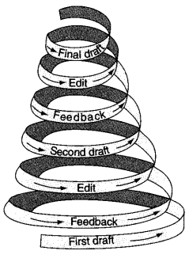
Setting and writing a task:
Setting the task
Collecting in writing
The current emphasis on process writing must be seen in the perspective of a balance between process and product. Do not go to an extreme in emphasizing process to the extent that the final product diminishes in importance!
The product is the ultimate goal, the reason that we go through the process of prewriting, drafting, revising, and editing. Process is not the end; it is the means to the end.

Slide 15
Writing Activity Route Map
Pre-writing, planning, drafting, revising
Writing, rewriting/editing and final draft
Post-writing
Fast writing
Proofreading
Decide the specific requirements: style, information layout, etc.
Planning the text
Brainstorming ideas
Selecting and rejecting ideas
Sorting and ordering ideas
Introducing and summarizing the main writing task
Preparing draft(s)
Focusing on useful models
Editing
Reading the final product and offering feedback
Preparing final text
Seeking feedback

Slide 16
1 | Introduce the topic
2 | Introduce and summarize the main writing task
3 | Brainstorm ideas
4 | Fast write
5 | Select and reject ideas
6 | Sort and order ideas
7 | Decide the specific requirements: style, information layout
8 | Focus on useful models
9 | Plan the text
10 | Get feedback
11 | Prepare draft(s)
12 | Editing
13 | Proofreading
14 | Prepare final text
14 | Reading the final product/text and offering feedback

Slide 17
Requirements for the writing task:
Task information - students need to have the necessary information to complete the task: what we want them to do, state clearly about any of the topic detail that we give them. E.g., if we ask them to respond to an invitation, they need to have understood the details of the invitation, who they are writing to, and what it is they are trying to achieve.
  The purpose and the audience of writing vary depending on the group, age, purpose of learning English.
Length - how long you intend the written assignment to be (number of words).
Language - if students need specific language to complete a writing task we need to give it to them (or help them to find it). This may involve offering them phrases, parts of sentences, or words.
Ideas - teachers need to be able to suggest ideas to help students when they get stuck. For some, this may be just a word or two.
Patterns & schemes – appropriate when students first study a writing genre and then create their examples of the same genre (e.g. 'an advertisement', 'a postcard', 'a curriculum vitae', etc.). Even with more instant/free writing, the students' lives will be made much easier if there is a pattern or scheme to follow.
Nemo’s story:
The format goes like this:
Once upon a time _______________________________
____________________________________________________
Every day________________________________________
____________________________________________________
One day__________________________________________
____________________________________________________
Because of that___________________________________
____________________________________________________
Because of that___________________________________
____________________________________________________
Until finally_______________________________________

Slide 18
Requirements for the writing task: examples of framework
Grammar poems
Aims: To reinforce grammar terms through creative writing.
Preparation: Prepare a poem 'rubric' (i.e. the framework for a poem) that consists solely of parts of speech.
1 article + noun
2 participle, participle, participle
3 adjective, adjective
4 repeat 1
5 pronoun + verb
6 pronoun + verb
7 pronoun + always/never/still + verb
8 repeat 1
9 repeat 3
10 repeat 2
Procedure
1 Write the rubric on the board, and check that the learners are familiar with the names of the different parts of speech.
2 Tell them that this is the model for a poem. The first line is the title of the poem, e.g.: The Sea, A Forest, The Sharks, etc.
3 Learners work individually or in pairs to compose their poems.
4 They then exchange poems, or the poems can be illustrated and displayed around the room.
Example: The Sea
Smiling, frowning, laughing
Angry, joyful
The sea
It comes
It goes
It never sleeps
The sea
Angry, joyful
Smiling, frowning, laughing

Slide 19
Ideas for generating ideas
Brainstorming - 'opening your mind and letting ideas pour out’.
Write the topic or title in a circle in the middle of the board.
Tell students to call out anything that comes to mind connected with the topic.
Write up everything on the board.
There should be no discussion or comments (especially derogatory ones!) - just ideas.
After writing ideas on the board, invite students to select ideas they like and can use, or maybe allow some discussion time in groups to continue the sifting process.
Text-starters
A lot of real-life writing involves looking at other texts and summarizing, reporting, responding to them, selecting ideas from them commenting on them. The actual content of 'text-starts' provides a lot of support for the writer in that there is something concrete to deal with and many ideas are already formulated and mainly need a response or opinion, rather than original thought.
  E.g. Resource material - Information about a holiday location (pictures, description, list of attractions, etc.)
  Writing task - You are the copy-writer for the local tourist board. Write a two-paragraph advertisement for the place to encourage more visitors to come.

Slide 20
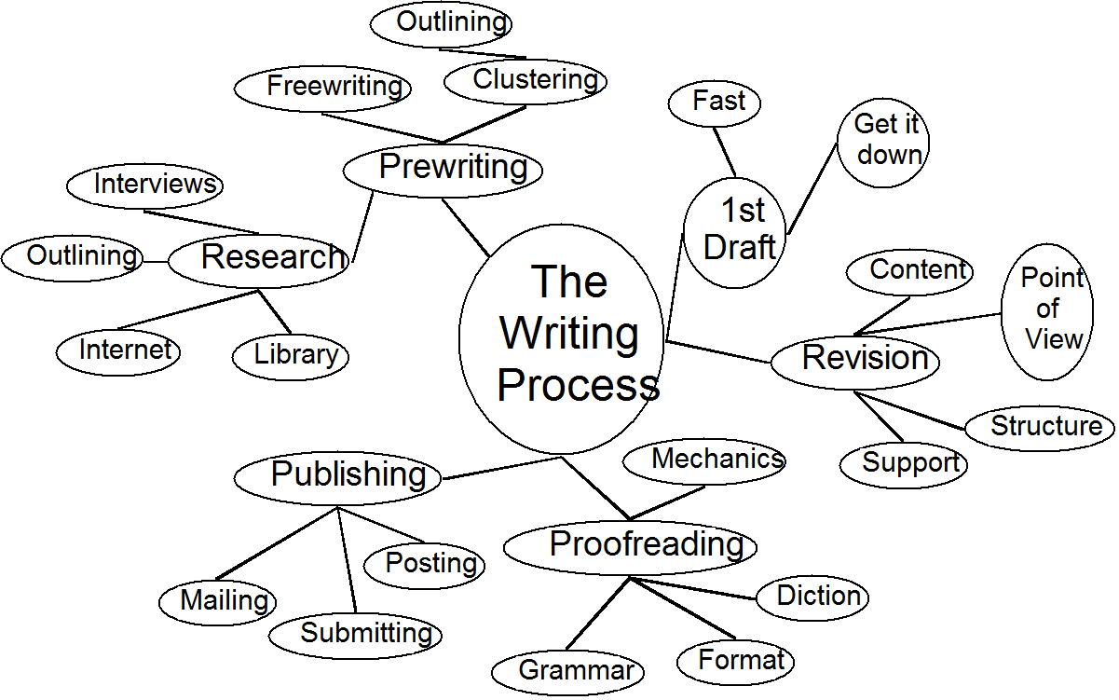
Techniques and activities for generating ideas
Fast-writing – it is designed to help you free ideas you might not realize that you have.
  Tell students that they need a few pieces of blank paper. The rules are that when you say 'start', they should:
  start writing about the topic, not stop writing;
  write 'um, um, um' or 'rubbish' or something else if they can't think of what to write;
  not stop to go back and read what they have written;
  keep writing till you say 'stop' (which will be after five / eight / ten minutes or however long you think is appropriate for your group).
Reading (extensively) a passage.
Listing (in writing-individually);
Clustering (begin with a key word, then add other words,
using free association);
Discussing a topic or question.

Slide 21
Techniques and activities for helping writing: structuring and organizing
'Card planning' - learners write down the main themes of their text as notes onto separate cards. They then arrange the cards in various orders until they get a sequence that seems to work.
Drawing a sketch diagram showing how their text will be put together, using lines and arrows to link separate items.
Looking at sample texts – offering students samples of the kind of texts they are working on, i.e. a kind of model on which to base their own work. A sample text can be studied for:
  The layout
  The overall message
  How the items are organized
  Specific phrases and sentences used
  Distinctive grammatical features
  The style and tone
  The effect on the reader

Slide 22
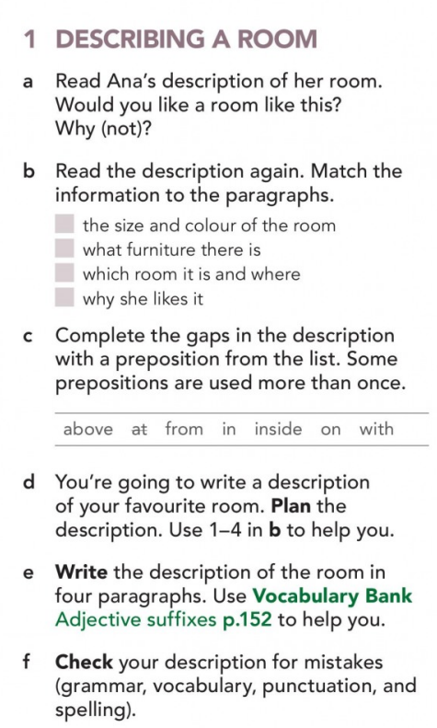
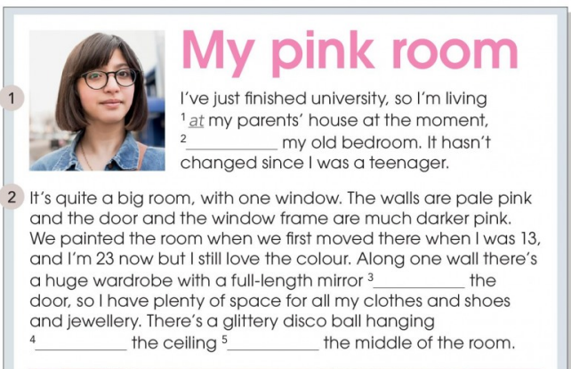
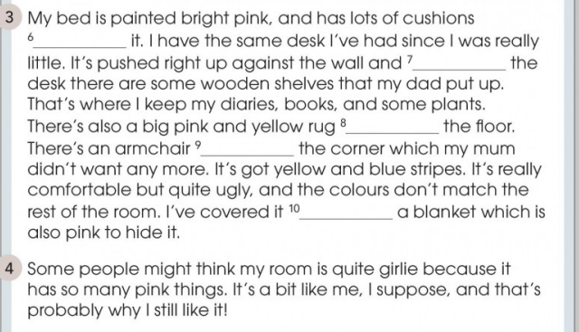
English File, Intermediate Plus Student's e-book, 4th ed.

Slide 23
Getting feedback on drafts:
Organize pairs of students to read each other's work, or groups to give comments.
Feedback as answer to specific questions/according to a feedback form of some kind or more freely as general response and comments.
As a result of feedback, students can write a new draft of their work, which can then be submitted again to readers for comments.
Using writer’s self-check list.

Slide 24
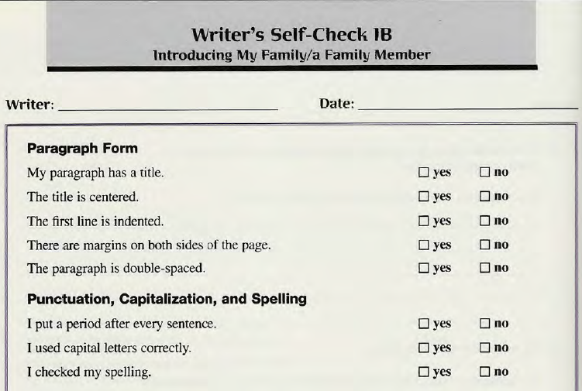
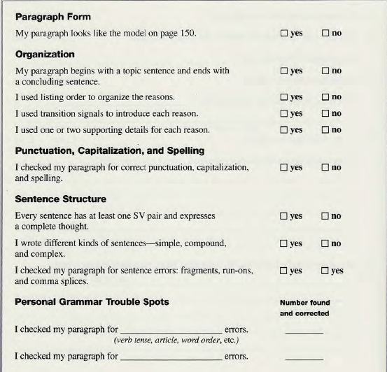
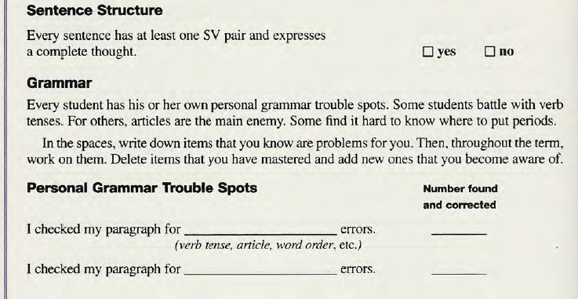
Example No 2

Slide 25
Marking
Direct feedback.
The teacher reads the piece of writing, locates the errors and corrects them overtly using a correction code or through explicit verbal comments: WW - wrong word, WT - wrong time/tense, WF – wrong form, WO - wrong order, SP - spelling, P- punctuation, X - extra word, MW - missing word, Art. - article, W Adj. – wrong adjective, NE - noun ending, SVA – subject-verb agreement, WV- wrong voice etc.
2. Indirect feedback. The teacher indicates the error but does not correct it. In this case, the options are: to circle or to underline the mistake; to signal its presence at the beginning of the line. It is a good technique for advanced students as they have to think, analyze and try to offer correction of the errors.
3. Selective feedback. The teacher does not mark all the errors, but a large proportion of them (only grammar or spelling).

Slide 26
Variations on traditional teacher marking
Use a green or a blue pen.
Discuss the marking criteria with students.
Write correct answers in the margin.
Use correction codes in the margin.
Underline all errors of one type (e.g. all verb tense mistakes, all spelling mistakes).
Only write a comment about the meaning and message of the piece.
Create a composite essay using good bits and problematic bits from a number of students' work. Photocopy it and hand it out for students to discuss and correct, together or in groups or individually, perhaps for homework.
Use errors from a number of different students' writing to devise an exercise, quiz, game, etc. Or get students to create the exercise themselves based on their own mistakes.
Give a dictation based on sentences from their work.
!Tell students before writing what will happen afterwards!

Slide 27
References:
Brown H. D. Teaching by Principles: An Interactive Approach to Language Pedagogy. Longman, 2015.
COUNCIL OF EUROPE. Common European Framework of Reference for Languages: Learning, Teaching, Assessment. Companion Volume with New Descriptors. Strasbourg: Council of Europe, 2018
Harmer J., How to Teach Writing. Pearson Education Limited/Longman, 2004.
Harmer J., How to Teach English. Pearson Education Limited/Longman, 2001.
Harmer Jeremy. The Practice of English Language Teaching: Buch. Harlow: Pearson/Longman, 2015.
Scrivener J. Learning Teaching. The Essential Guide to English Language Teaching. 3rd edition. Macmillan, 2014.
Ur P. A Course in English Language Teaching. Cambridge: Cambridge University Press, 2012.
Understanding writing assessment: what every teacher should know https://www.youtube.com/watch?v=zj-hc_cJuIo&t=219s
Useful digital tools for developing writing skills
Learners who want to be creative-Storybird/Book Creator / Make Beliefs Comix
Younger learners - Spelling City
Learners who want to create a product - Storybird/Book Creator / Make Beliefs Comix
Learners who want feedback on their writing - Write & Improve/Grammarly

Slide 28
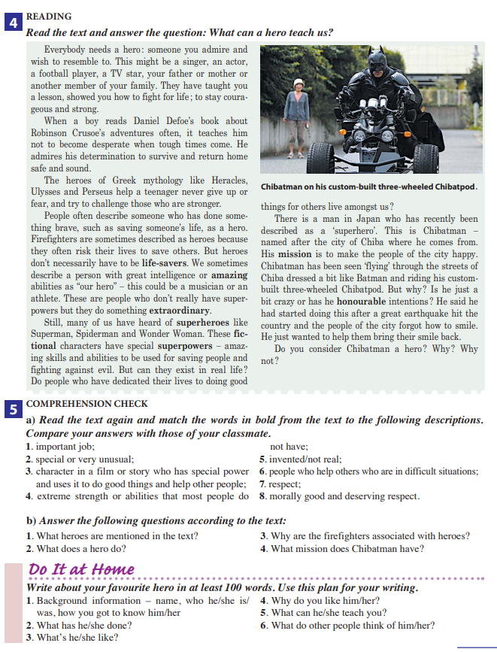
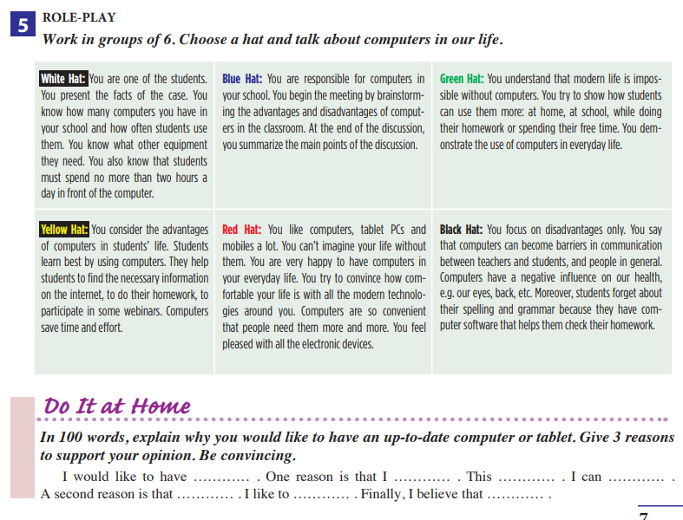
Analyze the prompts for the written tasks following the criteria given below:
Number of words;
Audience;
Purpose;
Requirements for the targeted language structure;
Is there a balance between process & product writing?
Is there a connection between reading and writing?
Is there any of scaffolding provided (models, writing frames, etc.)?

Slide 29
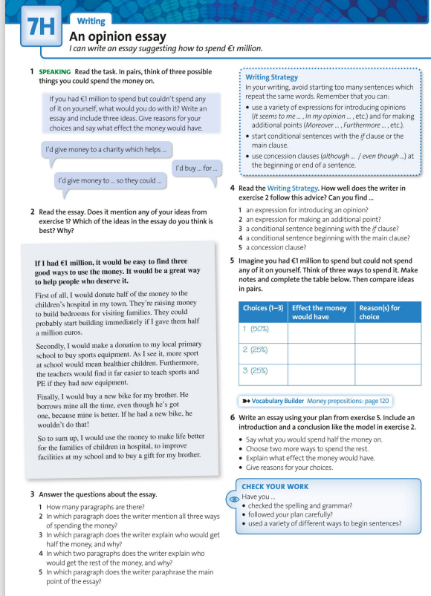
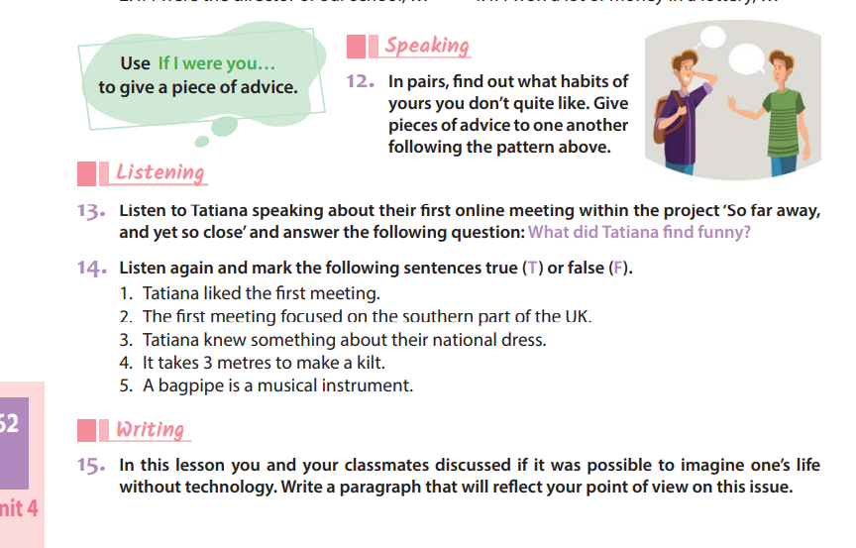

Slide 30
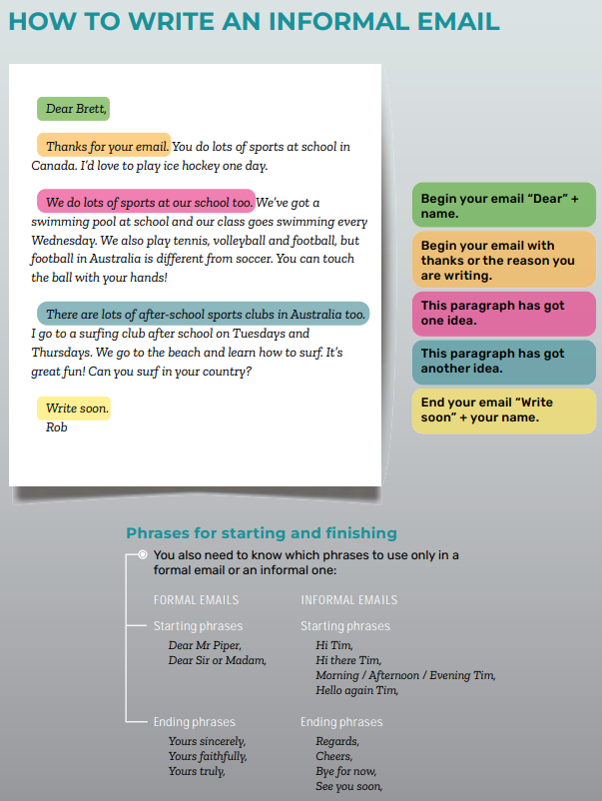
English: Level A 2.4: Form 8

Slide 31
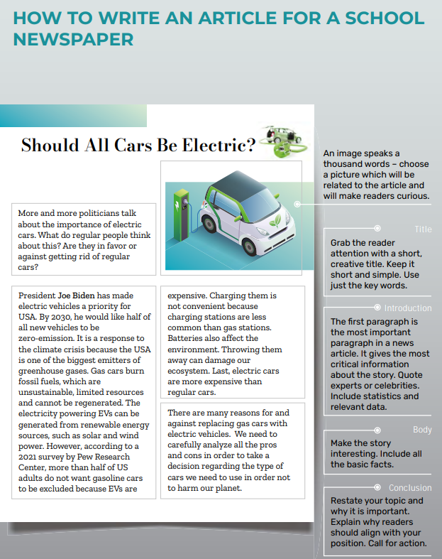
English: Level A 2.4: Form 8

