Slide 1
How to assess writing
Oxana Creanga

Slide 2
Study these writing subskills and choose which can be assessed in writing task.
Handwriting
Spelling
Grammar
Accuracy
Vocabulary
Originality
Coherence Genre
Cohesion
Structure
Creativity
Style
Editing
Planning
Clarity
Argument
Punctuation
Register
Organisation
Use of humour
Authorial voice
Reviewing
Synthesis
Monitoring
If we include all the writing abilities that you know, it will probably be impossible to assess all of them at once.

Slide 3
Extensive writing involves the following interrelated and interconnected skills:
Message
Linguistic skills
(using vocabulary and grammar to express their thoughts)
Cognitive skills (learners thinking about what they have to write)
- organization
- planning
Sociolinguistic skills
(learners adjust the message to suit the purpose and the audience)

Slide 4
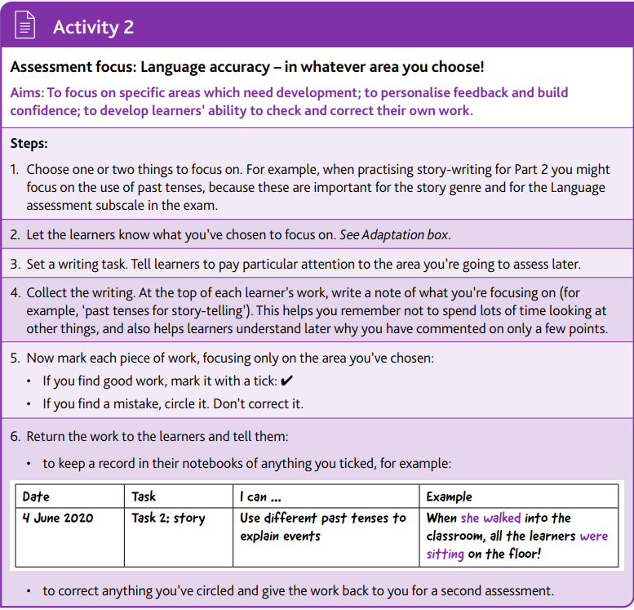
Assessment in a classroom supports instruction
Teachers may focus on a specific skill
Example from Assessing writing for Cambridge English Qualifications: A guide for teachers. B1 Preliminary
Teachers may assess the process of writing in collaboration tasks
In deciding what skill to assess we have to take into account who we are assessing and for what purpose (formative assessment vs summative assessment).

Slide 5
Requirements for the writing task:
Write
About X (a particular topic)
Write a letter to your friend about X
Write a letter to your friend about X and Y asking Z.
Linguistic aspect
Message
Sociolinguistic aspect
Cognitive aspect (requiring various parts to be included)
The purpose and the audience of writing varies depending on the group, age, purpose of learning English:
Write a letter … complaining about customer service Writing to … friends
… asking about a room for rent … teachers
… applying for a job … classmates

Slide 6
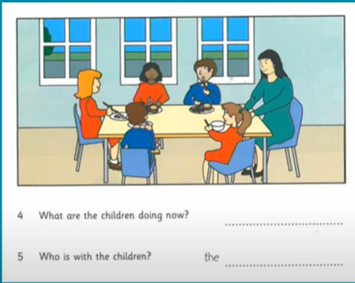
Evaluating writing:
The approach to marking can be suggested by the task itself (controlled writing, e.g. describing pictures that require the use of the present continuous tense)
Extensive writing involves more aspects to be evaluated:
Feedback | In class (formative) | Large scale (exams)
 | X
Detailed evaluative comments
A checklist
A few scores
A score |  | X

Slide 7
Evaluating writing:
Holistic scores vs Analytic scores
Single score Multiple subscores
Gives one overall score for a piece of writing
Appropriate for summative assessment
Give separate scores for different aspects of writing, such as task achievement, vocabulary, and grammar, etc.
Appropriate for formative assessment
Helps learners identify areas that need more attention.

Slide 8
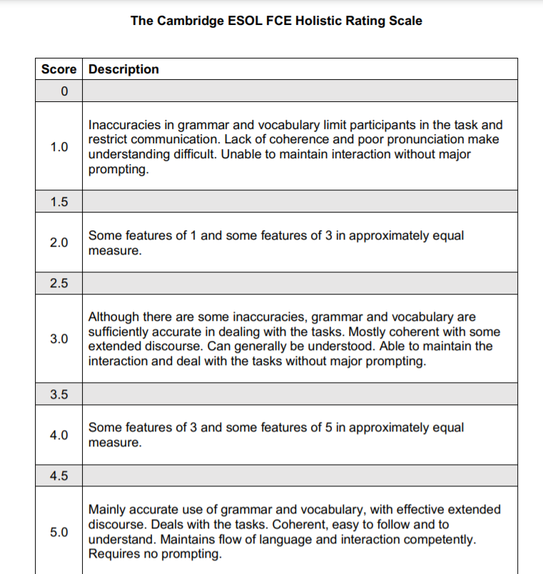
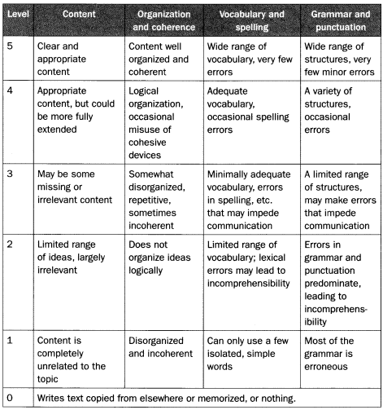

Slide 9
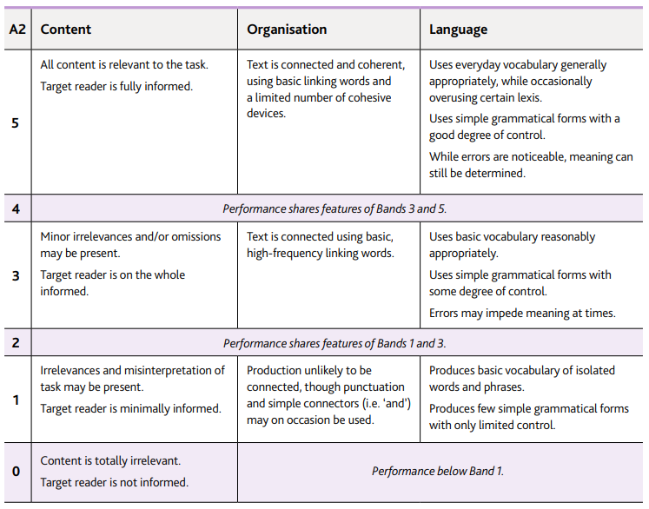
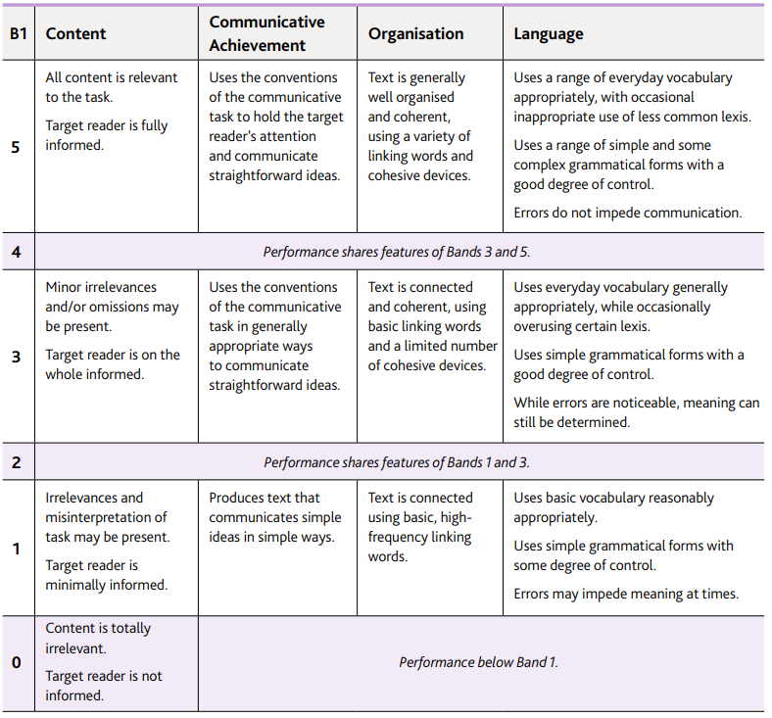

Slide 10
Cambridge guide to assessing writing https://www.cambridgeenglish.org/your-new-classroom/managing-learning-gaps/
http://rubistar.4teachers.org/index.php?screen=NewRubric&section_id=5#05
https://unsplash.com/images
https://www.youtube.com/watch?v=5-Tryu8KnIA
https://www.youtube.com/watch?v=zj-hc_cJuIo&t=2314s
https://www.nytimes.com/2021/02/01/learning/300-questions-and-images-to-inspire-argument-writing.html
https://www.youtube.com/watch?v=ruqKK_WpYYU

