Slide 1
Teaching Speaking
Oxana Creanga

Slide 2
Speech production is characterized by:
Linearity – speech production takes place in real times; words follow words, and phrases follow phrases.
Contingent nature (each utterance is dependent on a preceding one) – at the level of utterance (the spoken equivalent of sentences), speech is produced utterance-by-utterance, in response to the word-by-word and utterance-by-utterance productions of the person we are talking to (our interlocutor).
Spontaneity (real-time processing) - planning time is severely limited, i.e. the planning of one utterance may overlap with the production of the previous one.

Slide 3
Speaking involves the following stages:
Conceptualization (planning) – discourse type (e.g. story), topic, purpose (e.g. to amuse).
Formulation – framing the message: making strategic choices at the level of discourse (script), syntax, and vocabulary.
Articulation – articulatory processes combined with changes in loudness, pitch, tempo, pausing which help to organize the sounds into meaningful word-forms, and the words into utterances.
Self-monitoring (rethinking, self-correcting) – a process that happens concurrently with the stages of conceptualization, formulation, and articulation.
    Self-monitoring while planning - may result in the abandonment of the message altogether, as when someone starts to gossip and then realizes that the subject of the gossip is within hearing distance.
    Self-monitoring at the formulation stage may result in a slowing down, or a pause and the subsequent backtracking and re-phrasing of an utterance.
    Self-monitoring of articulation results in the kind of corrections that even fluent speaker have to make when a wrong word pops up.

Slide 4
What does speaking involve?
  recall of appropriate words
  organization of words into units
  movement of lips and tongue to form sounds
  monitoring sounds and correcting if necessary
  awareness of cultural conventions
  know when it is appropriate to speak, to interrupt, to ask a question, ...
  negotiate and manage exchanges
  speak with intelligible pronunciation
  select appropriate grammar and vocabulary

Slide 5
Microskills of Oral Communication
  Produce chunks of language of different lengths.
  Produce English stress patterns, words in stressed and unstressed positions, rhythmic structure, and intonational contours.
  Produce reduced forms of words and phrases.
  Use an adequate number of lexical units (words) in order to accomplish pragmatic purposes.
  Produce fluent speech at different rates of delivery.
  Monitor your own oral production and use various strategic devices - pauses, fillers, self-corrections, backtracking-to enhance the clarity of the message.
  Use grammatical word classes (nouns, verbs, etc.), systems (e.g., tense, agreement, pluralization), word order, patterns, rules, and elliptical forms.

Slide 6
Microskills of Oral Communication
  Express a particular meaning in different grammatical forms.
  Use cohesive devices in spoken discourse.
  Convey links between events and communicate such relations as main idea, supporting idea, new information, given information, generalization, and exemplification.
  Appropriately accomplish communicative functions according to situations, participants, and goals.
  Use appropriate registers, and other sociolinguistic features in face-to-face conversations.
  Use facial features, kinesics, "body language," and other nonverbal cues along with verbal language in order to convey meanings.
  Develop and use a battery of speaking strategies, such as emphasizing key words, rephrasing, accurately assessing how well your interlocutor is understanding you, etc.

Slide 7
Automaticity
allows speakers to focus their attention on the aspect of the speaking task that immediately requires it, i.e. planning or articulation.
Fluency
is generally understood in 2 complementary ways:
at the level of formulation it is achieved through prefabricated chunks, other aspect related to fluency (speed, placement of pauses, number of syllables between pauses), knowledge of the topic, etc.
in a holistic way, it is the speaker’s ability to articulate a (possibly complex) message, the ability to talk at length, with appropriate things to say in a wide range of contexts.
in a narrower (technical) interpretation, talking at length implies a lack of distraction through breaks and long pauses in the flow of speech.

Slide 8
Difficulties that learner-speaker faces:
  Knowledge factor - the learner doesn’t yet know aspects of the language that enable production:
    extralinguistic knowledge: background knowledge of topic and culture;
    linguistic knowledge: discourse knowledge, speech act knowledge, and knowledge of grammar, vocabulary, and phonology.
  Skill factor - the learner’s knowledge is not sufficiently automated to ensure fluency;
  Affective factors – lack of confidence or self-consciousness, which might inhibit fluency.

Slide 9
Accuracy v Fluency
Paul Nation's conditions for effective fluency activities
  All language items involved are already familiar to the students
  The focus is on communication (not form) in real time
  Supports are in place to outperform their normal proficiency.

Slide 10
Accuracy v Fluency
  Activities:
  1. Practical: easy to set up and manage
  2. Focused: have a purpose
  3. Predictable: anticipated language
  4. Natural: encourage accepted language use
  5. Generative: produce lots of language
  6. Versatile: adaptable for other levels

Slide 11
Interaction
Most speaking takes the form of face-to-face dialogue involves interaction.
  Dialogic Speaking
  Monologic speaking, such as lectures, political speeches, most speakers adjust their delivery to take into account the response of their audience.
Turn-taking – speakers should take turns to hold the floor, i.e. the ability to take the discourse initiative.
  Two speakers shouldn’t be speaking at once
  Long silences are to be avoided
  Listen when other speakers are speaking.

Slide 12
Interaction
Skills by means of which these rules are observed:
  Recognizing the appropriate moment to get a turn
  Signaling the fact that you want to speak
  Holding the floor while you have your turn
  Recognizing when other speakers are signaling their wish to speak
  Yielding the turn
  Signaling the fact that you are listening.

Slide 13
Interaction
Typical discourse markers for managing turn-taking include:
  that reminds me (= I'm continuing the same topic)
  by the way (= I'm indicating a topic change)
  well anyway (= I'm returning to the topic)
  like I say (= I'm repeating what I said before)
  yes, but (= I'm indicating a difference of opinion)
  Thornbury S. H. How to Teach Speaking. Longman, 2005, p.9.

Slide 14
Key concepts operationalized in the turn-taking scale include the following:
  ► initiating, maintaining and ending conversation;
  ► intervening in an existing conversation or discussion, often using a prefabricated expression to do so, or to gain time to think.

Slide 15
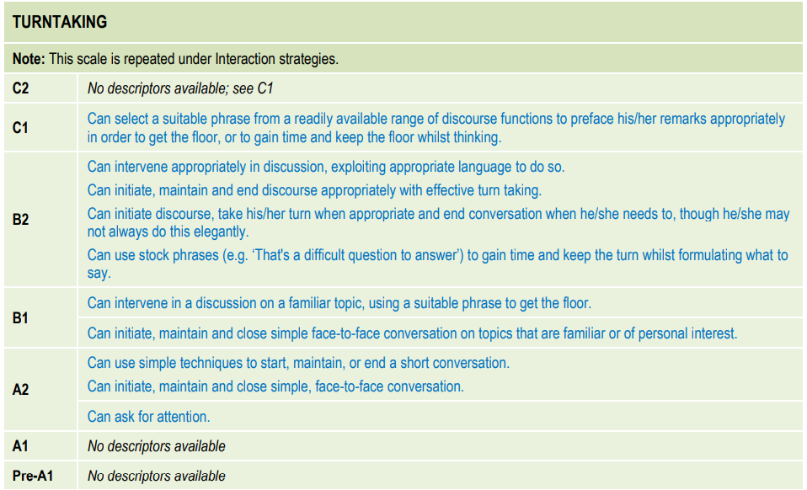

Slide 16
The Three-Stage Learning Process for Developing Speaking Skills
In order to activate knowledge of context factors (cultural, immediate situation) discourse strategies, communication strategies, the learning process needs to include three stages:
  Awareness
  Appropriation
  Autonomy
Thornbury S. H. How to Teach Speaking. Longman, 2005, p.40.

Slide 17
Awareness
To be made aware of features of the target language-base.
Awareness-raising – a term borrowed from cognitivist learning theory
Appropriation
To integrate these features into their existing knowledge-base.
The term is borrowed from the socio-cultural learning theory.
Autonomy
To develop the capacity to mobilize these features under real-time conditions and unassisted.

Slide 18
The Three-Stage Learning Process for Developing Speaking Skills
Awareness raising activities
Involves attention, noticing and understanding;
Is other-regulated (the teacher assists, guides the process and offers support, feedback).
Exposure to samples of speech: audio-reordered (scripted, semi-scripted, authentic); live, e.g. teacher-talk.
Notice the gap between what they can do and what other practitioners can through the task-based instructional cycle:
1. Sts perform a speaking task at the best of their current ability;
2. Sts observe skilled practitioners performing the same task and note features they would like to incorporate;
3. Sts re-perform the original task (or similar one) attempting to incorporate the targeted features.

Slide 19
The Three-Stage Learning Process for Developing Speaking Skills
Listen and read - hand out the transcript. Replay the recording while learners read silently.
Focus on language features - 'guided noticing' of selected features. This can involve the following procedures:
  identifying, e.g. underline, or circle, in the transcript examples of evaluative language.
  counting, e.g. count the number of times the speakers say you know and I mean.
  classifying, e.g. identify and classify the different discourse markers.
  matching, e.g. match idiomatic expressions in the text with their synonyms on a list.
  connecting, e.g. connect the pronouns in the text with their referents (i.e. the words they refer to).
  comparing and contrasting, e.g. compare these two versions of the same conversation and identify any differences.
An alternative way of guiding noticing is to provide a transcript that is either incomplete or in some way different from the actual recording.
E.g. Listen to the recording again and fill in the gaps in the transcript. (The gaps can represent all the discourse markers, for example.)
Awareness raising activities

Slide 20
The Three-Stage Learning Process for Developing Speaking Skills
Appropriation activities
Practised control;
  Other-regulation is progressively relinquished;
  Demonstrating progressive control of a skill, possibility of mistakes is present, but support is at hand.

Slide 21
The Three-Stage Learning Process for Developing Speaking Skills
Drilling (and chanting) - imitating and repeating words, phrases and whole utterances.
  – A useful noticing technique, since it draws attention to material that learners might not otherwise have registered. E.g. after learners have listened to a taped dialogue, and studied the transcript, the teacher can isolate specific phrases or utterances and ask learners to repeat them.
  – Helps to move new items from working memory into long-term memory,
  – Provides a means of gaining articulatory control over language of getting your tongue round it'.
N.B: controlled practice (mechanical and repetitive practice activities)
Appropriation activities

Slide 22
The Three-Stage Learning Process for Developing Speaking Skills
Milling /ˈmɪlɪŋ/ activities (a way of providing repetitive practice of formulaic language in a more communicative framework; involves learners walking around, asking all the other learners questions with a view to completing a survey or finding a close match.)
Assisted performance and scaffolding (reformulating or translating learners’ utterances).
Dialogues
    Items on board
    Chunks on cards
    Memorizing scripts
    Disappearing dialogue
    Dialogue building
Appropriation activities

Slide 23
The Three-Stage Learning Process for Developing Speaking Skills
Communicative tasks
  Information gap activity
  Jigsaw activity
  Guessing game
Task repetition
  The Onion
  Headlines
  4-3-2 (to retell a story or monologue within a time limit that decreases at each retelling, thereby encouraging greater automaticity)
Appropriation activities

Slide 24
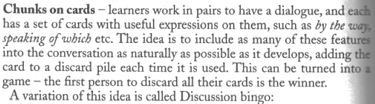
The Three-Stage Learning Process for Developing Speaking Skills

Slide 25
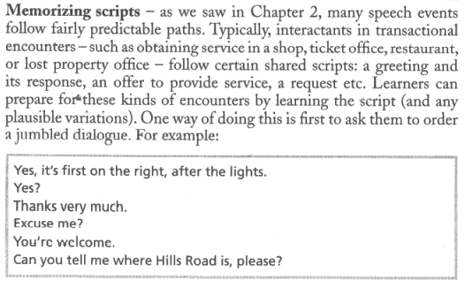
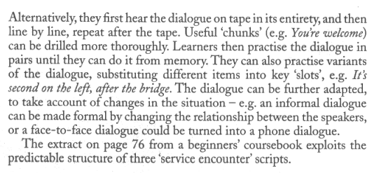

Slide 26
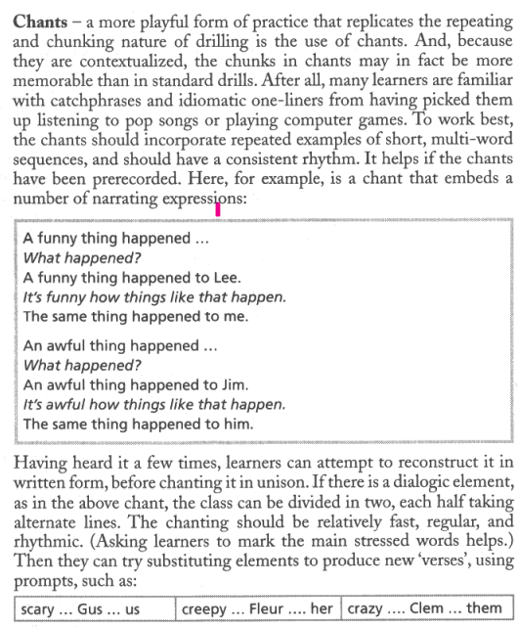

Slide 27
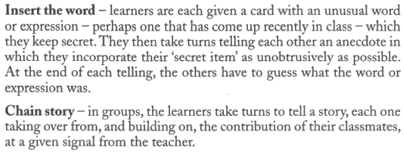
The Three-Stage Learning Process for Developing Speaking Skills
Activities developing autonomy
The capacity to self-regulate performance as a consequence of gaining control over skills that were formally other-regulated.
Characteristics:
- speed,
- economy (ignore inessentials),
- accuracy (quick at detecting and rejecting errors),
- anticipation (think and plan ahead),
- reliability (perform in real operating conditions).
Presentation and talks
Show and tell
Did you read about
Storytelling based activities
Guess the lie
Insert the word
Chain story

Slide 28
The Three-Stage Learning Process for Developing Speaking Skills
Activities developing autonomy
Autonomy in speaking require that the speaker is able to:
- work fast, be spontaneous, and cope with unpredictability;
- anticipate and plan ahead;
- ignore inessentials, and carry out the task using minimal means;
- be accurate:
- be versatile, ie perform a range of different speaking tasks about a range of different topics:
- be reliable, ie perform the task equally well under different, even adverse, conditions.

Slide 29
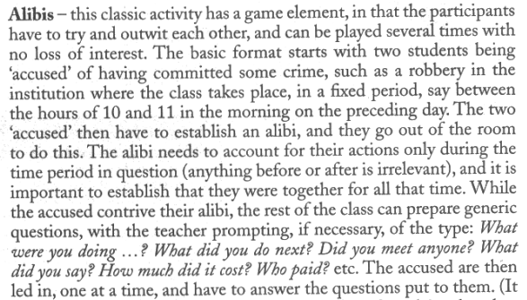
The Three-Stage Learning Process for Developing Speaking Skills
Role-play and simulations
Alibis /ˈælɪbaɪ/
Shopping around
Discussion and debates
Discussion cards (with statements related to a pre-selected topic)
Warm-up discussions
Pyramid debate/discussions
Conversation and chat
Sentence star
True/false sentences
One of us /some of us

Slide 30
Features of communicative activities
  Motivation of the activity to achieve some outcome, using language;
  The activity takes place in real time;
  Achieving the outcome requires the participants to interact, to listen as well as to speak;
  Because of the spontaneous and jointly constructed nature of the interaction, the outcome is not 100 % predictable;
  There is no restriction of the language used.

Slide 31
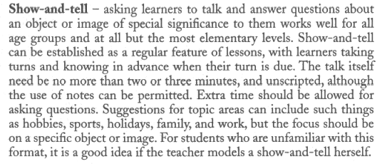
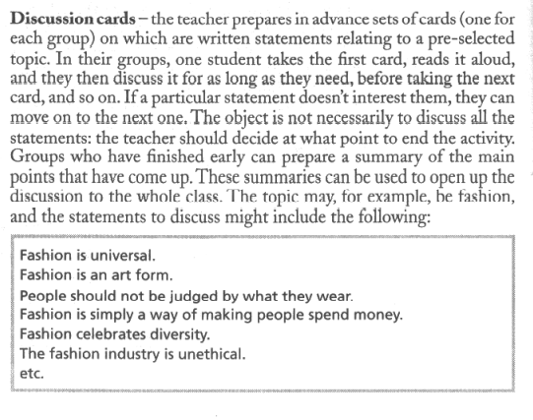
Examples of activities to develop sts’s autonomy:

Slide 32
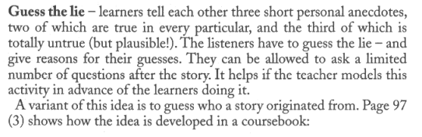
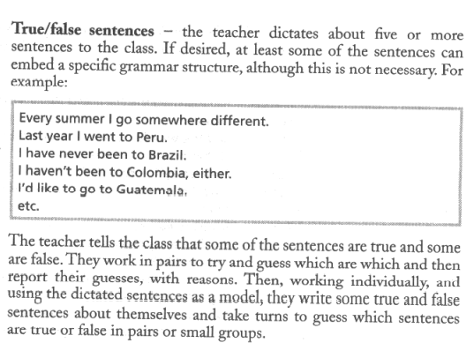
Examples of activities to develop sts’s autonomy:

Slide 33
Criteria for Speaking Tasks
  Productivity - a speaking activity needs to be maximally language productive in order to provide the best conditions for autonomous language use.
  Purposefulness- the speaking activity has a clear outcome, especially one which requires learners to work together to achieve a common purpose. For example, the aim of having to reach a jointly agreed decision; reporting to the class on their discussion is also an effective way of ensuring a greater degree of commitment to the task. A competitive element - such as turning the task into a race - can also help.
  Interactivity - activities should require learners to take into account the effect they are having an audience, one which can demonstrate interest, understanding, and even ask questions or make comments at the end.

Slide 34
Criteria for Speaking Tasks
  Challenge -the task should determine the learners to draw on their available communicative resources to achieve the outcome (increases achievement and excitement). If the degree of challenge is too high, this can be counterproductive, inhibiting learners or reducing them to speaking in their L1. The teacher needs to be sensitive to the degree of difficulty a task presents individual learners and to adjust the task accordingly.
  Safety - while learners should be challenged, they also need to feel confident that, when meeting those challenges and attempting autonomous language use, they can do so without too much risk. The classroom should provide the right conditions for experimentation, including a supportive classroom dynamic and a non-judgmental attitude to error on the part of the teacher.
  Authenticity - speaking tasks should have some relation to real-life language use. Learners need to experience a quality of communication in the classroom that is essentially the same as communication outside the classroom, i.e. the need to perform in real operating conditions, e.g. spontaneously, unassisted, with minimal preparation, and making do with their existing resources. It also means that the kinds of topics, genres, and situations that are selected for speaking tasks bear some relation to the learners' perceived needs and interests.

Slide 35
Methodological approaches to speaking:
  Integrated skills approach
  Task-based approach – processes of speaking are foregrounded
  Genre-based approach – products of speaking are foregrounded
  A genre is a variety of speech (or writing) found in a particular place, with particular people, in a particular context, to achieve a particular result, using a particular channel (E.g. face to face, by phone). A genre is often characterized by specific choices about style, manner, tone, quantity, volume, directness, choice of words, formality, type of content, etc.
    Giving an academic lecture
    Job interview
    Making a phone enquiry
    Chatting with a friend
    Explaining medical problems to a doctor
    Negotiating a sale
    Giving street directions
A classroom culture that prioritizes authentic communication

Slide 36
Basic speaking sequence
  Set the task
  Plan the speaking
  Rehearse the speaking
  Feedback / Review the success
  Add/Correct / Revise
  Redo the task
  Exposure to example (the stage can come at any point).

Slide 37
Example of a speaking sequence:
  Set task: Tell learners that they must phone a hotel to make a reservation.
  Plan the speaking: Learners are asked to work in pairs to decide what the caller will say and how the receptionist will respond. Learners should not write out a whole script, but can make notes of particular phrases.
  Rehearse the speaking: Learners practise in pairs. The teacher listens in and suggest corrections and improvements.
  Do the task: Make new pairs. Without further discussion, learners 'phone' each other and do the task.
  Feedback / review: The pairs meet and reflect on whether the task was done well. The teacher may draw attention to specific language that learners could use and specific ways of interacting appropriate to the genre.
  *Exposure to example: Play a recording of competent speakers doing the same task. The class is asked to take down notes about language they use.
  Add/correct/revise: The pairs work out how they could improve their task next time.
  Redo the task: Make new pairs. The task is done again.

Slide 38
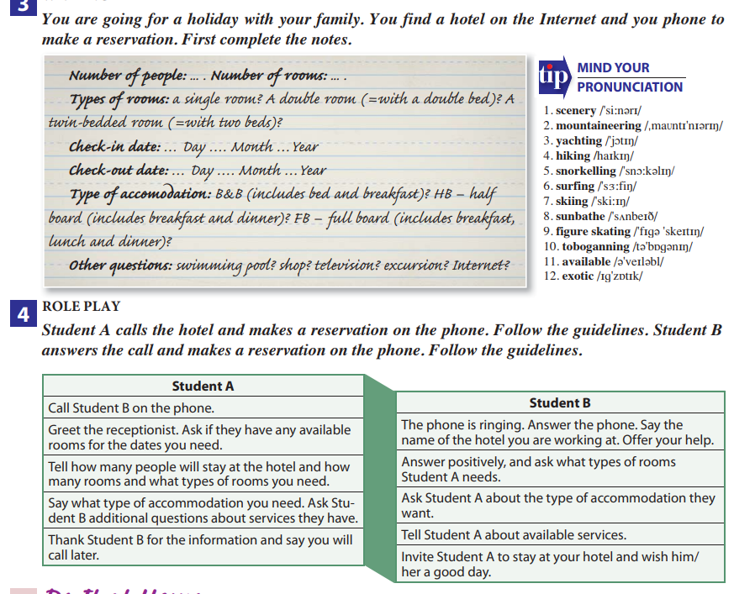

Slide 39
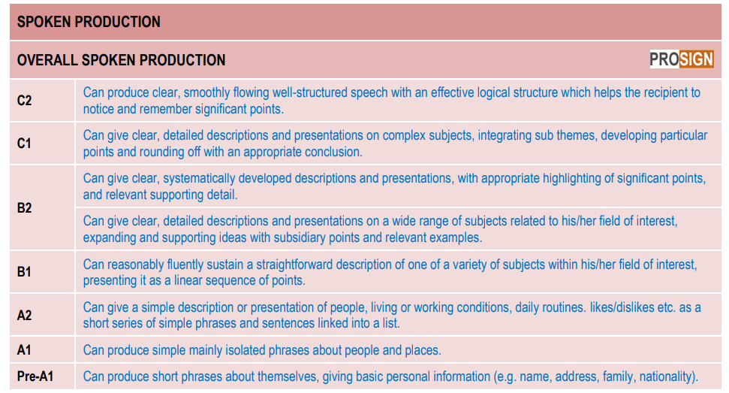

Slide 40
Ideas for correction work after a fluency activity
  Write up a number of sentences used during the activity and discuss them with the students.
  Write a number of sentences on the board. Ask the students to come up to the board and correct the sentences.
  Invent and write out a story that includes a number of errors you overheard during the activity. Hand out the story the next day and the students, in pairs or as a whole group, find the errors and correct them.
  Write out two lists headed 'A' and 'B'. On each list, write the same ten sentences from the activity. On one list, write the sentence with an error; on the other, write the corrected version. Thus the correct version of sentence 3 might be on either list A or list B (the other list has the incorrect version). You divide the students into two groups, 'A' and 'B', and hand out the appropriate list to each group. The groups discuss their own list (without sight of the other list) and try to decide if their version of each sentence is correct or not. If it is wrong, they correct it. When they have discussed all the sentences, the groups can then compare the two sheets (and perhaps come to some new conclusions).

Slide 41
References:
  Brown H. D. Teaching by Principles: An Interactive Approach to Language Pedagogy. Longman, 2015.
  COUNCIL OF EUROPE. Common European Framework of Reference for Languages: Learning, Teaching, Assessment. Companion Volume with New Descriptors. Strasbourg: Council of Europe, 2018
  Harmer J., How to Teach English. Pearson Education Limited/Longman, 2001.
  Harmer J. The Practice of English Language Teaching: Buch. Harlow: Pearson/Longman, 2015.
  Scrivener J. Learning Teaching. The Essential Guide to English Language Teaching. 3rd edition. Macmillan, 2014.
  Thornbury S. H. How to Teach Speaking. Longman, 2005.
  Ur P. A Course in English Language Teaching. Cambridge: Cambridge University Press, 2012.
  Ur P. Penny Ur's 100 Teaching Tips. Cambridge University Press , 2016.
  https://youtu.be/F3qoGQCZ_PM

Slide 42
