Slide 1
Teaching Pronunciation
Oxana Creanga

Slide 2
CHANGING GOALS FOR PRONUNCIATION TEACHING
During much of the 20th century pronunciation teaching was governed by “Nativeness principle”
- the attainment of the native-speaker accent, British Received Pronunciation (RP) or the American equivalent - General American (GA))
The assumption was challenged in the 1980s with the communicative approach which placed the emphasis on the communicative competence.
“Intelligibility principle”
- The capacity to make one’s speech understandable to people from a wide range of lge backgrounds, both native speakers and non-native speakers, and thus participate effectively in international communication.

Slide 3
The Importance of Pronunciation
  Studies of EIL (English as an international language) show that pronunciation can account for up to two thirds of communication breakdowns between non-native speakers.
  International intelligibility is therefore an essential component of intercultural communicative competence (language knowledge and usage skills needed for communicating with people from different linguistic and cultural backgrounds), and this makes the teaching of pronunciation more relevant than ever.

Slide 4
INTELLIGIBILITY, COMPREHENSIBILITY, AND ACCENTEDNESS
Intelligibility refers to how easily a listener can identify the individual words or phrases that a speaker produces (‘I can understand almost everything’).
Comprehensibility relates to the effort required by the listener to understand what the speaker is saying (‘I don’t have to concentrate to understand’). Thus, speakers can be intelligible but may be judged to be poorly comprehensible if understanding their speech requires concentrated effort on the listener’s part.
Accentedness is the extent to which listeners judge the speaker’s accent to deviate from what they consider neutral or ‘standard’—in other words, how much of an ‘accent’ the speaker has (‘The speaker’s accent is different from mine’).

Slide 5
ACCOMMODATION SKILLS FOR PRONUNCIATION
Pronunciation accommodation skills involve users adjusting their expectations as listeners or modifying features of their own speech.
  Receptive accommodation, the skill of adjusting one’s expectations as a listener in order to understand the many accents encountered when using English with speakers from a variety of language backgrounds.
  Productive accommodation is the ability to adjust one’s output to one’s listener(s), taking into account their needs and their level of competence in English.
    Some native speakers do this naturally in order to make themselves more easily understood. With guidance from their teachers, non-native speakers can also do this by identifying and working on the aspects of their pronunciation that are most likely to compromise their intelligibility in EIL settings. For example,
    speakers can enhance their international intelligibility by paying attention to not devoicing voiced consonants at the end of words, for example mad vs mat.
    the absence of palatalization (making the sound milder than it should be)
    keeping the habit of pronouncing long and short vowels.

Slide 6
Pronunciation and Communicative Language Skills
Speaking skills
Pronunciation training in English significantly boosts sts' confidence in speaking, addressing the issue of reduced participation among sts unsure of their pronunciation skills; teachers can enhance learners' confidence through activities like
  teaching sts how to check the pronunciation of new vocabulary prior to speaking,
  helping them with sounds they find hard to articulate,
  showing them how to link words so as to increase fluency.

Slide 7
Pronunciation and Communicative Language Skills
LISTENING SKILLS
Bottom-up processing
  Experts in EFL listening have agreed that more attention needs to be paid to bottom-up processing, which involves decoding the individual phrases, words, and sounds that learners hear, especially important for lower-level learners, who are often unable to make use of either contextual clues or prior knowledge to fill gaps in their understanding
    pronunciation teaching should reintroduce the ear-training and sound discrimination exercises that were widely discredited with the arrival of communicative language teaching.
Connected speech
  Modifications to the dictionary form of a word through processes such as assimilation, elision, or coalescence.
    focus on connected speech for listening is for intermediate and higher-level learners.

Slide 8
Pronunciation and Communicative Language Skills
VOCABULARY LEARNING
Sound-Spelling Norms:
  Challenge: Learners might apply native language sound-spelling norms to English, leading to mispronunciations.
  Example: "Real" (/reˈæl/) might be mispronounced, hindering intercultural communication; learners expecting to hear ‘library’ as /ˈlaɪbrəri/, with three full syllables, might not recognize the word when it is embedded into natural speech and pronounced as /ˈlaɪbri/ with two syllables.
  Proper guidance prevents communication breakdowns and enhances intelligibility.
Vocabulary Retention:
  Neurolinguistic Insight: Correct pronunciation aids the phonological loop, ‘inner ear’ and an ‘inner voice’, which hold and repeat verbal information so that it can be transferred successfully from working memory to long-term memory.
  Significance: Good pronunciation supports effective vocabulary retention, aiding future language use and communication.

Slide 9
Pronunciation and Communicative Language Skills
Enhancing Reading Skills Through Pronunciation
  Essential Connection: Pronunciation is integral for beginners learning to read in English.
  Processing in Working Memory: Both L1 and L2 reading involve accurate matching of sounds to written words.
  Examples: Correct pronunciation of letter combinations (e.g., -ght, -igh, -tion) and the possible pronunciations of (e.g., 'ea' in 'head', 'meat', 'break') enhances word and overall reading fluency.
Impact of Pronunciation on Reading Problems:
  Research Findings: Reading issues in EFL often stem from poor pronunciation of English sounds.
  Solution: Improving pronunciation skills can significantly enhance reading abilities, aiding learners in overcoming reading challenges.

Slide 10

What to Teach
Lingua Franca Core (LFC)
Jennifer Jenkins pioneered research into intelligibility in spoken interactions between non-native speakers gathering empirical data in both study and social settings.
Jenkins analyzed breakdowns in communication that could be attributed to pronunciation and this allowed her to identify a small number of aspects of English pronunciation that appeared to be central to intelligibility between non-native speakers.
From this, Jenkins created a list of priorities for pronunciation in English, which she called the Lingua Franca Core (LFC).
Jenkins, J. (2000). The phonology of English as an international language. Oxford: Oxford University Press.
Jenkins, J. (2007). English as a lingua franca: Attitude and identity. Oxford: Oxford University Press.

Slide 11
What to Teach
Productive competence - the ability to produce a sound, word, or other language feature
Receptive competence - the ability to understand a sound, word, or other language feature produced by other speakers.

Slide 12
Priority pronunciation features for productive competence (based on the LFC)
Most consonant sounds
  The pronunciation of /f/ as /p/, with ‘coffee’ sounding like ‘copy’ could seriously impair international intelligibility.
  Similarly, replacing /tʃ/ with /ʃ/ would make ‘chairs’ sound like ‘shares’ and also threaten intelligibility.
  Exceptions: Common variants of /θ/, /ð/, and /r/ are acceptable and widely intelligible, e.g. ‘think’ may be pronounced as ‘tink’, ‘then’ as ‘den’, and ‘ready’ with a trilled r.
Aspiration of /p/, /t/, and /k/ at the beginning of a word
  f aspiration is too weak, a word may be mistaken for another, e.g. ‘pear’ will sound like ‘bear’, ‘tense’ like ‘dense’, and ‘coat’ like ‘goat’.
Consonant clusters at the beginning or in the middle of a word
  Adding an extra sound is unlikely to affect intelligibility, but consonant sounds cannot usually be deleted from a cluster, e.g. ‘stone’ is likely to be understood if pronounced as ‘sitone’ but not as ‘tone’ or ‘sone’.

Slide 13
Priority pronunciation features for productive competence (based on the LFC)
Vowel length
  There needs to be a clear distinction between long and short vowels, e.g. ‘fill’/’feel’.
Nuclear (sentence) stress
  The placement of stress in a sentence shows the emphasis of the speaker and therefore affects its interpretation, e.g. ‘I’ve rented a FLAT’/‘I’ve RENTed a flat’/‘I’VE rented a flat’.
Word stress
  Word stress needs to be correctly placed to achieve intelligibility, e.g. listeners may not recognize ‘balloon’ pronounced as ‘BAlloon’, ‘folLOW’ as ‘follow’ or ‘creation’ as ‘CREation’

Slide 14
Rhythm
The speech rhythm of native English speakers is stress-timed.
This means that in each phrase or sentence certain words are stressed (usually the lexical words which carry the main content) and the other words are shortened to fit the rhythm.
Therefore, how long each phrase or sentence takes to say depends on how many stresses there are in it.
  e.g. My old GRANDfather used to go SWIMming in the middle of DeCEMber (three stresses) does not take much longer to say than
  My GRANDpa went SWIMming in DeCEMber (three stresses).
Many other languages are syllable-timed: the time it takes to say a sentence depends on how many syllables there are. So the first of the sentences above, if pronounced according to syllable-timing (18 syllables) would take quite a lot longer to say than the second (10 syllables).

Slide 15
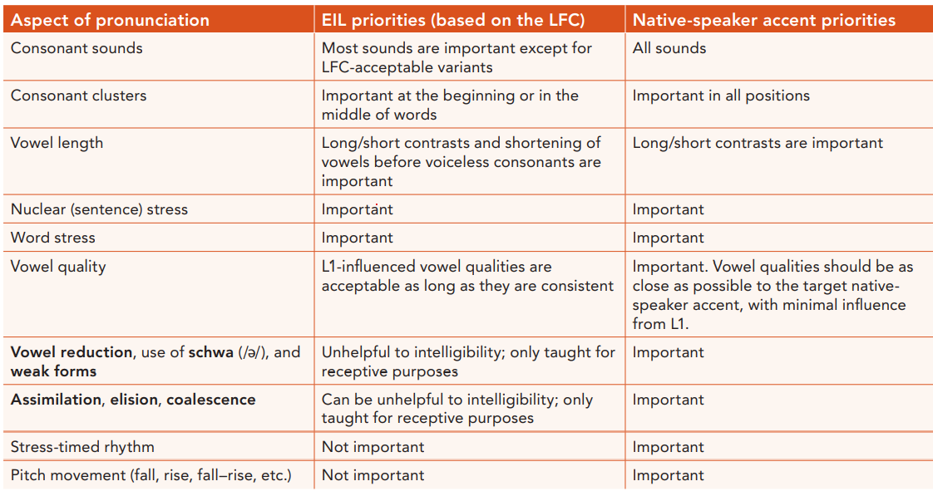
EIL (English as an International Language) and native-speaker accent priorities

Slide 16
AN INTEGRATED APPROACH TO TEACHING PRONUNCIATION
Pronunciation is intrinsic to the teaching of other skills, especially speaking, listening, and reading.
Pronunciation activities need to be anchored in one or more of the other language skills being taught.
Pronunciation is a support system that works in the background whilst other systems are in operation.

Slide 17
Pronunciation and speaking
Pronunciation supports speaking in different ways.
Work on new language structures, e.g., requires pronunciation practice.
  Activities focusing on accurate pronunciation of plural -s or regular past tense -ed endings;
  Consonant clusters can be integrated into accuracy-focused oral work on a grammar structure, e.g., third conditional structures such as ‘If we hadn’t followed them, we’d’ve got lost’.
  Modeling pronunciation of lexical chunks, such as ‘if I were you’, ‘I see what you mean’, or ‘it’s on the tip of my tongue’. Helping learners to produce lexical chunks more fluently will optimize the contribution of these chunks to their overall speaking fluency.

Slide 18
Pronunciation and listening
Pronunciation can help learners deal more effectively with the bottom-up processing requirements that listening places on them.
  Work on minimal pairs will help learners recognize the difference between problematic sounds.
  The less effort needed to distinguish between /æ/ and /ʌ/, as in ‘hat’ and ‘hut’, for example, the more attention the listener can devote to contextual clues and other aspects of top-down processing.
  Targeted pronunciation work can also help learners to pick up on the weak forms of function words. It can be very hard for learners to make sense of ‘He said that they could have won.’ where four of the words are weakened and come one after another. Other examples: ‘and a dress’ / ‘an address’; ‘I’ll go’ / ‘I’d go’; ‘she’s gone’/ ‘she’d gone’.

Slide 19
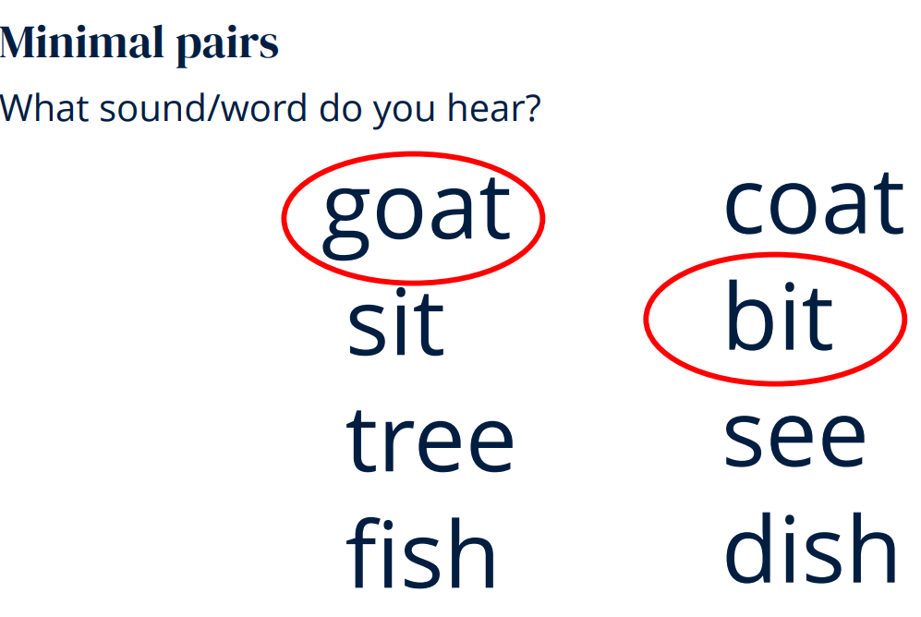
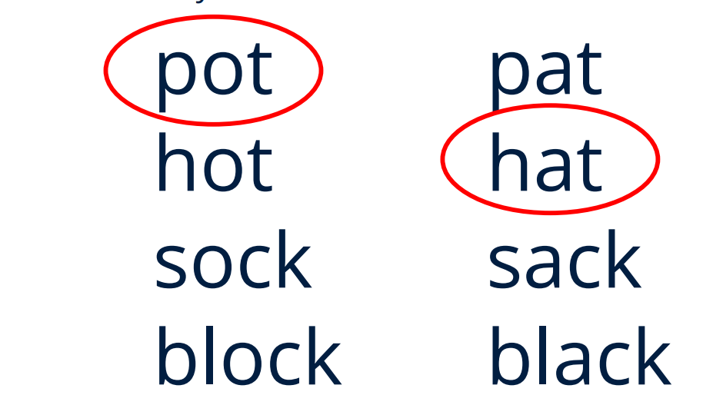
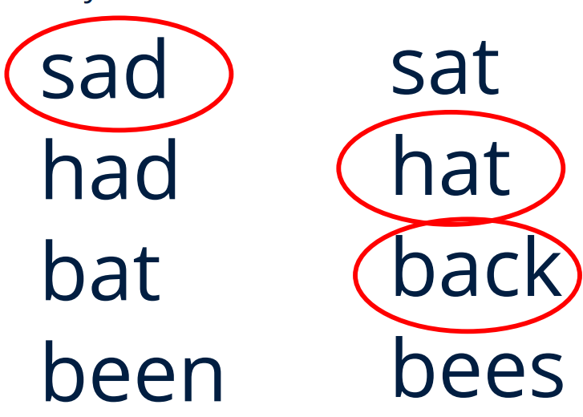

Slide 20
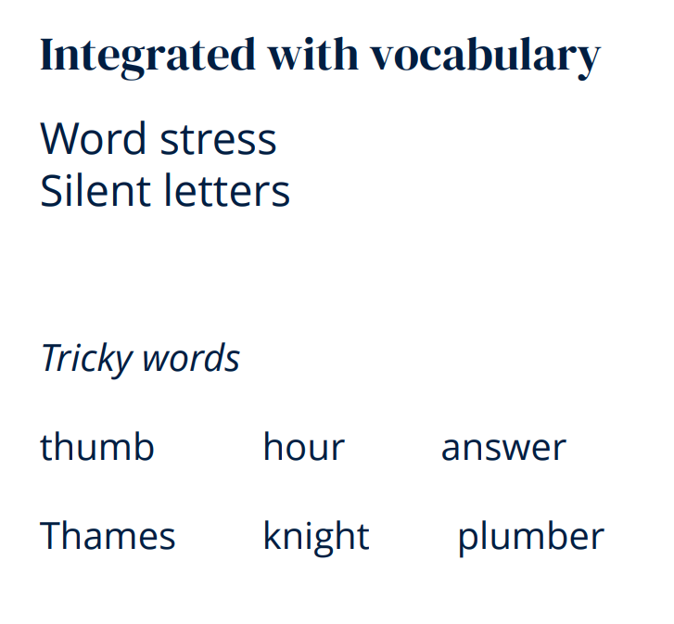
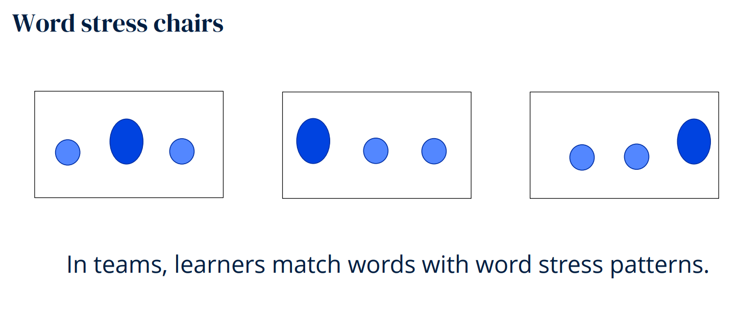
Pronunciation and vocabulary
Checking vocabulary prior to speaking/reading allows teachers to detect pronunciation problems and deal with them before they distract learners during the speaking/reading activity itself.
Aspects that can be addressed at this stage:
  Problematic consonant and vowel sounds,
  Consonant clusters,
  Word stress.

Slide 21
Pronunciation as articulation awareness
  Pronunciation involves mastering the physical articulation and prosody of a language, which is often unconscious in one's native language but requires conscious attention and muscle awareness. Understanding where the sounds are produced (place of articulation), and how (manner of articulation), helps them visualize movements which would not normally be visible.
  Demonstration - especially when the articulation of a sound is easy to see – for example, the closed lips for the phoneme /m/.
  Guided discovery techniques - raising awareness of place of articulation, help the students to become aware of their tongue position for /s/ and /z/, with the tip almost touching the alveolar ridge; getting sts to notice the vibration in the throat which accompanies /z/ but not /s/ for the manner of articulation.
  (Imitation)Drills - sts repeat words or chunks of text containing a high concentration of the target pronunciation feature, so that it is very noticeable. While sts are repeating, encourage them to pay attention to their articulation. In this way, they build a mental association between how each phoneme sounds and how it feels.

Slide 22
Pronunciation as articulation awareness
Use a phonemic chart
  A phonemic chart can summaries an invaluable amount of information. Backgrounds of different colors are used to show voiced or unvoiced consonants and vowel length. e.
  Whenever students need clarification about the sounds of English, you can show them in what ways they differ.

Slide 23
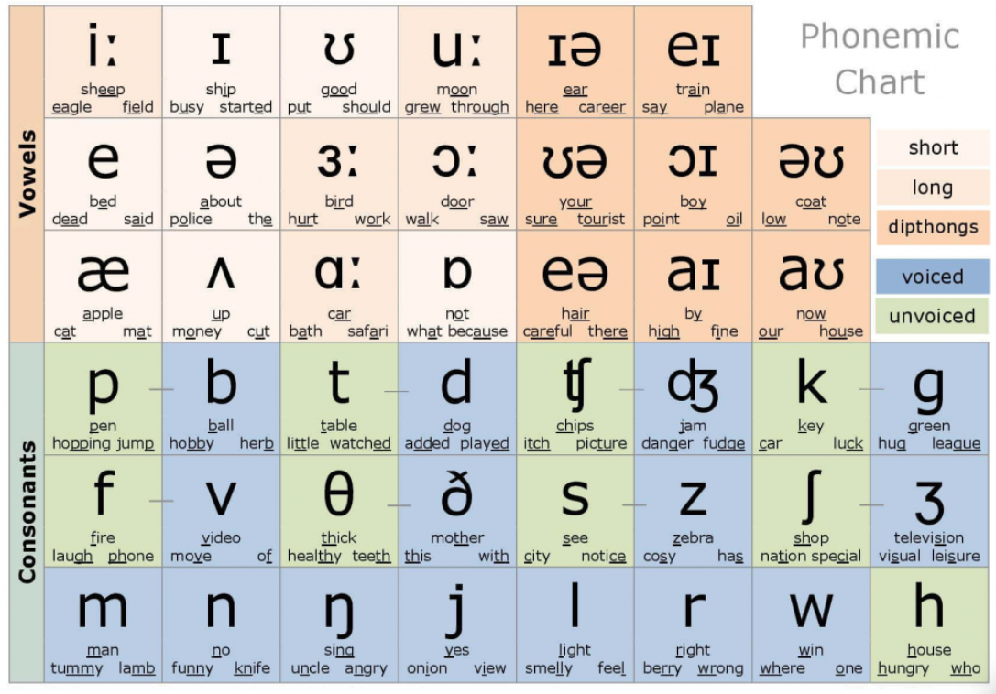
British English Pronunciation Chart/Phonemic Chart

Slide 24
Pronunciation as articulation awareness
Use the phonemic symbols from the International Phonetic Alphabet (IPA)
The alphabet which we use to write English has 26 letters but (British) English has 44 sounds. Inevitably, English spelling is not a reliable guide to pronunciation because:
  Some letters have more than one sound
  Sometimes letters are not pronounced at all
  The same sound may be represented by different letters
  Sometimes syllables indicated by the spelling are not pronounced at all.
How do you pronounce gh in 'enough', 'through' and 'ghost'? (like f in fun, not pronounced, like g in got)
How many syllables are there in 'chocolate'? (2)
Pronunciation: muscle, mind, meaning, memory | Hancock McDonald ELT

Slide 25
Pronunciation as articulation awareness
Use the phonemic symbols
Students can use dictionaries effectively. Knowing phonemic symbols enables students to get the maximum information from dictionaries.
Students can become independent learners. They can find out the pronunciation of a word by themselves without asking the teacher. What is more, they can write down the correct pronunciation of a word that they hear.
Phonemic symbols are a visual aid. Students can see that two words differ, or are the same, in pronunciation. For example they can see that 'son' and ‘sun' must be pronounced the same because the phonemic symbols are the same.

Slide 26
Pronunciation as knowledge
This aspect of pronunciation focuses on sts' understanding of rules and patterns in the target language, such as recognizing when the past tense -ed ending adds an extra syllable or understanding how final letters affect vowel pronunciation, e.g. the a of tape is pronounced /eɪ/.
  How to teach
  present pronunciation patterns explicitly
  present activities making the patterns very salient and let the students work out the patterns for themselves, implicitly or explicitly.
  games.
  E.g. EXPLAIN THE MAGIC -E RULE
  Show students how the addition of an -e at the end of a word changes its
  pronunciation:
  bit – bite cut – cute
  dim – dime hug - huge
  pin – pine

Slide 27
Pronunciation as receptive skill
We can give our students samples of language which contain a high density of a given pronunciation feature, so that that feature becomes very noticeable to them:
  Poems
  Rhymes
  Raps
  Chants
  Limericks
  Tongue twisters
Ask the students simply to listen to these, since the focus is receptive.
However, in practice, it is better if they attempt to recite the texts themselves, because there is no better way of enhancing awareness of a feature than attempting to produce it.
We can use micro-drilling – where you repeat very small fragments of the text over and over, and the students repeat.

Slide 28
Pronunciation as receptive skill
Assimilation - when two different sounds converge into one.
E.g. the change that occurs when /t/ and /d/ are followed by /j/:
/t/ + /j/ = /tʃ/ e.g. don’t you /dəʊntʃju:/
(learners understand don’(t) chew)
/d/ + /j/ = /dʒ/ e.g. I told you /aɪ’təʊldʒu:/
(learners understand tall dew)
Assimilation of /t/ and /k/= /k/
In fluent speech, when one word ends in a vowel sound followed by a /t/ and the next word begins with a /k/, the /t/ changes to a /k/. So /kredɪt kɑːd/ becomes /kredɪk kɑːd/.

Slide 29
Pronunciation as receptive skill
Teach the schwa /ə/ sound
  Schwa is the weak vowel sound produced in most unstressed syllables, with the tongue in a central, relaxed position, as in about, mother, translator, support. If students have difficulty producing this sound, suggest them lean back in their chair, keep their mouth relaxed and then produce a short ‘uh’ sound. They find this quite funny and tend to remember it!
Explain weak forms and strong forms
  The pronunciation of unstressed function words is generally weakened following a principle of economy. The ‘h’ sound is lost at the beginning of the auxiliary verb have and pronouns (e.g. he-him-his), and vowels in unstressed determiners, conjunctions, prepositions and auxiliaries tend to become schwa.
  E.g. In fluent everyday English, when the modal auxiliary 'can' is unstressed, its pronunciation changes to /kən/. 'I /kæn/ speak four languages' becomes: 'I /kən/ speak four languages'.
A cup of tea = Ə cup Ə tea
A glass of wine = Ə glass Ə wine
I'll talk to him later = I'll talk tƏ him later
I could have done that = I could Əv done that.

Slide 30
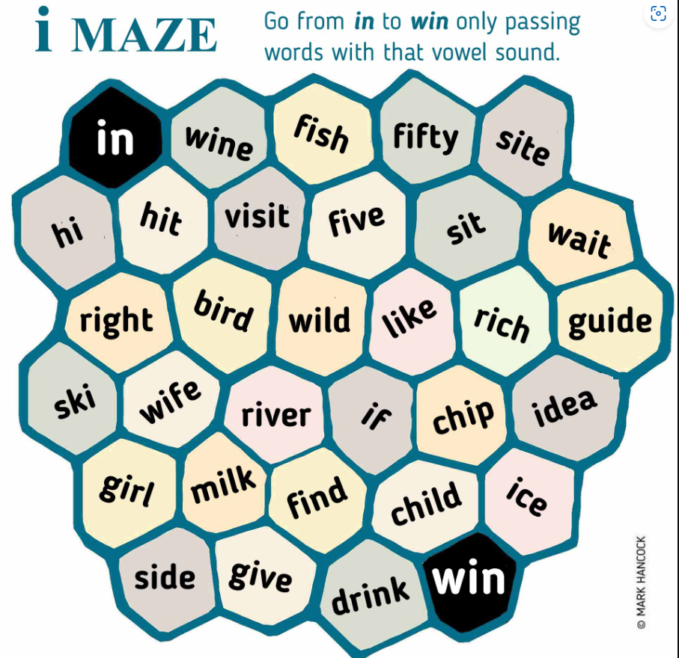
Examples of Pronunciation Activities
English Language Teaching Materials | Hancock McDonald ELT

Slide 31
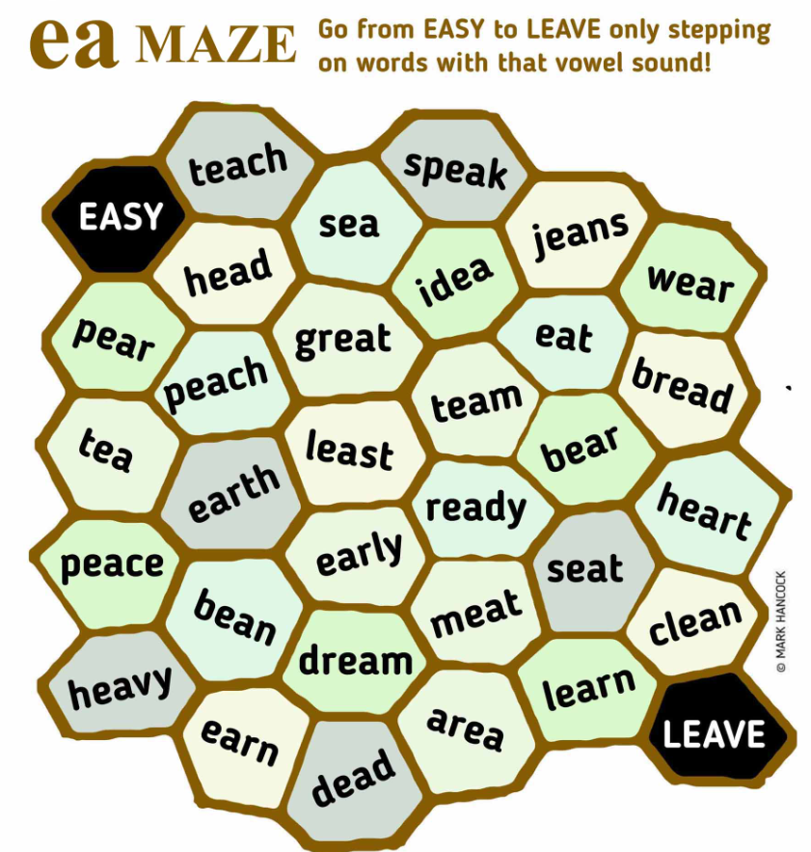
Examples of Pronunciation Activities
English Language Teaching Materials | Hancock McDonald ELT

Slide 32

Examples of Pronunciation Activities
Empty Hexagon Maze Small.JPG (3198×2619) (hancockmcdonald.com)

Slide 33
Examples of Pronunciation Activities: PRONUNCIATION JOURNEY
PROCEDURE
  Give out or project PRONUNCIATION JOURNEY.
  Point out the pair hit-heat at the bottom of the page. Explain that if they hear hit, they should turn left and if they hear heat they should turn right. Now say 1. hit, 2. hit, 3. heat, 4. hit and ask students which city they have reached (answer = Singapore).
  Try a few more examples using other word pairs. You may use words from different pairs at each of the junctions 1-4, for example 1. heat, 2. live, 3. feel, 4. cheap = Tokyo.
  When students are completely familiar with the procedure, get one volunteer to say words from the word pairs. Advise the reader to make the difference between the left and right words very clear! You and the rest of the class should follow and identify the city. If anybody reaches the wrong destination, get them to work out where they went wrong. Was it because the reader didn't make the difference clearly enough?
  Students can now work in pairs. They take turns to be reader and listener, guiding each other to one of the city destinations. Remind the readers to make the difference between the left and right words very clear, otherwise their partners will reach the wrong city!
  Get them to change partners and do the activity again.
  Use the second version of the map, with complete sentences at the bottom instead of separate words, and repeat the game.
Level: A1 upwards Focus: Pronunciation – vowel sounds /I/ and /i:/ Activity: distinguishing similar sounding words

Slide 34
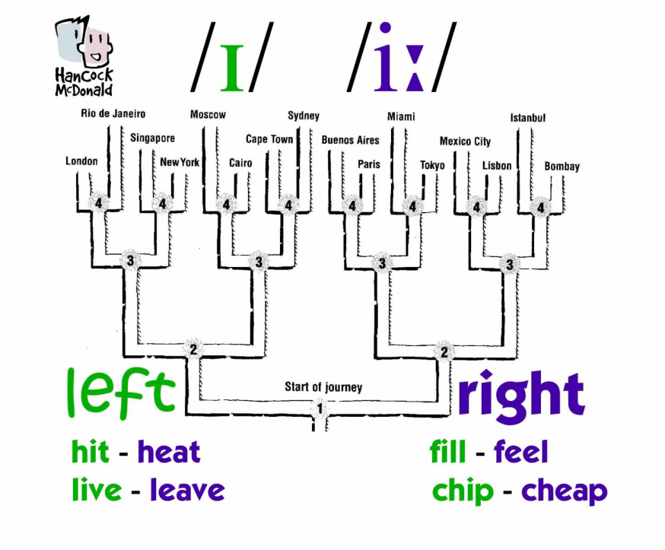
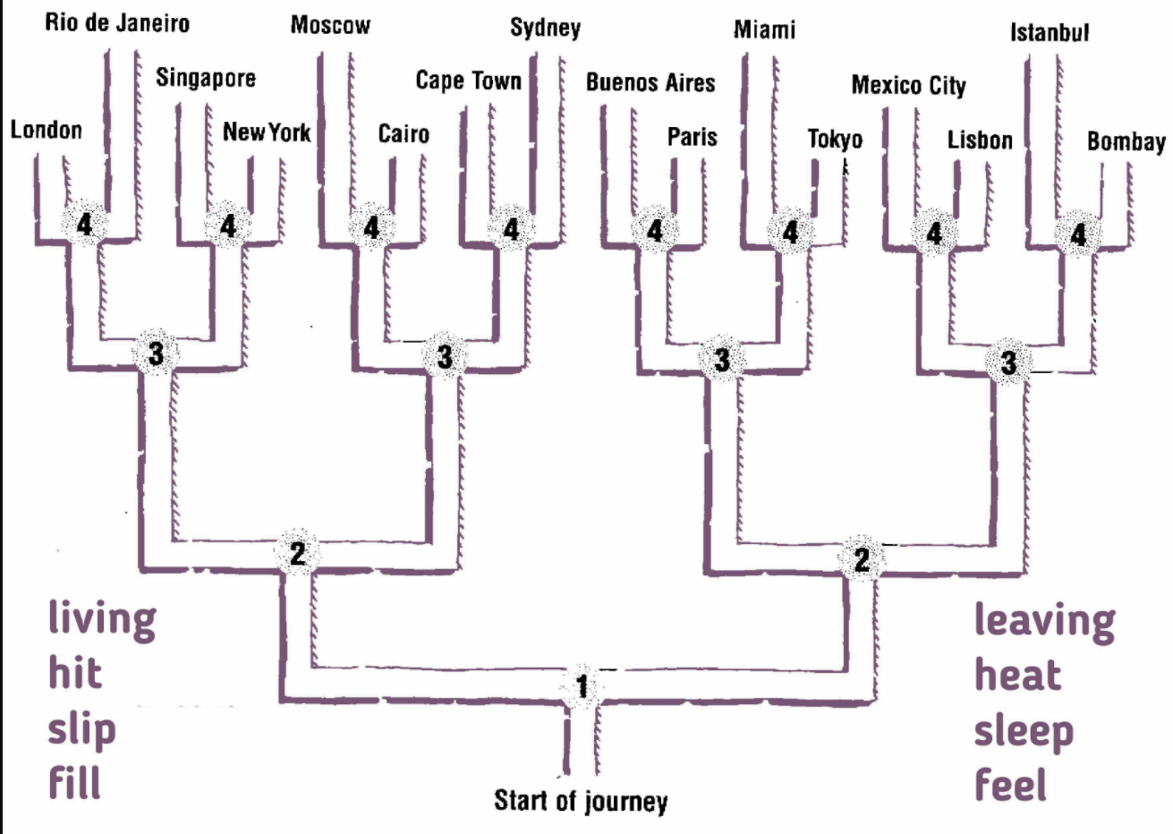
Examples of Pronunciation Activities
English Language Teaching Materials | Hancock McDonald ELT

Slide 35
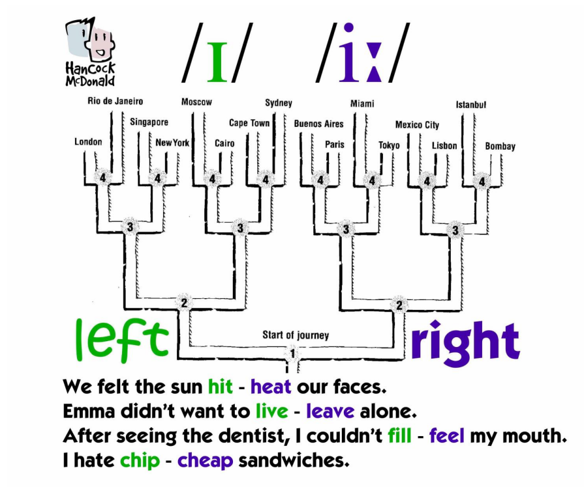
English Language Teaching Materials | Hancock McDonald ELT

Slide 36
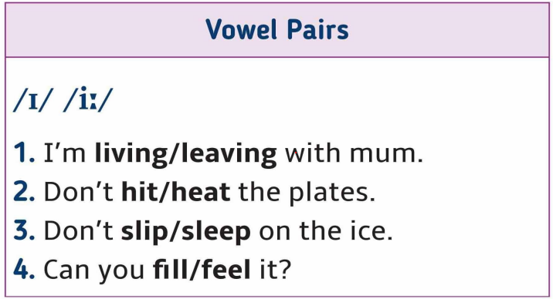
Examples of Pronunciation Activities

Slide 37
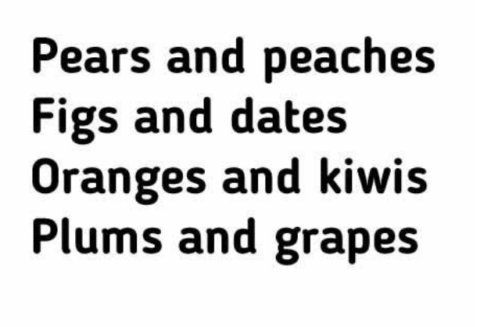
Examples of Pronunciation Activities: Rhymes and Raps (features of connected speech)

Slide 38
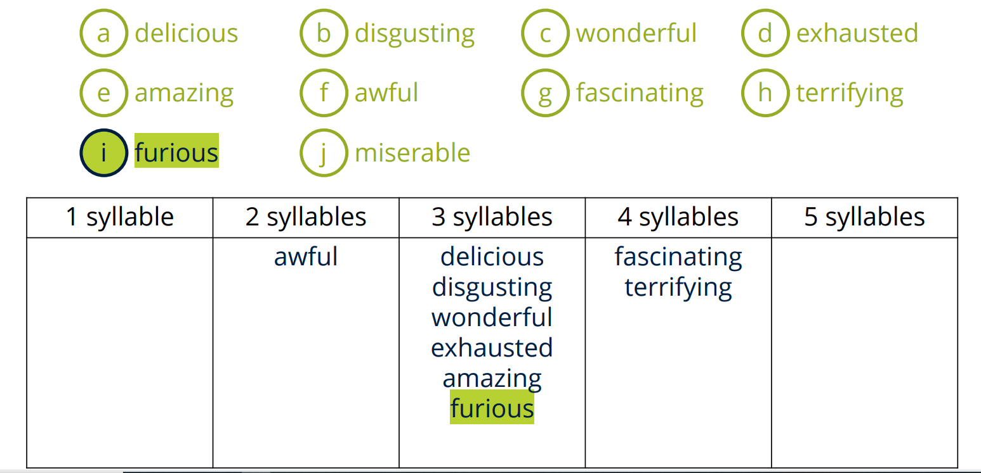

Slide 39
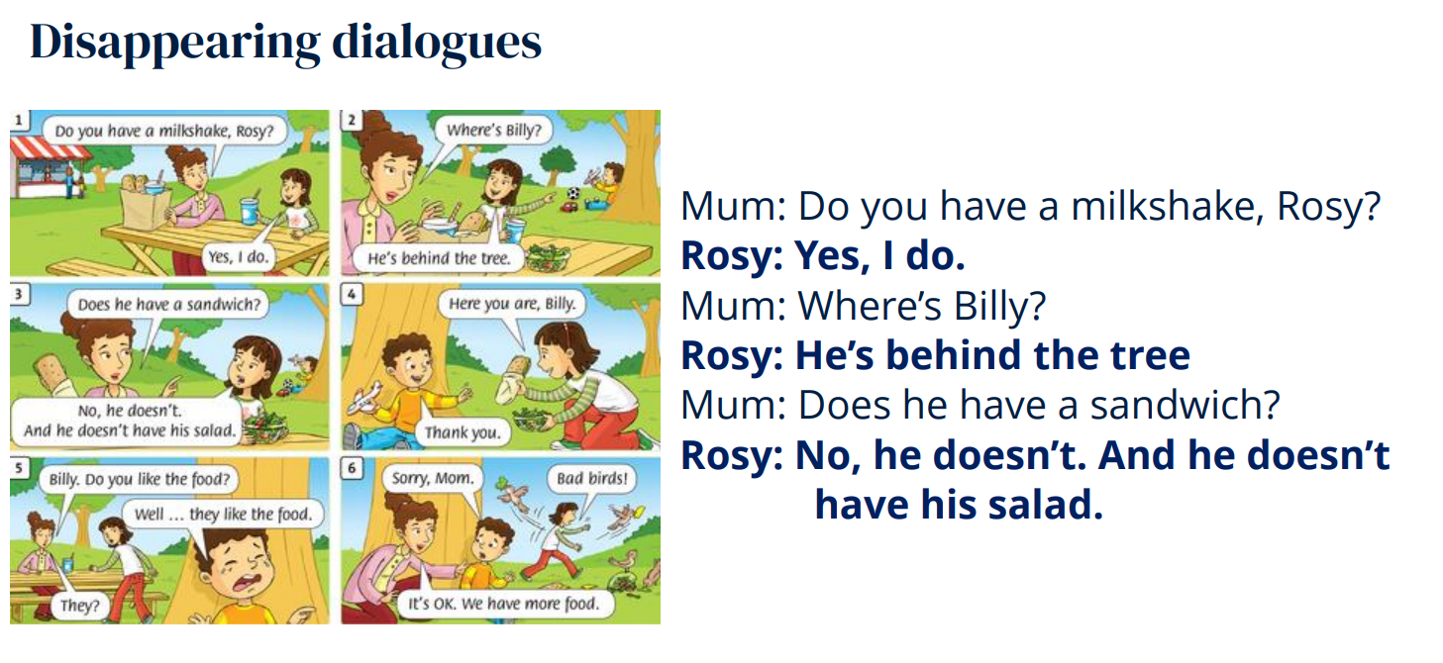

Slide 40
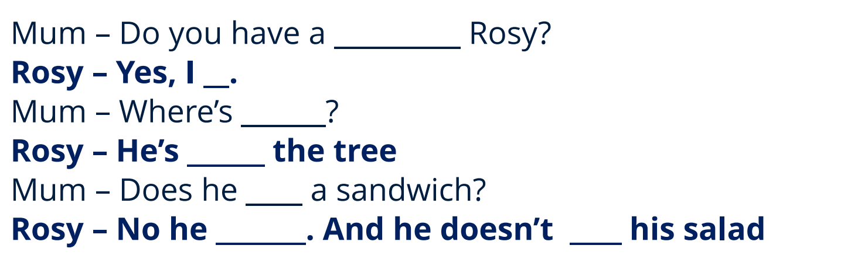
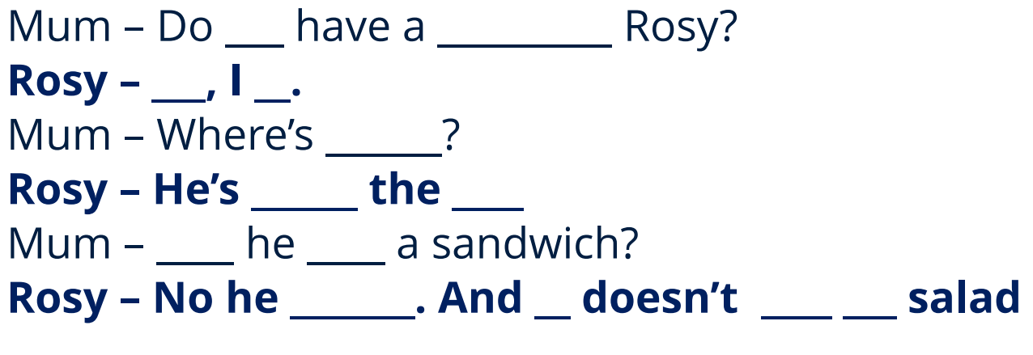

Slide 41
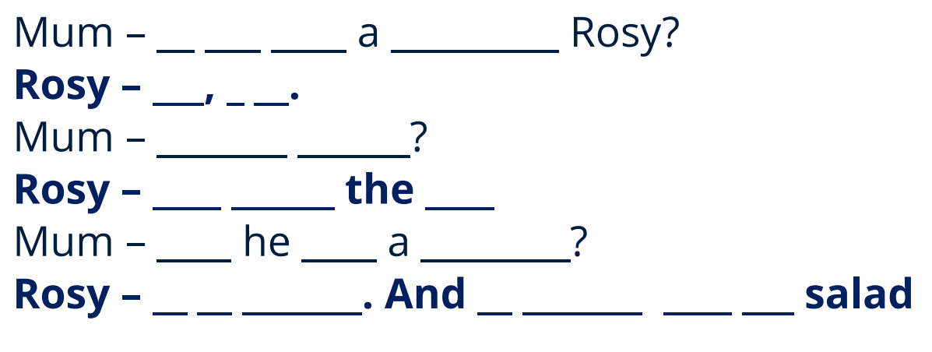

Slide 42
References
English Pronunciation in Use, Cambridge
Essential tips for teaching pronunciation: Cambridge English
Fortescue, Ushapa. Pronunciation in the Primary Classroom. Webinar, OUP.
Harmer, Jeremy. The Practice of English Language Teaching. Buch. Harlow: Pearson/Longman, 2015.
Hewings, Martin. Pronunciation practice activities. Cambridge Handbooks for Language Teachers.
BBC Learning English - Pronunciation
Pronunciation Skills: Introduction to the series – YouTube
Pronunciation skills with Adrian Underhill pronunciation chart part II
Pronunciation Skills: The Three levels of Pronunciation
Mazes, Maps, Rhymes and Raps: Pronunciation Made Practical with Mark Hancock – YouTube
Pron Journey hit v heat | Hancock McDonald ELT
Underhill, Adrian, Sound Foundations Learning and Teaching Pronunciation. Macmillan, 2009.
Hancock, Mark. Mark Hancock’s 50 Tips for Teaching Pronunciation. Pocket Editions Cambridge Handbooks for Language Teachers.
Walker, R., Low, E., & Setter, J. (2021). English Pronunciation for a Global World [PDF]. Oxford: Oxford University Press. www.oup.com/elt/expert

