Slide 1






  MODERN
  philosophy

Slide 2

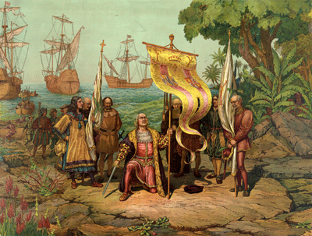
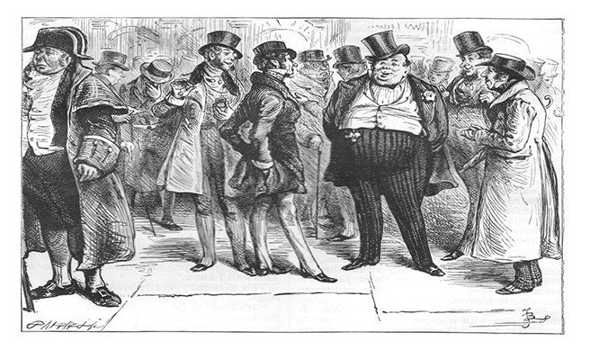
The Modern
outlook
Interest
in Science
Christopher Columbus discovered America
The humanists taught eloquence, tolerance, freedom to think, to be critical, equality in front of the law etc. They offer history, poetry, moral (comparable to the sophists in ancient Greece)
Bourgeoisie, the middle class, typically with reference to its perceived materialistic values or conventional attitudes.
The spirit of modern philosophy was built in the age of Renaissance.
Protestant Reformation initiated by Luther and continued by Calvin
The rebirth of the Greek and Roman civilization in Italy during 16th Century reflected in many cultural aspects such as literature, architecture, philosophy, art etc. The main agents of renaissance’s movement were the humanist such as Dante, Petrarkha, Rabelais, Thomas Morus, etc.

Slide 3
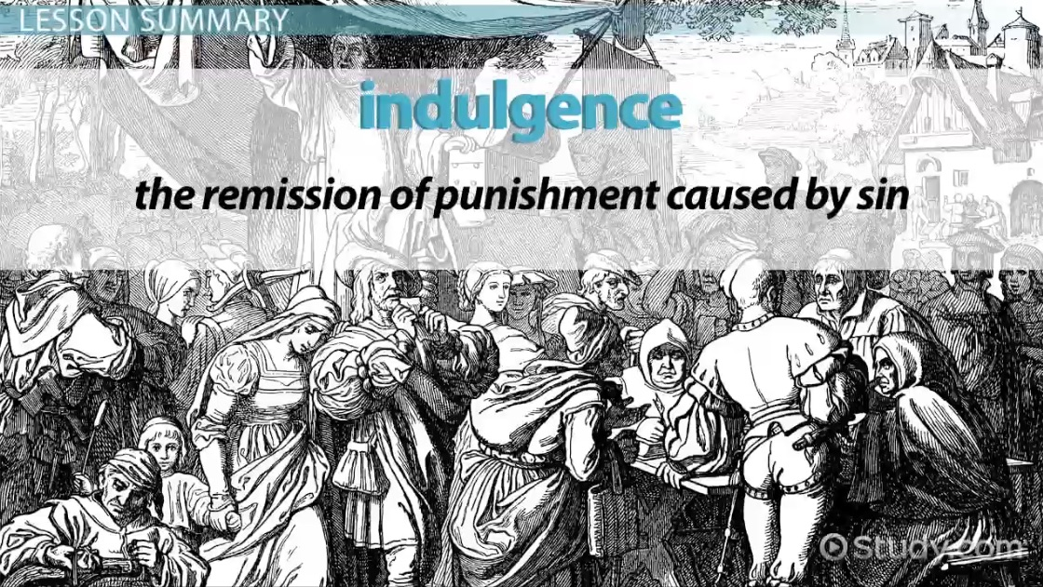
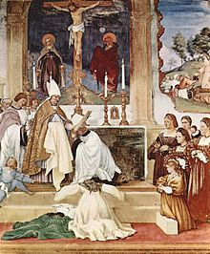
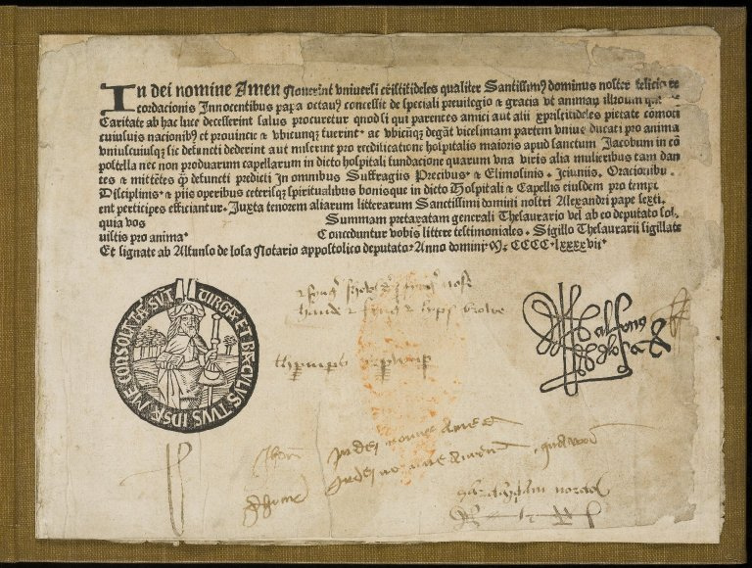
The Catholic Church describes an indulgence as "a remission before God of the temporal punishment due to sins whose guilt has already been forgiven, which the faithful Christian who is duly disposed gains under certain prescribed conditions through the action of the Church which, as the minister of redemption, dispenses and applies with authority the treasury of the satisfactions of Christ and the saints“ 1

Slide 4
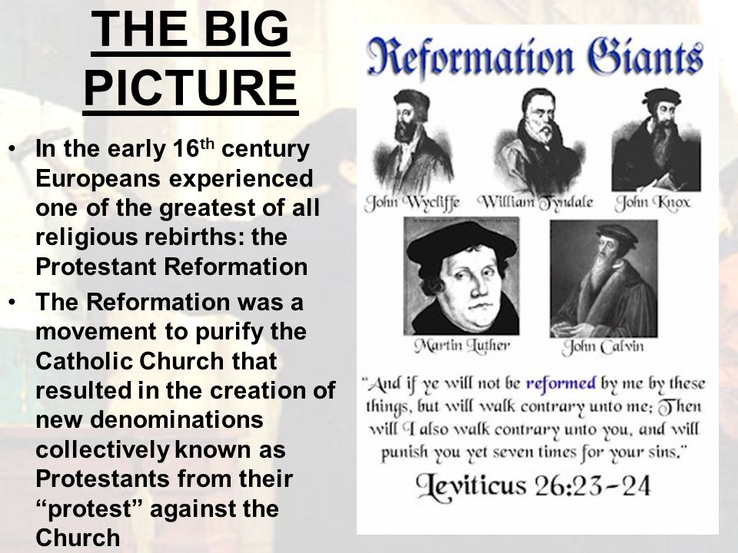

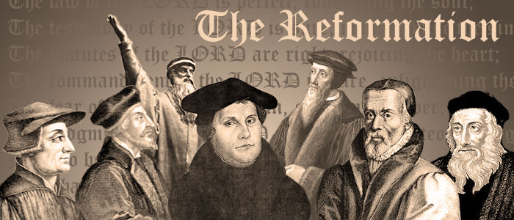
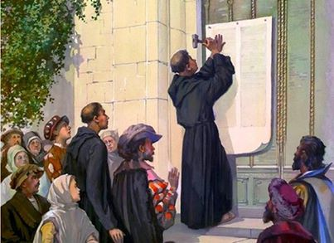
Renaissance understood the human subjectivity as rational capacity. But the reformation stressed it as subjective faith. Both of them are the same in their revolt against medieval mentality that centered on ‘objective reason’ or ‘objective faith’.
1. Crisis of the certainty of salvation
  Lifted up the notion of individual faith & conscience (indulgence)
2. Crisis of the authority of the Church
  Created the possibility for social change
  Caused religious wars in Europe
  Relationship between faith & reason reconsidered.

Slide 5
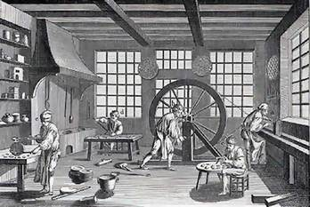
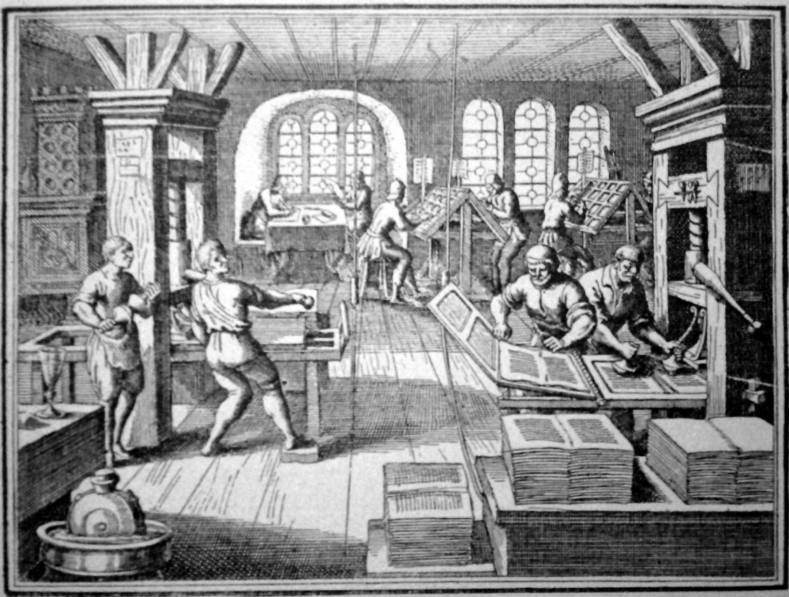
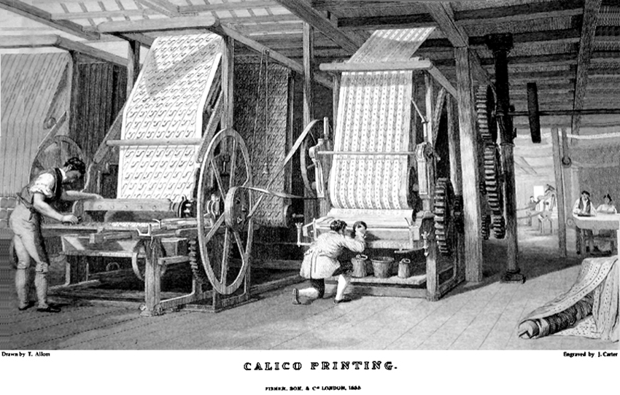
Key concepts of the modernity: “technological progress”, “revolution”, “economic growth”
The Meaning of Modernity
“Moderna” means “new” and “now”. Modern is a temporal orientation to ‘here and now’ [not ‘there and past” of the medieval mentality]
The term relates to the concept of time: linear progress [contrary to cyclical concept of time]

Slide 6
Main keyword
Science
Cosmocentrism
Rationality
Rationalism
Epistemology
Realism
Pantheism
Anthropocentrism
Individualism
Vs. collectivism
Empiricism
Naturalism

Slide 7


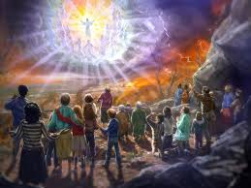
Man as Natural Being
Renaissance culture viewed man as natural being. He doesn’t come from heaven, but grows from earth and is provided with natural talents and vitality.
So, the naked figures in the renaissance’s gallery glorified the natural beauty of man.

Slide 8




Subject as Center of Thought
Descartes
Modern
Philosophy
Critique as
Epistemological
Foundation
Progress as
Concept of time
-I. Kant
G.W.F. Hegel

Slide 9


Modern Philosophy is a philosophy of the subject
As a whole we can view the modern western philosophy as a research program on epistemological and metaphysical problems of consciousness as subject. 2
1. The origin of consciousness (e.g. Descartes and Locke)
2. The Development of consciousness (e.g. Hegel, Kierkegaard, Comte)
3. The Collapse of consciousness (e.g. Schopenhauer, Nietzsche)

Slide 10
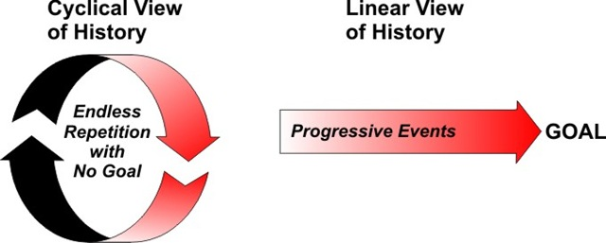
History has a teleological structure
History isn’t arbitrary, but has an end that can be anticipated. The German idealists tried to discover the rational scheme behind the empirical historical events. They believed that the ‘telos’ of history was freedom of man and his society. The civilization process was a way to the human freedom.

Slide 11

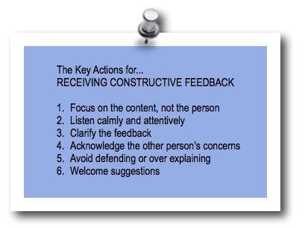


Critique as a central concept
Critique isn’t a mere refusal against something, but a reasonable negation with a complex epistemological conditions. It originates during the rise of modern natural sciences those are very skeptical against the medieval metaphysical thought. Critique is an advocate of the factual.
Critique is a mean of the processes of emancipation; it functions as:
1. Self-reflection of knowledge (critique of knowledge or epistemology)
2. Barrier breaker of ideological manipulations (critique of ideology or enlightenment)
3. Struggle against political injustice (critique of regime or revolution)

Slide 12
The Mainstreams of Modern Philosophy
Rationalism (Descartes, Spinoza, Leibniz, Malebranche, Pascal)
Empiricism (Hobbes, Locke, Berkeley, Hume)
Criticism (Kant)
Idealism (Fichte, Schelling, Hegel, Schoppenhauer)
Materialism (Feuerbach, Marx)
Positivism (Comte, Mach)
Existentialism (Kierkegaard and Nietzsche)

Slide 13
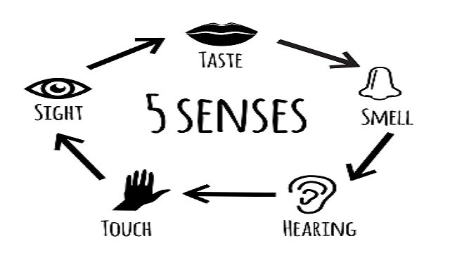



Rationalism
Empiricism
Epistemology
Rationalism: we can have substantive a priori knowledge of how things stand outside the mind.
Empiricism is a theory that states that knowledge comes only or primarily from sensory experience.
Intuition and deduction thus provide us with knowledge a priori, which is to say knowledge gained independently of sense experience.
Empiricism in the philosophy o science emphasizes evidence, especially as discovered in experiment. It is a fundamental part of the scientific method that all hypotheses and theories must be tested against observations of the natural world rather than resting solely on a priori reasoning, intuition, or revelation.
The Innate Knowledge Thesis: We have knowledge of some truths in a particular subject area, S, as part of our rational nature.

Slide 14
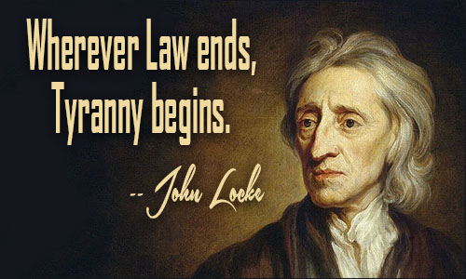
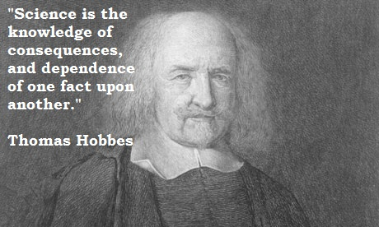
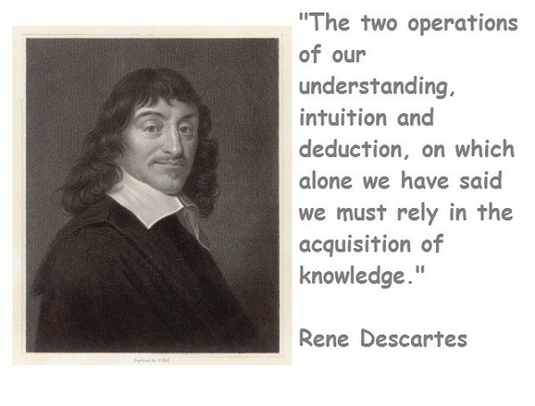

René Descartes (1596-1650)
Discourse on the Method (1637)
Meditations on First Philosophy (1641)
Francis Bacon (1561-1626)
Novum Organum Scientiarum (1620)
New Antlantis (1627)
John Locke (1632-1704)
Essay Concerning Human Understanding (1690)
Thomas Hobbes (1588-1679)
Leviathan (1668)
De cive (1642)

Slide 15
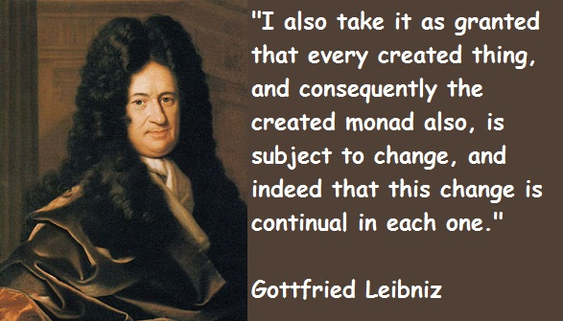
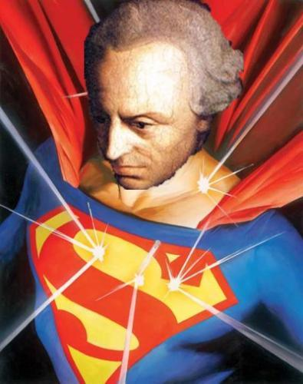
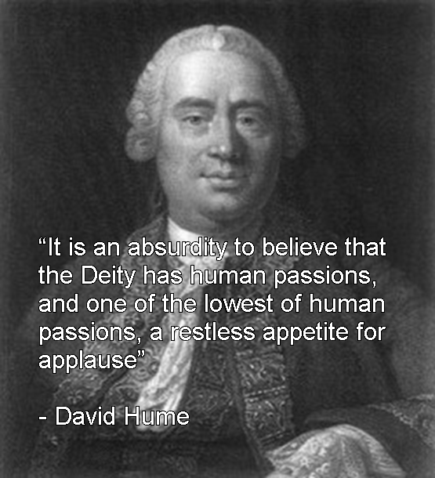
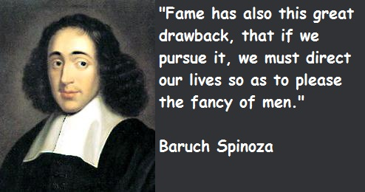
Baruch Spinoza (1632-1677)
Ethics(1677)
Tractatus Theologico-Politicus(1670)
David Hume (1711-1776)
Treatise of Human Nature (1739)
An Enquiry Concerning Human Understanding (1748)
Gottfried Leibniz (1588-1679)
Discourse on Metaphysics (1686)
Monadology (1714)
Immanuel Kant (1724-1804)
Critique of Pure Reason (1781)
Prolegomena to Any Future Metaphysics (1783)

Slide 16
Modern European Philosophy
Rationalism
Descartes (1641)
Empiricism
Spinoza (1665)
Leibniz (1685)
Bacon (1561)
Locke (1689)
Hobbes (1588)
Hume (1739)
Kant

Slide 17
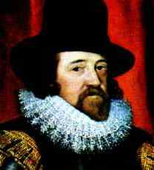
Francis Bacon (1561-1626)
Bacon was a central guiding force to the emerging modern worldview.
Francis Bacon entered Trinity College when he was just 12 years old! 3
Bacon supposedly coined the phrase “knowledge is power.”
Knowledge becomes utilitarian!!!!

Slide 18
Bacon essentially proposed the Modern “Scientific” Method in his book Novum Organum (New Instrument) that to interpret nature one should proceed through inductive reasoning. One should proceed from fact to axiom and then on to physical law.
A disinterested approach by developing a hypothesis to explain an observation and so arrive at a Law of Nature
Basically one should bend over backwards not to accept any preconceived idea.

Slide 19
Natural Philosophy
This simple inductive recipe
fact → axiom → physical law
has had two enormous revolutionary consequences for society:
It resulted in the Science and Technology 4

Slide 20


Hypothesis
Deductive Reasoning
Observation
Confirmation
Top Down approach
Theory
Law
Further Test
Inductive Reasoning
Hypothesis
Bottom up approach
Observation
Bacon’s greatest intellectual contribution was his championing of modern science and the scientific method.

Slide 21



Before beginning this induction, the inquirer is to free his or her mind from certain false notions or tendencies which distort the truth. These are called "Idols" (idola), and are of four kinds:
“Idols” block the acquisition of new knowledge.

Slide 22

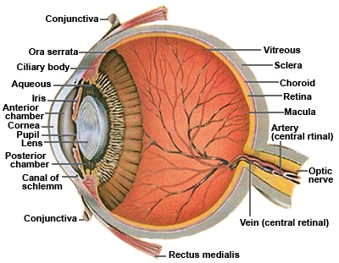


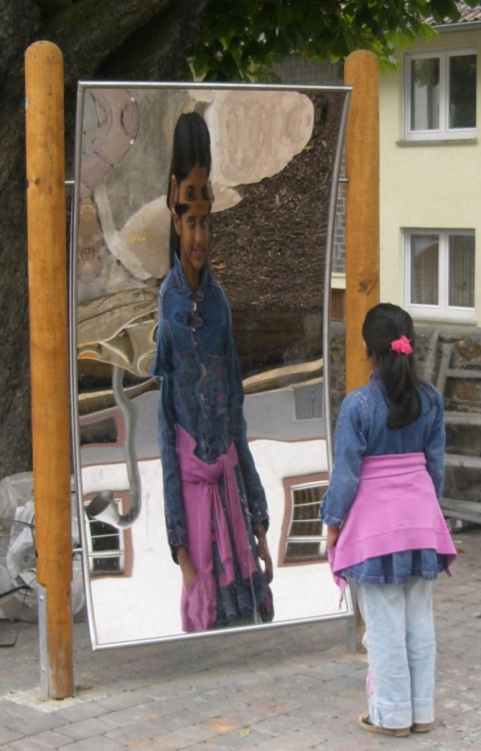

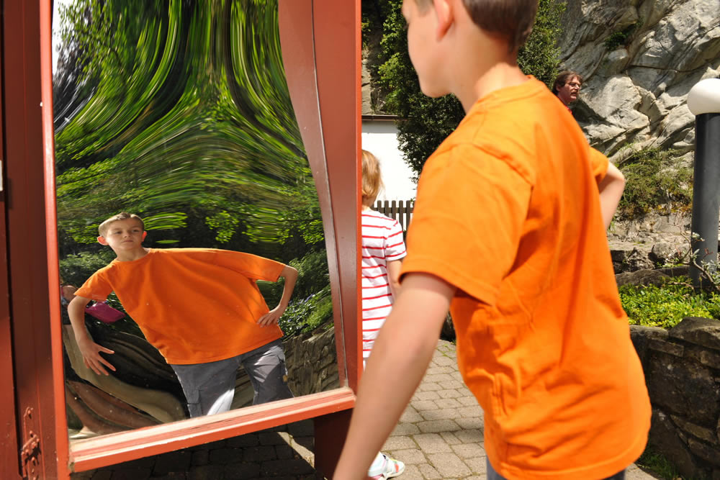


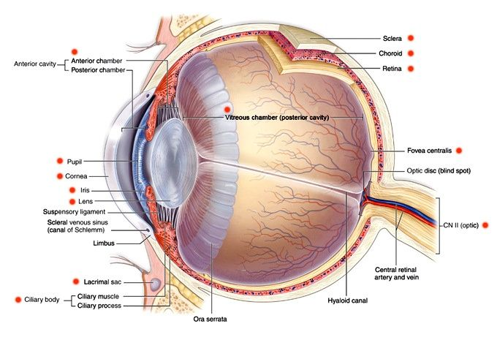
The Five Idols
1-st idol: “Idols of the Tribe” are cultural and anthropological view’s prejudices.
The Idols of the Tribe have their origin in the production of false concepts due to human nature, because the structure of human understanding is like a crooked mirror, which causes distorted reflections (of things in the external world).5

Slide 23

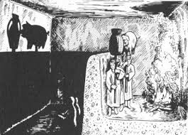
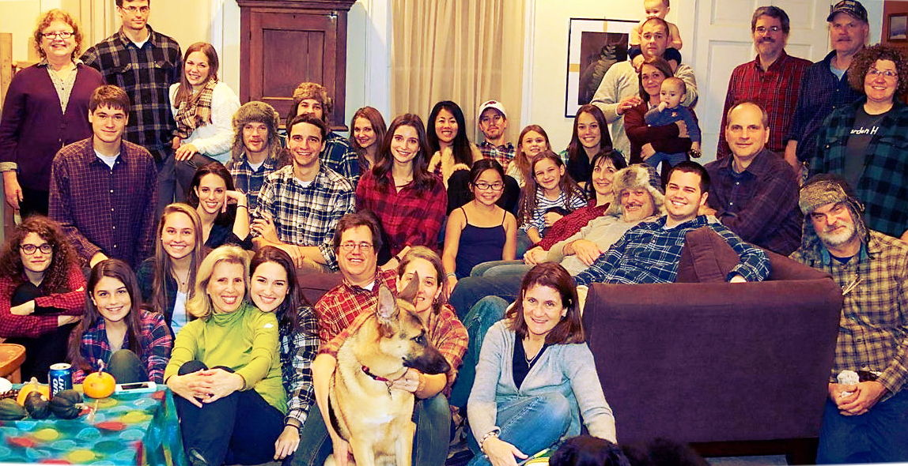
The Five Idols
The Idols of the Cave consist of conceptions or doctrines which are dear to the individual who cherishes them, without possessing any evidence of their truth. These idols are due to the preconditioned system of every individual, comprising education, custom, or accidental or contingent experiences.
2-st idol: “Idols of the Cave” are personal prejudices.

Slide 24




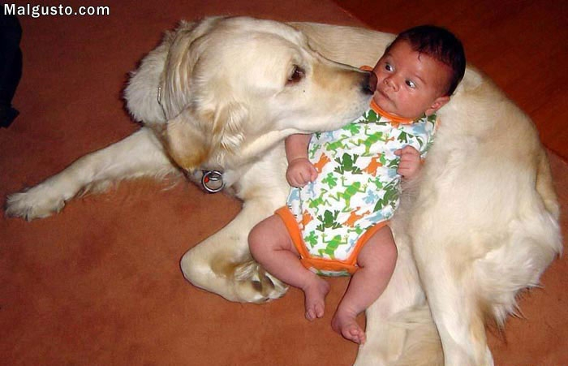
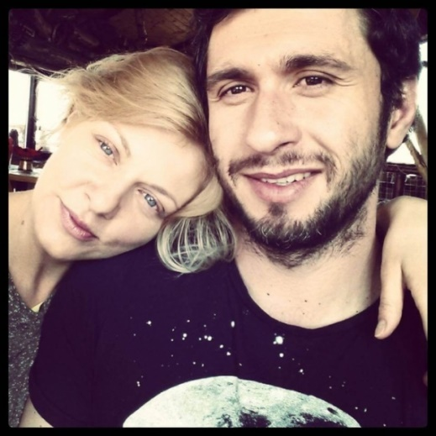

The Five Idols
3-st idol: “Idols of the Market-Place” has to do with the tyranny of language
Social
stereotypes
These idols are based on false conceptions which are derived from public human communication. They enter our minds quietly by a combination of words and names, so that it comes to pass that not only does reason govern words, but words react on our understanding.
Misunderstanding
Gossip
Lies
Linguistic
improvisation

Slide 25
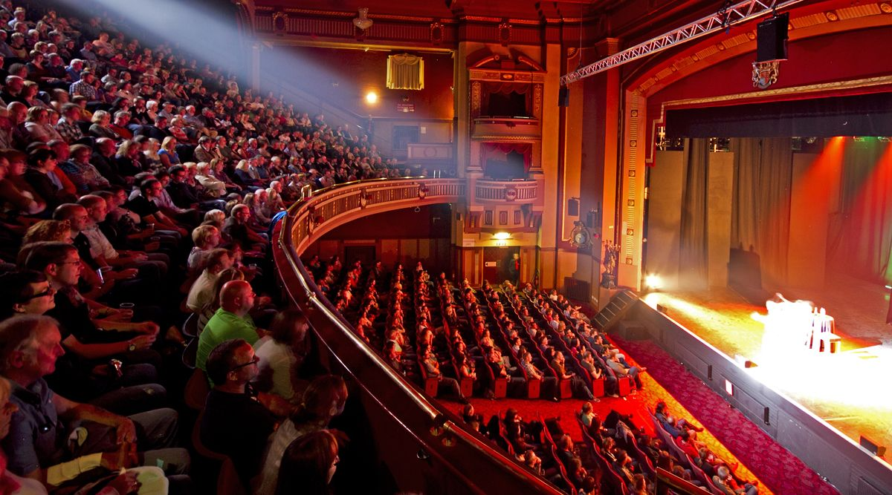
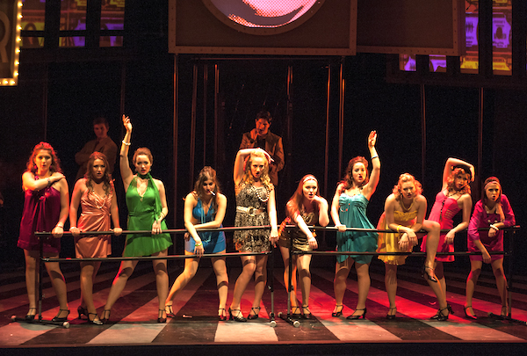



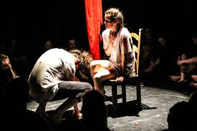
The Five Idols
4-st idol: “Idols of the Theater” has to do with received tradition.
According to the insight that the world is a stage, the Idols of the Theatre are prejudices stemming from received or traditional philosophical systems. These systems resemble plays in so far as they render fictional worlds, which were never exposed to an experimental check or to a test by experience. The idols of the theatre thus have their origin in dogmatic philosophy or in wrong laws of demonstration.

Slide 26
The Five Idols
4-st idol: “Idols of the Theater” has to do with received tradition.
According to the insight that the world is a stage, the Idols of the Theatre are prejudices stemming from received or traditional philosophical systems. These systems resemble plays in so far as they render fictional worlds, which were never exposed to an experimental check or to a test by experience. The idols of the theatre thus have their origin in dogmatic philosophy or in wrong laws of demonstration.

Slide 27



The Five Idols
5th idol: “Idols of the Schools” is a belief in a blind rule of reasoning.
Bacon ends his presentation of the idols in Novum Organum, with the remark that men should abjure and renounce the qualities of idols, “and the understanding [must be] thoroughly freed and cleansed”. He discusses the idols together with the problem of information gained through the senses, which must be corrected by the use of experiments.

Slide 28
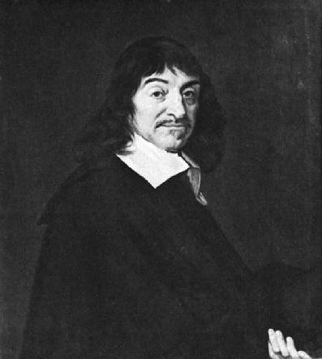
Rene Descartes
(1596-1650)
“Cogito, ergo sum”
(I am think, therefore I am)
6

Slide 29
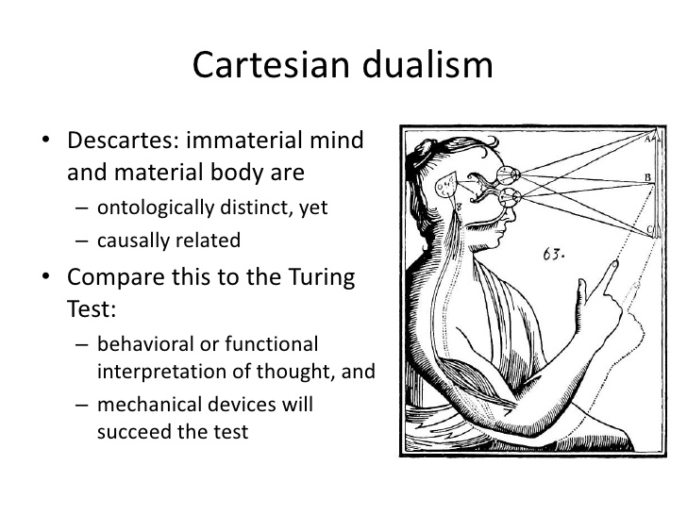

Rene Descartes was–and is–considered the father of modern philosophy. But he was not only a philosopher. He is also a well known French mathematician and scientist.7
Essais philosophiques (Philosophical Essays) which was published in 1637 was one of Rene’s works. This contains four parts: geometry, optics, meteors, and Discours de la mèthode (Discourse on Method). The last topic describes his philosophical speculations. 8

Slide 30

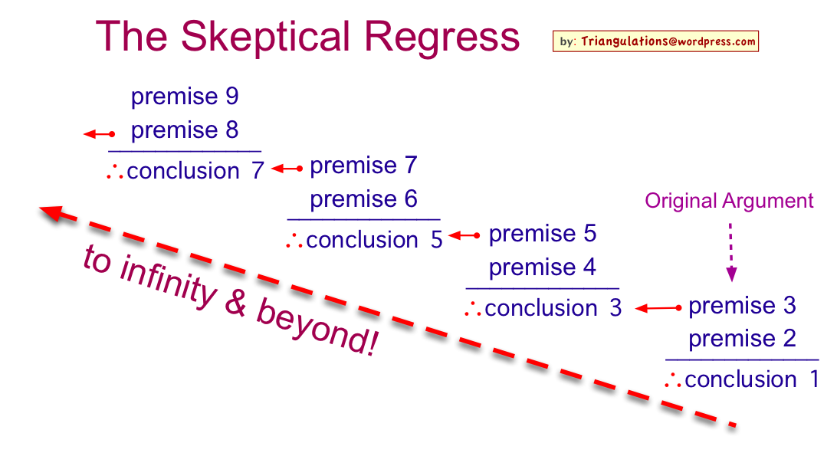
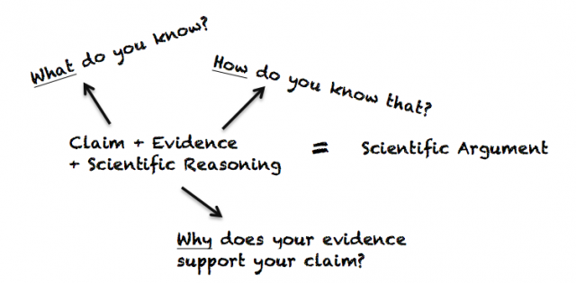
The wider agenda:
to show that we indeed do, as against the claims of skepticism, have knowledge, and that a theory of knowledge need not fall prey to the infinite regress or the circular argument
The ‘narrow’ agenda:
to provide a solid justificatory framework for doing natural science.

Slide 31



Dubito, ergo cogito, ergo sum
"I doubt, therefore I think, therefore I am"
Doubt
Think
I am
Descartes uses the method of what is sometimes called hyperbolic doubt (i.e. exaggerated doubt for a specific purpose); he does not say “doubt everything” or “treat every former opinion as false”, but rather “doubt everything or treat everything as false until proven otherwise”.9

Slide 32
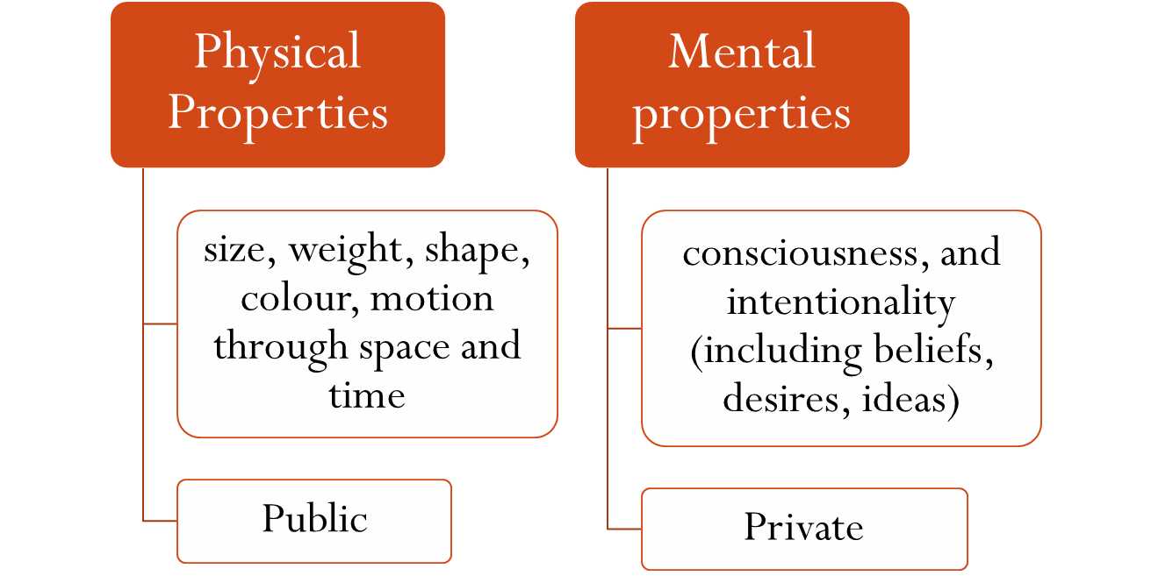
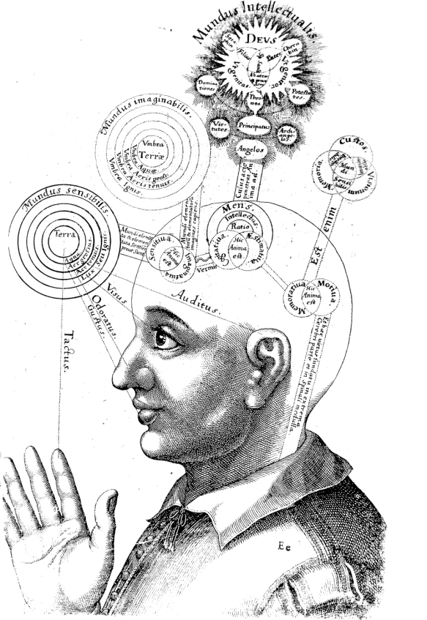

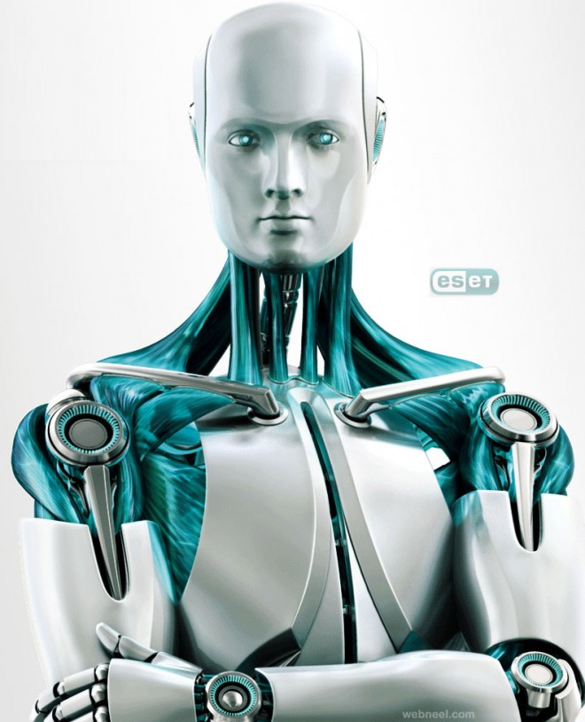

God, according to Descartes's philosophy, created two classes of substance that make up the whole of reality:
Thinking substances,
or minds,
2. extended substances,
or bodies.”

Slide 33









The theory of „Social contract”
The social contract or political contract is a theory or model, originating during the Age of Enlightenment, that typically addresses the questions of the origin of society and the legitimacy of the authority of the state over the individual.
Social contract arguments typically posit that individuals have consented, either explicitly or tacitly, to surrender some of their freedoms and submit to the authority of the ruler or magistrate (or to the decision of a majority), in exchange for protection of their remaining rights.

Slide 34

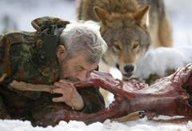

„Social contract”
R o u s s e a u
H o b b e s
The natural state of humanity
„Bellum omnium
contra omnes”
In a “state o nature", human life would be "solitary, poor, nasty, brutish and short". In the absence of political order and law, everyone would have unlimited natural freedoms, including the "right to all things" and thus the freedom to plunder, rape, and murder; there would be an endless "war of all against all"

Slide 35
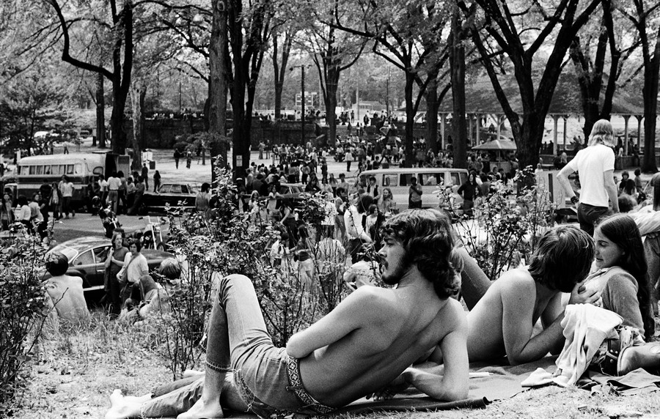
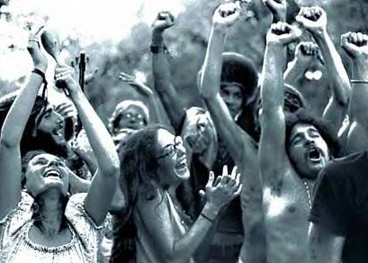


The theory of „Social contract”
R o u s s e a u
H o b b e s
Starea naturală a omului
Om pentru
om este frate
„Bellum omnium
contra omnes”
The central assertion of social contract approaches is that law and political order are not natural, but are instead human creations. The social contract and the political order it creates are simply the means towards an end—the benefit of the individuals involved—and legitimate only to the extent that they fulfill their part of the agreement.

Slide 36
R o u s s e a u
H o b b e s
Social Contract
Rousseau believed that liberty was possible only where there was direct rule by the people as a whole in lawmaking, where popular sovereignty was indivisible and inalienable. But he also maintained that the people often did not know their "real will", and that a proper society would not occur until a great leader ("the Legislator") arose to change the values and customs of the people, likely through the strategic use of religion.
To avoid war, free men contract with each other to establish political community, i.e. civil society, through a social contract in which they all gain security in return for subjecting themselves to an absolute sovereign, one man or an assembly of men. Though the sovereign's edicts may well be arbitrary and tyrannical, the only alternative to the terrifying anarchy of a state of nature.

