Slide 1
The Nature of Approaches and Methods in Language Teaching
Oxana Creanga

Slide 2
Approach vs. Method
The improvement of the quality of language teaching is based on general principles and theories concerning:
  how languages are learned,
  how knowledge of language is represented and organized in memory,
  how language itself is structured.
  Methods are described based on the difference between a philosophy of language teaching at the level of theory and principles and a set of derived procedures for teaching a language.

Slide 3
Approach vs. Method
  An approach is a set of correlative assumptions dealing with the nature of lge teaching and lge learning. It describes the nature of the subject matter to be taught ... .
  Method is an overall plan for the orderly presentation of language material, no part of which contradicts, and all of which is based upon, the selected approach. An approach is axiomatic, a method is procedural. Within one approach, there can be many methods ... .
  A technique is implementational - that which actually takes place in a classroom. It is a particular trick, stratagem (/ˈstrætədʒəm/ planned way), or contrivance (/kənˈtraɪvəns/) used to attain an immediate objective. Techniques must be consistent with a method, and therefore in harmony with an approach as well (Richards and Rodgers, p.15) .

Slide 4
Approach vs. Method
Match the concepts with their corresponding definitions:
Approach
the level at which theory is put into practice and at which choices are made about the particular skills to be taught, the content to be taught, and the order in which the content will be presented
the level at which classroom procedures are described, the actual moment-to-moment classroom steps that lead to a specified outcome
Method
Technique
the level at which assumptions and beliefs about language and language learning are specified

Slide 5
Approach vs. Method
Match the concepts with their corresponding definitions:
Approach
the level at which theory is put into practice and at which choices are made about the particular skills to be taught, the content to be taught, and the order in which the content will be presented
Method
the level at which classroom procedures are described, the actual moment-to-moment classroom steps that lead to a specified outcome
Technique
the level at which assumptions and beliefs about language and language learning are specified

Slide 6

Method
“A language teaching method is a single set of procedures which teachers are to follow in the classroom. Methods are usually based on a set of beliefs about the nature of language and learning.”
Nunan, D. Practical English Language Teaching New York: McGraw-Hill, p.5.

Slide 7
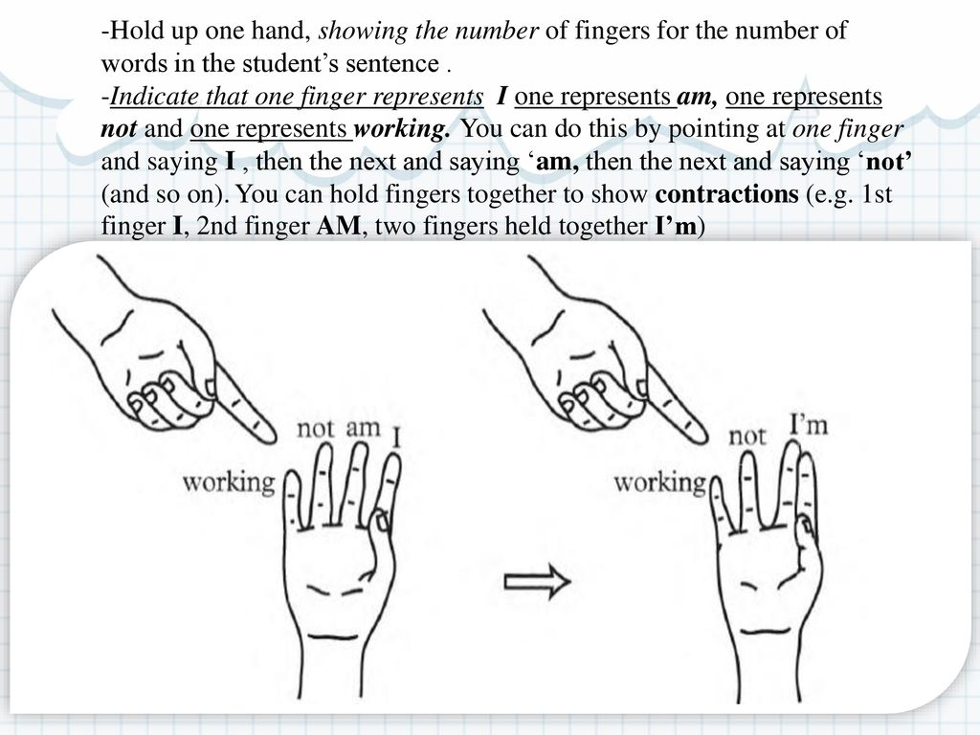
Method, Procedure, and Technique
A procedure - an ordered set of techniques, the step-by-step measures to execute a method.
  can be described in terms such as first you do this, then you do that....
  is “smaller than a method and larger than a technique.” (J. Harmer, p. 78, 2001)
  E.g. In the grammar-translation method, the procedure starts by explaining the grammar rules and exemplifying these rules through sentences that the students then had to translate into their mother tongue.
Examples of techniques:
  - silent viewing - the teacher plays the video with no sound;
  - finger technique is used by some teachers who hold up their hands and give each of their five fingers a word, e.g. He is not playing tennis, and then by bringing the is and the not fingers together, show how the verb is contracted into isn't;
  - elicitation - a technique by which the teacher gets the learners to give information rather than giving it to them.

Slide 8
Theoretically related to an approach
Organizationally determined by a design
Method
Practically realized in a procedure (implementation phase)

Slide 9
Design - the level in which objectives, syllabus, and content are determined, and in which the roles of teachers, learners, and instructional materials are specified.

Slide 10
Linguistic Aspects of Approach
Different theoretical views of language that inform current approaches and methods in language teaching:
The structural view - language is a system of structurally related elements for the coding of meaning. The target of language learning is the mastery of elements of this system, generally defined in terms of:
  phonological units (e.g., phonemes),
  grammatical units (e.g., clauses, phrases, sentences),
  grammatical operations (e.g., adding, shifting, joining, or transforming elements),
  lexical items (e.g., function words and structure words).
  Methods that embody this view of language: Audiolingual Method, Total Physical Response, and the Silent Way.

Slide 11
Linguistic Aspects of Approach
  2. The functional view - language is a vehicle for the expression of functional meaning. This theory emphasizes the semantic and communicative dimension rather than purely the grammatical characteristics of language, and leads to a specification and organization of language teaching content by categories of meaning and function rather than by elements of structure and grammar. Functional models of language are linked to the concept of communicative competence - knowing how language is used to achieve different kinds of communicative purposes.
  Methods that embody this view of language: the English for specific purposes movement, Communicative Approach, Action-Oriented Approach.

Slide 12
A language function refers to what students do with language as they engage with content and interact with others.
  Functions represent the active use of language for a specific purpose.
  Students use language functions in order to express ideas, communicate with others, and show understanding of content in an academic setting.
  Examples of functions:
    1. Introducing self and other people
    2. Exchanging personal information
    3. Asking how to spell someone's name
    4. Giving commands
    5. Apologizing and thanking
    6. Identifying and describing people
    7. Asking for information

Slide 13
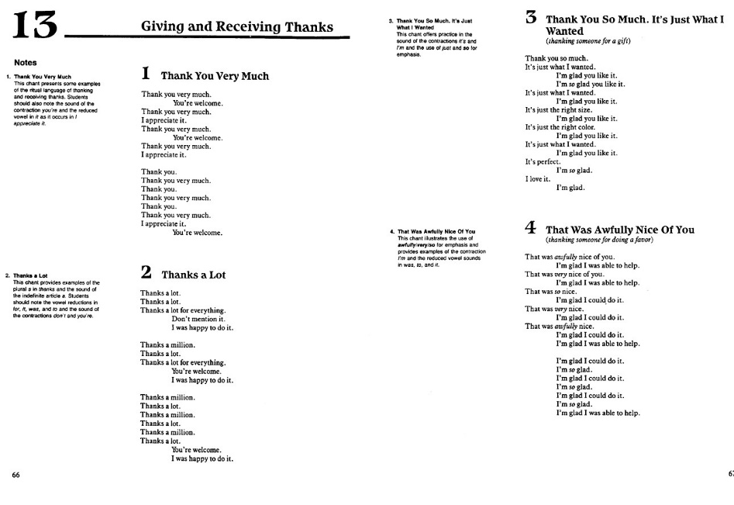


Slide 14
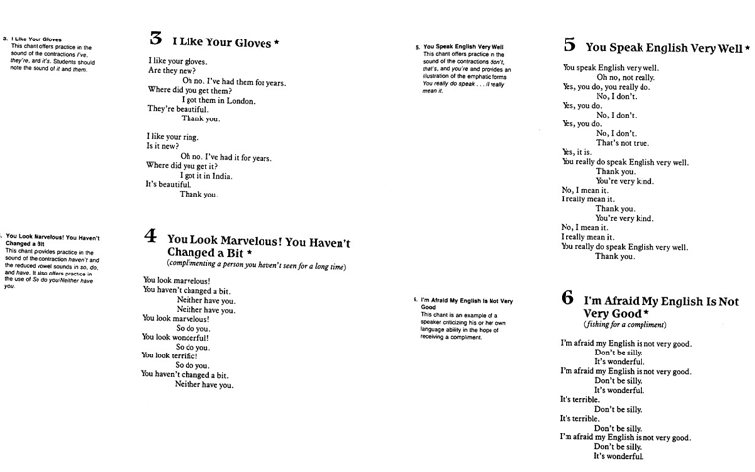
https://www.youtube.com/watch?v=81ENxuXrhWs

Slide 15
Linguistic Aspects of Approach
  3. The interactional view - language is seen as a vehicle for the realization of interpersonal relations and for the performance of social transactions between individuals. Language is seen as a tool for the creation and maintenance of social relations.
  Interactional theories focus on the patterns of speech acts, negotiation, and interaction found in conversational exchanges. Language teaching content, according to this view, may be specified and organized by patterns of exchange and interaction or may be left unspecified, shaped by the inclinations of learners as interactors.
  Methods that embody this view of language: TBLT, Community Language Learning

Slide 16
Linguistic Aspects of Approach
  4. Sociocultural model
  Language is viewed as a communicative activity in which the social context is central. Knowledge is constructed through social interaction with others and reflects the learner's culture, customs, and beliefs as well as the collaborative activities people are engaged in.
  Methods that embody this view of language: TBLT, Content-Based Instruction, and Cooperative Language Learning.

Slide 17
Linguistic Aspects of Approach
  5. The lexical view of language
  It prioritizes the role of lexis and lexical chunks or phrases in language and highlights the interrelatedness of grammar and vocabulary. Lexis and grammar are not viewed as discrete, but as being intrinsically related.
  Drawing on the findings of corpus studies, advocates of lexical models of language suggest that grammatical competence arises out of phrase- and lexically-based learning and argue for a greater role for vocabulary as well as lexical phrases and chunks in language teaching.
  This view is reflected most directly in the Lexical Approach, also compatible with aspects of Content-Based Instruction and CLIL (Content and Language Integrated Learning).

Slide 18

Psycholinguistic Aspects of Approach – Theories of Language Learning
A learning theory underlying an approach relies on 2 aspects:
The psycholinguistic and cognitive processes involved in language learning - process-oriented theories:
      habit formation,
      induction,
      inferencing,
      hypothesis testing,
      generalization.
The conditions that need to be met in order for these learning processes to be activated - condition-oriented theories - emphasize the nature of the human and physical context in which language learning takes place: Counseling-Learning and the Silent Way.

Slide 19

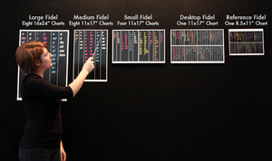
Psycholinguistic Aspects of Approach – Theories of Language Learning
Examples:
James Asher's Total Physical Response (TPR) method is rooted in learning theory rather than a theory of language itself.
TPR emphasizes the role of motor activity and coordinating language with physical actions in language learning.
According to James Asher, using physical actions and body movement to coordinate language production and comprehension is believed to create favorable conditions for successful language learning.
Caleb Gattegno's Silent Way method focuses on creating conditions for successful learning, including learners' confidence and conscious control of their learning process.
Techniques in the Silent Way method aim to train learners to use their intelligence effectively for enhanced learning.

Slide 20
Theories of Language Learning
Stephen D. Krashen's Monitor Model of second language development (1981)
At the level of process, Krashen distinguishes between acquisition and learning.
  Acquisition refers to the natural assimilation of language rules through using language for communication.
  Learning refers to the formal study of language rules and is a conscious process.

Slide 21
Theories of Language Learning
According to Krashen, learning is available only as a "monitor." The monitor is the repository of conscious grammatical knowledge about a language that is learned through formal instruction and that is called upon in the editing of utterances produced through the acquired system.
In Krashen's theory, the conditions necessary for the process of "acquisition" are described in terms of the type of "input" the learner receives, which must be:
  comprehensible,
  slightly above the learner's present level of competence,
  interesting or relevant,
  not grammatically sequenced,
  in sufficient quantity,
  experienced in low-anxiety contexts.
Tracy D. Terrell's Natural Approach, James Asher's Total Physical Response addresses both the process and conditions of language learning.

Slide 22
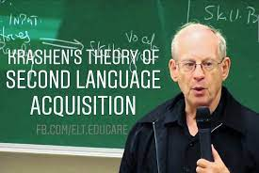
The Affective Filter Hypothesis
  Definition: The Affective Filter Hypothesis, proposed by Krashen, views a learner's emotional state as a variable filter affecting language acquisition.
Low Affective Filter: A low affective filter is preferable as it allows necessary input for language acquisition to flow freely, with minimal hindrance.
Three Affective Variables: Research in second language acquisition identifies three affective or attitudinal variables:
  Motivation: High motivation generally leads to better language learning outcomes.
  Self-Confidence: Learners with self-confidence and a positive self-image tend to be more successful.
  Anxiety: Low personal and classroom anxiety promotes second language acquisition.

Slide 23
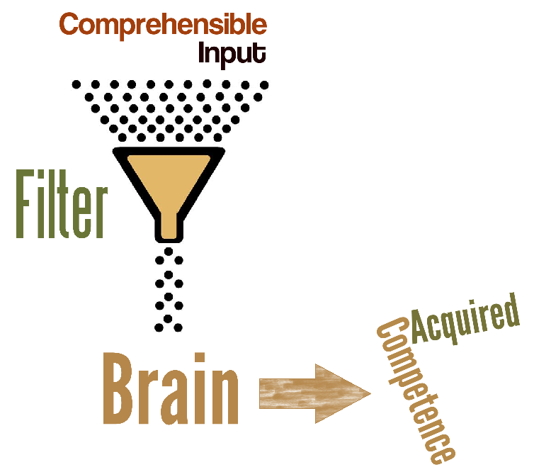
The Affective Filter Hypothesis
Impact of Affective Filter:
  Learners with a low affective filter actively seek and receive more input, interact confidently, and are receptive to the input they receive.
  In contrast, anxious learners have a high affective filter, hindering the acquisition process.
Developmental Aspect: The affective filter, which includes emotions like fear or embarrassment, tends to rise during early adolescence. This may explain why children often appear to have an advantage in acquiring a second language compared to older learners.

Slide 24
Pairings of language theory and learning theory
Structuralism
Behaviorism (a way of forming and developing speech habits by a multiple mechanical repetition of a reaction to a stimulus.
Audiolingualism
Cognitive Code Learning
With a finite number of grammatical rules and a limited vocabulary, we can create an infinite number of sentences.
It values the use of rules as helpful shortcuts in learning, especially when linked to prior knowledge.
It emphasizes active engagement, conscious thinking, and discussion as essential components of language learning, promoting it as an intelligent, rule-seeking, and problem-solving process.
Chomsky’s theory of Transformational Generative Grammar (language is rule-governed and creative)
Mentalist approach to acquisition

Slide 25
Design - links the theory with the method
Design is the level of method analysis consisting of:
  (a) the objectives of a method;
  (b) the way language content is selected and organized within the method, i.e. the syllabus model the method it incorporates;
  (c) the types of learning tasks and teaching activities the method advocates;
  (d) the roles of learners;
  (e) the roles of teachers;
  (f) the role of instructional materials.

Slide 26
Objectives
- what a method sets out to achieve
The specification of particular learning objectives depends on the method.
Examples of objectives:
  to teach oral skills first, followed by reading and writing skills regarded as secondary and derived from transfer of oral skills;
  to teach general communication skills giving greater priority to the ability to express oneself meaningfully and to make oneself understood (product-oriented objectives);
  to teach accurate grammar and pronunciation from the very beginning (linguistically oriented objectives);
  to teach the basic grammar and vocabulary of a language (linguistically oriented objectives);
The types of objectives determine the degree of emphasis placed on vocabulary acquisition and grammatical proficiency and the way grammatical or pronunciation errors are treated in the method.

Slide 27
The Syllabus
- decisions about the choice of language content (words, patterns, tenses, constructions, functions, topics, etc.), i.e. subject matter (ESP courses) and linguistic matter (Audiolingual Method, Grammar Translation).
  Content issues involve the principles of item selection and the instructional materials to be used,
  Sequencing and gradation principles.
  E.g. in grammar-based courses matters of sequencing and gradation are determined according to the difficulty of items or their frequency. In communicative or functionally oriented courses (e.g., in ESP programs) sequencing may be according to the learners' communicative needs.
Audiolingual, structural-situational methods
A list of grammatical items and constructions often with an associated list of vocabulary items.
Notional-functional syllabuses
Specify the communicative content of a course in terms of functions, notions, topics, grammar, and vocabulary.

Slide 28

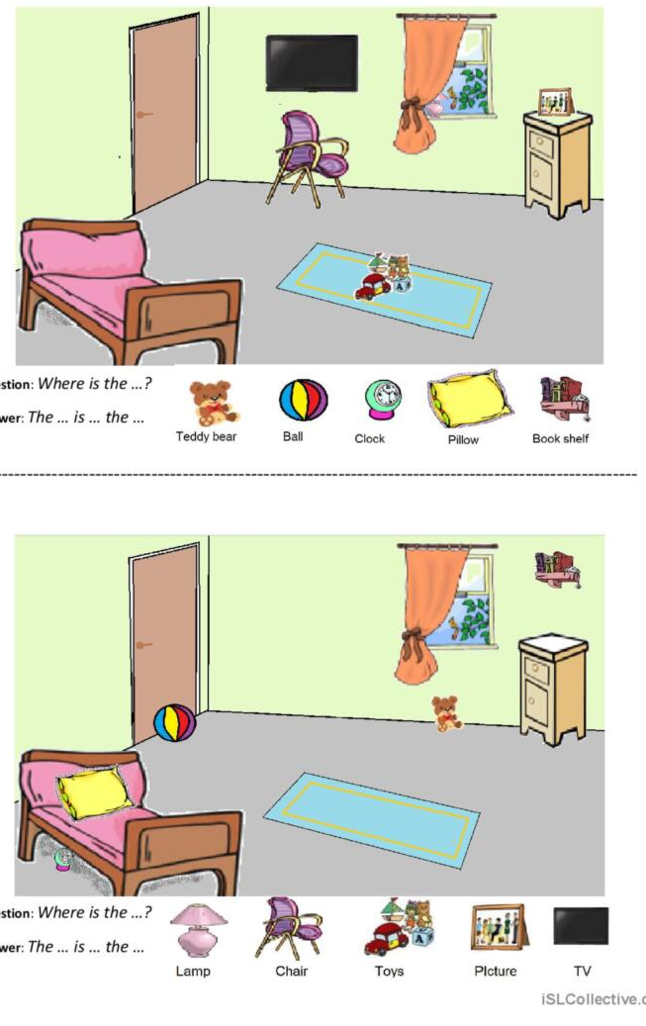
Types of learning and teaching activities
The objectives of a method are attained through the instructional process - the organized and directed interaction of teachers, learners, and materials in the classroom.
The activity types that a method advocates often serve to distinguish methods.
    dialogue and pattern practice/drills (Audiolingualism);
    problem-solving activities that involve the use of special charts and colored rods (The Silent Way).
    tasks that involve an "information gap" and "information transfer"; i.e., learners work on the same task, but each learner has different information needed to complete the task (CLT).
    responding to commands (Total Physical Response)
Differences in activity types in methods may also involve different arrangements and groupings of learners, e.g.:
  oral chorus drilling
  problem-solving/ information-exchange activities pair work.

Slide 29
Learner roles
how learners are regarded, learners' contribution to the learning process reflected in:
  the types of activities learners carry out,
  the degree of control learners have over the content of learning,
  the patterns of learner groupings adopted,
  the degree to which learners influence the learning of others
  the view of the learner as processor, performer, initiator, problem solver.
E. g.:
Audiolingualism - very limited roles available to learners, learners were seen as stimulus-response mechanisms whose learning was a direct result of repetitive practice.

Slide 30
Learner roles
E.g.: Individualized approach to language learning (Johnson and Paulston)
  (a) Learners plan their own learning program and thus ultimately assume responsibility for what they do in the classroom.
  (b) Learners monitor and evaluate their own progress.
  (c) Learners are members of a group and learn by interacting with others.
  (d) Learners tutor other learners.
  (e) Learners learn from the teacher, from other students, and from other teaching sources.
Counseling-Learning - learners as having roles that change developmentally through five stages, extending from total dependency on the teacher in stage 1 to total independence in stage 5.

Slide 31
Teacher roles
Teacher roles in methods are related to the following Issues:
  the types of functions teachers are expected to fulfill, i.e. that of practice director, counselor, or model;
  the degree of control the teacher has over how learning takes place;
  the degree to which the teacher is responsible for determining the content of what is taught;
  the interactional patterns that develop between teachers and learners.

Slide 32
Teacher roles
Teacher roles
Less teacher-directed learning methods: teacher as a catalyst, consultant, model-provider for learning
e.g. The Silent Way, Suggestopedia, Counseling-Learning
Teacher-dependent methods - the teacher is regarded as the primary source of language and of language learning
e.g. Audiolingual Method

Slide 33
Instructional materials
- specify subject matter content, define or imply the day-to-day learning objectives that constitute the goals of the syllabus.
Instructional materials reflect decisions concerning:
the primary goal of materials | to present content, to practise content, to facilitate communication between learners, or to enable learners to practise content without the teacher's help
the form of materials | textbook, audiovisuals, computer software
the relation of materials to other sources of input | whether materials serve as the major source of input or only as a minor component of it
the abilities of teachers | teachers’ competence in the language or degree of training and experience

Slide 34
Instructional materials
Example:
In CLT materials:
  will focus on the communicative abilities of interpretation, expression, and negotiation;
  will focus on understandable, relevant, and interesting exchanges of information, rather than on the presentation of grammatical form;
  will involve different kinds of texts & different media, which the learners can use to develop their competences through a variety of different activities and tasks.

Slide 35
Procedure
- the actual moment-to-moment techniques, practices, and behaviors that operate in teaching a language according to a particular method.
- determines the way tasks and activities advocated by a certain method are integrated into lessons and used as the basis for teaching and learning.
There are three dimensions to a method at the level of procedure:
Procedure focuses on the way a method handles the presentation, practice, and feedback phases of teaching.
(a) the use of teaching activities (drills, dialogues, information-gap activities, etc.) to present new language and to clarify and demonstrate formal, communicative, or other aspects of the target language;
(b) the ways in which particular teaching activities are used for practising language;
(c) the procedures and techniques used in giving feedback to learners concerning the form or content of their utterancees.

Slide 36
Example of a procedure within the notional-functional approach
    Presentation of a brief dialogue or several mini-dialogues.
    Oral practice of each utterance in the dialogue.
    Questions and answers based on the topic and situation in the dialogue.
    Questions and answers related to the student's personal experience but centered on the theme of the dialogue.
    Study of the basic communicative expressions used in the dialogue or one of the structures that exemplify the function.
    Learner discovery of generalizations or rules underlying the functional expression of structure.
    Oral recognition, interpretative procedures.
    Production activities, proceeding from guided to freer communication.

Slide 37
Method
Approach
Design
Procedure
a) The theory of lge
- an account of the nature of the lge proficiency
- an account of the basic units of lge structure
b) The theory of nature of lge learning
- an account of the psycholinguistic and cognitive processes involved in lge learning
- an account of the conditions that allow for the successful use of these processes.
a) Classroom techniques, practices, and behaviours observed when the method is used
- resources in terms of time, space, and equipment used by the teacher
- interactional patterns observed in lessons
- tactics and strategies used by the teachers and learners when the method is used
a) General and specific objectives of the method
b) A syllabus model
- criteria for the selection and organization of linguistic/subject-matter content
c) Types of learning and teaching activities
- kinds of tasks and practice activities to be employed in the classroom
d) Learner roles
- types of learning tasks set for learners
- degree of control learners have over the content of learning
- patterns of learner groupings that are recommended or implied
- degree to which learners influence the learning of others
- the view of the learner as a processor, performer, initiator, problem solver, etc.
e) Teacher roles
- types of functions teachers fulfill
- degree of teacher influence over learning
- degree to which the teacher determines the content of learning
- types of interactions between teacher and learners
f) The role of instructional materials
- primary function of materials
- the form materials take
- relation of materials to other input
- assumptions made about teachers and learners

Slide 38
 | Theory of language | Theory of learning | Objectives | Syllabus | Activity type | Learner role | Teacher role | Roles of materials
Audiolingual | Language is a system of rule-governed structures hierarchically arranged. | Habit formation, skills are learned better if oral precedes written | Control of structures of sound, form, order, mastery over symbols of the language, native-speaker mastery | Graded syllabus of phonology, morphology and syntax. Contrastive analysis. | Dialogues and drills, repetition and memorization, pattern practice. | Organisms that can be directed by skilled training techniques to produce correct responses | Central and active teacher-dominated method. Provides model, control direction and pace | Primarily teacher-oriented, tapes and visuals, language labs.
TPR | Basically structuralist, grammar-based view of the lge. | L2 learning is the same as L1 learning, comprehension before production is imprinted through carrying out commands, right-brain functioning, reduction of stress | Teach oral proficiency, to produce learners who can communicate uninhibitedly and intelligibly with native speakers | Sentence-based syllabus with grammatical and lexica criteria being primary, focus on meaning not form. | Imperative drills to elicit physical actions | Listener and performer, little influence over the content of learning | Active and direct role, “the director of a stage play” with students as actors | No basic text, materials and media have an important role later. Initially voice, actions and gestures are sufficient.
Community Language Learning | Lge is more than the system for communication. It involves the whole person, culture, education, developmental communicative processes. | Learning involves the whole person. It is a social process of growth from child-like dependence to self-direction and independence | No specific objectives. Near native mastery is the goal. | No set syllabus. Course progression is topic-based. Learners provide the topic. It emerges from learners’ intention and the teacher’s reformulations. | Combination of innovative and conventional. Translation, group work, recording, transcription, reflection, observation, free translation. | Learners are members of a community. Learning is not viewed as individual accomplishment, but as sth achieved collaboratively. | Counselling/ parental analogy. Teacher provides a safe environment in which students can learn and grow. | No textbooks which would inhibit learning. Materials are developed as course progresses.

Slide 39
 | Theory of language | Theory of learning | Objectives | Syllabus | Activity type | Learner role | Teacher role | Roles of materials
The Silent Way | Each language is composed of elements that give it a unique rhythm and spirit. Functional vocabulary and core structure are key to the spirit of the language | Processes of learning a second language are fundamentally different from L1 learning. L2 learning is an intellectual, cognitive process. Surrender to the music of the lge, silent awareness then active trial. | Near-native fluency, correct pronunciation, basic les practical knowledge of the grammar of the L2. Learner learns how to learn a language. | Basically structural lessons planned around grammatical items and related vocabulary. Items are introduced according to their grammatical complexity. | Learner responses to commands, questions, and visual cues. Activities encourage and shape oral responses without grammatical explanation or modeling by teacher. | Learning is a process of personal growth. Learners are responsible for their own learning and must develop independence, autonomy, and responsibility. | Teachers must (a) teach (b) test (c) get out of the way. Remain impassive. Resist temptation to model, remodel, assist, direct, exhort. | Unique materials: colored rods, color-coded pronunciation and vocabulary charts.
The Natural Approach | The essence of language is meaning. Vocabulary, not grammar, is the heart of language. | There are two ways of L2 language development: "acquisition"-a natural subconscious process, and "learning"-a conscious process. Learning cannot lead to acquisition. | Designed to give beginners and intermediate learners basic communicative skills. Basic personal communicative skills (oral/written); academic learning skills (oral/written). | Based on selection of communicative activities and topics derived from learner needs. | Activities allowing comprehensible input, about things in the here-and- now. Focus on meaning, not form. | Should not try to learn but language in the usual sense, but should try to lose themselves in activities involving meaningful communication. | The teacher is the primary source of comprehensible input. Must create positive low-anxiety climate. Must choose and orchestrate a rich mixture of classroom activities. | Materials come from realia rather than text- books. Primary aim is to promote comprehension and communication.

Slide 40
 | Theory of language | Theory of learning | Objectives | Syllabus | Activity type | Learner role | Teacher role | Roles of materials
Suggestopedia | Rather conventional, although memorization of whole meaningful texts is recommended. | Learning occurs through suggestion, when learners are in a deeply relaxed state. Baroque music is used to induce this state. | To deliver advanced conversational competence quickly. Learners are required to master long lists of vocabulary pairs, although the goal is understanding, not memorization. | The unit courses consisting of 1,200-word dialogues graded by vocabulary and grammar. | Listening exercises under deep relaxation, questions and answers, role-play. | Must maintain a passive state and allow the materials to work on them (rather than vice versa). | To create situations in which the learner is most suggestible and present material in a way most likely to encourage positive reception and retention. Must exude authority and confidence. | Consists of texts, tapes, most classroom fixtures, and music. Texts should have force, literary quality, and interesting characters.
Communicative Language Teaching | Language is a system for the expression of meaning; primary function-interaction and communication. | Activities involving real communication; carrying out meaningful tasks; and using language which is meaningful to the learner promote learning. | Objectives will reflect the needs of the learner; they will include functional skills as well as linguistic objectives. | Will include some/all of the following: structures, functions, notions, themes, tasks. Ordering will be guided by learner needs. | Functional communication activities (comparing sets of pictures and noting similarities and differences; ordering the sequence of events; discovering missing features in a map or picture; following directions; solving problems. Social interaction activities: conversation, discussion dialogues and role plays, simulations, debates. | Learner as negotiator, interactor. | Facilitator of the communication process, participants' tasks, and texts; needs analyst, counselor, process manager. | Primary role in promoting communicative language use; task-based materials; authentic.

Slide 41

References
BROWN, H. D. Teaching by Principles: An Interactive Approach to Language Pedagogy. Longman, 2015.
BURDENIUC, G., ROTARU S. Methodology Basics of Teaching English as a Foreign Language. Chisinau: Arc, 2014.
CELCE-MURCIA, M. Teaching English as a Second or Foreign Language. 3^{rd/} 4th edition, Massachusetts: Heinle & Heinle Thomson Learning, 1979. 533p.
Harmer, Jeremy. The Practice of English Language Teaching: Buch. Harlow: Pearson/Longman, 2015.
Larsen-Freeman D. Techniques and Principles in Language Teaching. Second Edition. Oxford University Press, 2000. 189.
RICHARDS, J. C., RODGERS, T. S. Approaches and Methods in Language Teaching. Third Edition. Cambridge: Cambridge University Press, 2014.

