Slide 1
Using verbs correctly.1
PhD Dorina Macovei

Slide 2
Using Verbs Correctly
The Verb Tenses
Using Verb Moods

Slide 3
What are VERBS?
Verbs are words that name an action or describe a state of being.
There are four basic types of verbs:
action verbs, linking verbs, auxiliary verbs, and verb phrases.
Verbs also convey information through changes in their form. Here are the five things that can be found out from a verb:
Tense (when the action takes place: past, present, or future)
Person (who or what experiences the action)
Number (how many subjects act or receive the action)
Mood (the attitude expressed toward the action)
Voice (whether the subject acts or is acted upon: the active or passive voice)

Slide 4
Using Verb Moods
The grammatical mood conveys the speaker’s attitude about the state of being of what the sentence describes.
There major moods in English:
the indicative mood is used to make factual statements or ask questions,
the imperative mood - to express a request or command,
(3) the conditional mood - to express a proposition whose validity is dependent on some condition
(4) the (rarely used) subjunctive mood - to show a wish, doubt, or anything else contrary to fact.

Slide 5
The Indicative Mood
The Indicative Mood regards the action as actually occurring in reality, as a matter of fact. The indicative mood is the most common and is used to express facts and opinions or to make inquiries.
E.g. Coal mining is a major industry of Appalachia.
We still need someone to buy ingredients for our lunch.
Do you know where the old man lives?
Has the train arrived?
2. The Imperative Mood states requests, orders, and strong suggestions. The imperative is identical in form to the second person indicative.
E.g. Go there now!
Do not postpone this any longer!

Slide 6
The Subjunctive Mood
expresses desires, wishes, and assumptions (presupunere) that are not necessarily to be fulfilled in reality.
rarely appears in everyday conversation or writing and is used in a set of specific circumstances.
allows speakers to form sentences that express commands, requests, suggestions, wishes, hypotheses, purposes, doubts, and suppositions that are contrary to fact at the time of the utterance.
has a limited role in English compared to other languages such as French or Italian, but it's important to use it properly in formal writing.
I demand that she leave at once!

Slide 7
HOW IS IT FORMED?
The subjunctive form of a verb (apart from to be) is made from the 3rd person present singular, without the -s (or -es) ending. With these verbs, the same forms are used whether or not the context is the present or the past.
It is essential that every child have the same educational opportunities.
We felt it was important that James write to Uncle James.
The subjunctive of to be is simply be in most cases, but were is used in certain constructions with if and to express a wish.
The subjunctive is found in several traditional circumstances. For example, in the sentence "God save the Queen," the verb "save" is in the subjunctive mood. Similarly, in the sentence "Heaven forbid," the verb forbid is in the subjunctive mood.

Slide 8
It is usually found in complex sentences. The subjunctive mood is used in dependent clauses to express unreal conditions and in dependent clauses following verbs of wishing or requesting.
The subjunctive mood is used in dependent clauses that do the following:
1) express a wish
She wishes her boyfriend were here.
2) begin with as if and as though when such clauses describe a speculation or condition contrary to fact
He acted as if he were guilty.

Slide 9
3) begin with that and express a demand, requirement, request, or suggestion and use a verb such as to advise (that), to ask (that), to command (that), to demand (that), to desire (that), to insist (that), to order (that), to propose (that), to recommend (that), to request (that), to suggest (that), to urge (that) a îndemna.
I requested that he be present at the hearing.
It was suggested that he wait till the next morning.
They demanded that the prime minister explain who authorized the action.
The ordinary indicative forms of the verbs in these examples would be waits and explains but it would be grammatically incorrect to use them in these cases:
✗ It was suggested that he waits till the next morning.
✗ They demanded that the prime minister explains who authorized the action.

Slide 10
4. are attached to independent clauses that use an adjective that expresses urgency such as It is best (that), It is crucial (that), It is desirable that), It is essential (that), It is imperative (that), It is important (that), It is recommended (that), It is urgent (that), It is vital (that), It is a good idea (that), It is a bad idea (that).
It is urgent that Harraway attend Monday's meeting.
(But they are very formal and unusual in British English)
!!! After many of the above expressions, the word "should" is sometimes used to express the idea of subjunctiveness. This form is used more frequently in British English and is most common after the verbs "suggest," "recommend" and "insist."
e.g.: The doctor recommended that she should see a specialist about the problem.
Professor William suggested that Wilma should study harder for the final exam.
5. The subjunctive is also used in certain fixed expressions: as it were, be that as it may be, far be it from me, heaven forbid, if need be, so be it, suffice it to say
Do is not used in negative subjunctives:
The committee was concerned that the club not overspend its budget.

Slide 11
4. The conditional mood is marked by the words might, could, and would.
to make requests and to refer to situations which are uncertain or which depend on something else happening or being the case:
I would like some coffee please. We would live in Spain if we had the money.
If he’d arrived earlier, we would have had time for dinner.
The conditional mood - a grammatical mood used to express a proposition whose validity is dependent on some condition, possibly contrary to fact. It refers to a distinct verb form that expresses a hypothetical state of affairs, or an uncertain event. The conditional mood is generally found in the independent clause of a conditional sentence, namely the clause that expresses the result of the condition, rather than the dependent clause expressing the condition.
If you loved me you would support me – would support is the conditional mood as it expresses the result of the condition. Some grammar books classify conditional clauses as belonging to subjunctive mood.

Slide 12
The Verb Tenses
Learning verb tenses is one of the most important tasks in any language learning.
The tense of a verb shows its time.
Each English tense has:
a perfect form, indicating completed action, (HAVE DONE)
a progressive form, indicating an on-going action, and (BE DOING)
a perfect progressive form, indicating an on-going action that has been in progress for some time. (HAVE BEEN DOING)
!!!! Note that not all the English tenses can be translated exactly in other languages.

Slide 13
Here is a chart of the English tenses
 | Affirmative/ Negative/ Question | Use | Signal Words
Simple Present | A: He reads. N: He does not read. Q: Does he read? | action in the present taking place once, never or several times, with certain regularity general/habitual activities facts – universal truth actions taking place one after another future action set by a timetable or schedule in sentences type I (If I talk, …) | always, every …, never, normally, often, seldom, sometimes, usually, at the weekend

Slide 14
Present Continuous | A: He is reading. N: He is not reading. Q: Is he reading? | action taking place at the moment of speaking action taking place only for a temporary period action personally arranged for the future changing situations smb’s irritating habit | at the moment, just, just now, Listen!, Look!, now, right now, today, this week, these days, tonight, tomorrow
Simple Past | A: He read. N: He did not read. Q: Did he read? | action in the past taking place once, never or several times actions taking place one after another in the past action taking place in the middle of another action in sentence type II (If I talked, …) | yesterday, 2 minutes ago, in 1990, the other day, last Friday, when I was a child

Slide 15
Past Continuous | A: He was reading. N: He was not reading. Q: Was he reading? | action going on at a certain time in the past long actions taking place at the same time long action in the past that is interrupted by another action | at … o’clock yesterday, when, while, as long as
Present Perfect Simple | A: He has read. N: He has not read. Q: Has he read? | putting emphasis on the result of a past action that could have taken place at any moment in the past action that is still going on (non-action verbs) action that has stopped recently finished action that has an influence on the present action that has taken place once, never or several times before the moment of speaking | already, ever, just, never, not yet, so far, till now, up to now, since, for, today, these days, this week, lately, recently, it’s the first, second …time, to be - superlative

Slide 16
Present Perfect Continuous | A: He has been reading. N: He has not been reading. Q: Has he been reading? | putting emphasis on the course or duration (not the result) action that has recently stopped or is still going on and there is evidence about it finished action that influenced the present | all day, for 4 years, since 1993, how long?, the whole week
Past Perfect Simple | A: He had read. N: He had not read. Q: Had he read? | action taking place before a certain time in the past sometimes interchangeable with past perfect progressive putting emphasis only on the fact (not the duration) if sentence type III (If I had talked, …) | already, just, never, not yet, once, until that day

Slide 17
Past Perfect Continuous | A: He had been reading. N: He had not been reading. Q: Had he been reading? | action taking place before a certain time in the past sometimes interchangeable with past perfect simple putting emphasis on the duration or course of an action | for, since, the whole day, all day
Future Simple | A: He will read. N: He will not read. Q: Will he read? | action in the future that cannot be influenced spontaneous decision assumption with regard to the future assumption: I think, probably, perhaps | in a year, next …, tomorrow

Slide 18
Future Continuous | A: He will be reading. N: He will not be reading. Q: Will he be reading? | action that will be in progress at a certain time in the future action that is sure to happen in the near future predicting future trends and tendencies | in one year, next week, tomorrow at this time, at …o’clock
Future Perfect | A: He will have read. N: He will not have read. Q: Will he have read? | action that will be finished by a certain time in the future | by Monday, in a week, by …o’clock
Future Perfect Continuous | A: He will have been reading. N: He will not have been reading. Q: Will he have been reading? | action taking place before a certain time in the future putting emphasis on the course of an action | for …, the last couple of hours, all day long

Slide 19
Conditional I | A: He would read. N: He would not read. Q: Would he read? | action that might take place if sentences type II (If I were you, I would go home.)
Conditional II | A: He would have read. N: He would not have read. Q: Would he have read? | action that might have taken place in the past if sentences type III (If I had seen that, I would have helped.)

Slide 20
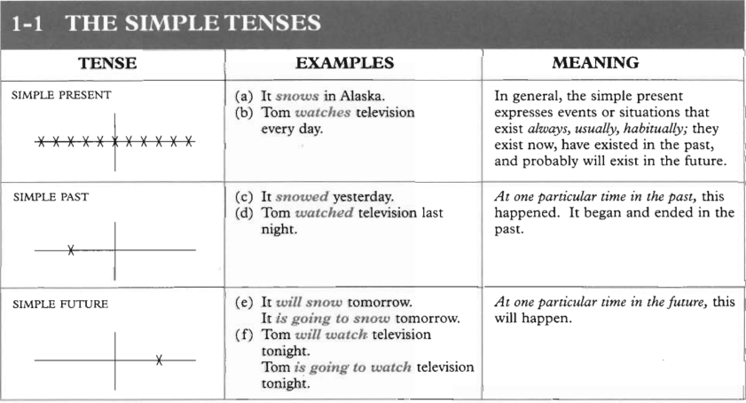

Slide 21
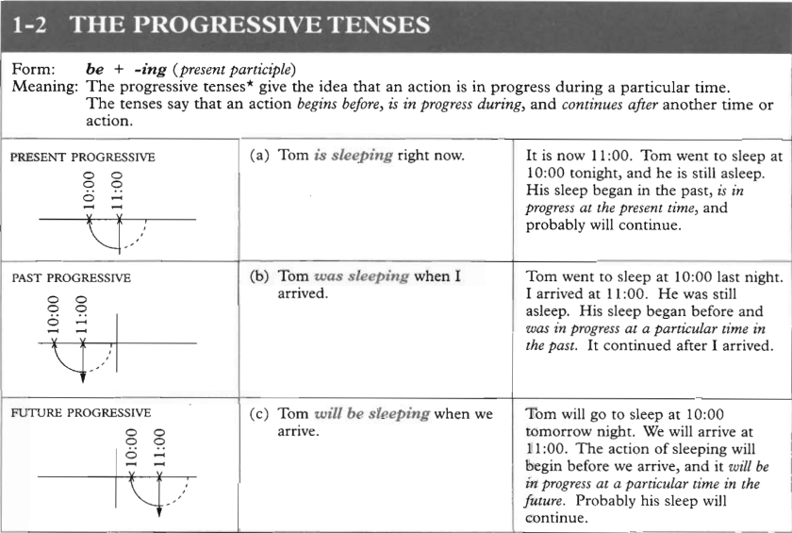

Slide 22
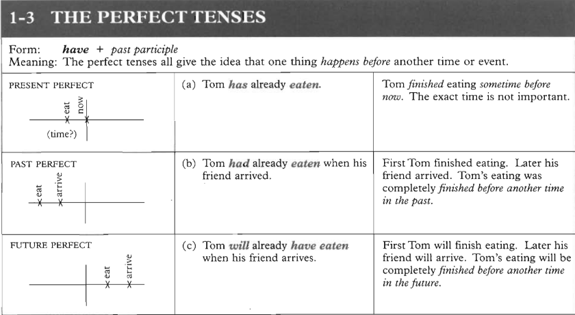

Slide 23
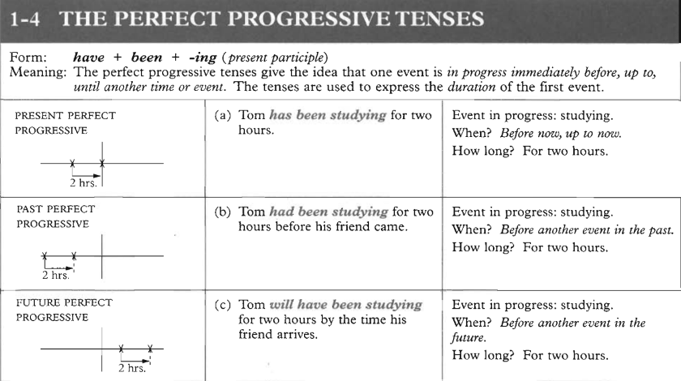

Slide 24
Instructions, commentaries, stories
Present tenses - common in instructions, commentaries and stories. The simple present is used for things that happen one after another, and the present progressive for longer background situations.
I put some butter in a frying pan. While the butter is melting, I break three eggs into a bowl and beat them ...

Slide 25
More about present tenses
repeated actions Repeated actions just around the moment of speaking: present progressive.
Other repeated actions: simple present.
Why is he hitting the dog? Jake's seeing a lot of Felicity these days.
I go to the mountains about twice a year. Water boils at 100" Celsius.
changes We use the present progressive for changing and developing situations, even if these are not just around the moment of speaking.
The political situation is getting worse. Children are growing up faster.
Scientists say the universe is expanding, and has been since the beginning of time.
not around the moment of speaking The simple present and present progressive can be used together even when we are talking about things going on around other moments, not the moment of speaking.
This is common with when (meaning 'whenever’).
You look lovely when you're smiling. When the post comes I'm usually having breakfast.

Slide 26
More about present tenses
progressive with always We can use a progressive form with always and similar words to talk about repeated but unpredictable or unplanned events.
She's always turning up with little presents for the children.
I'm always running into Joanna in the supermarket.
The structure is often used to make complaints and criticisms.
This computer's continually crashing at the most inconvenient moments.
She's forever taking days off because of one little illness or another.
This government is always thinking of new ways to take your money.

Slide 27
non-progressive verbs
Some verbs are rarely or never used in progressive forms, even if we are talking about what is happening at a particular moment.
I don't like her hairstyle.
I called because I need to talk.
Many of these verbs refer to states rather than actions.

Slide 28
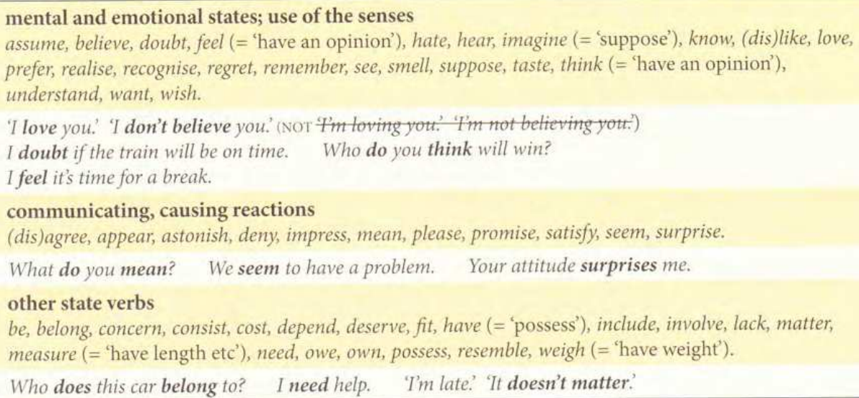
Task: look at the verbs explained in brackets, can they be used with a different meaning?

Slide 29
Progressive and non-progressive uses
progressive and non-progressive uses Some of these verbs may occasionally be used in progressive forms, especially to emphasise the idea of change, development or novelty.
As I get older, I'm remembering less and less.
I didn't expect to like this place, but I'm really loving it.
Some others are used in progressive forms with particular meanings. Compare:
What do you think of her singing? What are you thinking about?
I weigh too much these days. I got a shock when I was weighing myself this morning.
Look (meaning 'seem') can often be progressive or not, with little difference.
You look / You’re looking a bit tired today.

Slide 30

Smell and taste can be progressive when we are talking about the deliberate use of the senses to find something out:
Feel (referring to physical sensations) can be progressive or not, with little difference.
I feel / I'm feeling fine.
See can be progressive when it means “meet”
I (can) see John over there. I'm seeing the doctor tomorrow
This meat smells funny. I (can) smell smoke.
The soup tastes wonderful. I think I (can) taste garlic in it.
'What are you doing?' 'I'm smelling the fish to see if it's OK.’
'Leave that cake alone!' 'I’m just tasting it to see if it is OK.'
Make some guesses and remarks about the yacht, using the following verbs:
weigh, measure, belong, look, imagine, suppose, impress

Slide 31
more about the present progressive, going to and will
spoken and written English
Be going to and the present progressive are particularly common in spoken English, as ways of talking about the future. This is because conversation is often about future events that we can see coming, so present forms are natural. In written English, these forms are less often used. Will is extremely common in writing, because written language tends to deal with less immediate future events, when we do not see the future in the present. Will is also preferred when giving information about impersonal, fixed arrangements - for example official itineraries:
We're meeting Sandra at 6.00.
The President will arrive at the airport at 14.00. He will meet…

Slide 32
shall and will In modern English l/we will and l/we shall can generally be used with no difference of meaning. Will is more common, and shall is dying out. (In any case, the commonest forms in speech are the contractions I'll and we'll.) shall in questions In older English, shall was used to talk about obligation (rather like should). This meaning still survives in first-person questions, where shall is used to ask for instructions or suggestions, or offer services
What time shall we come round? Shall I take your coat?
Compare the use of will to ask for information:
What time will we get into London? legal language Legal documents, such as contracts, often use shall to express obligation.
The hirer shall be responsible for maintenance of the vehicle. (from a car-hire contract)

Slide 33
be+infinitive: I am to...
Official Plans and Fixed Arrangements: used to indicate official plans and fixed arrangements.
The Prime Minister is to visit British soldiers in Antarctica.
Our firm is to merge with Universal Export.
Pre-conditions Common in clauses where the main clause expresses a pre-condition.
We’d better hurry if we’re to get there by lunchtime.
You’ll need to start working if you’re to pass your exam.
Orders Used to give orders, often by parents.
You’re to do your homework before you go to bed.
Tell Lenny she’s not to be back late.
Internet search: Find more examples with Students/visitors, etc., are to/ are not to

Slide 34
Future progressive
Indicates that something will be in progress at a certain time in the future.
This time next Tuesday, I’ll be lying on the beach.
You won’t be able to park here tomorrow; they’ll be mending the road.
polite enquiries A common use of the future progressive is to ask politely 'What have you already decided?' Compare:
Will you write to Oliver? (request or order)
Are you going to write to Oliver? (perhaps pressing for a decision)
Will you be writing to Oliver? (just asking about plans)

Slide 35
Future perfect
The future perfect tense (e.g., “I will have driven/worked”) is used to indicate that something will be completed by a certain time in the future.
We’ll have finished planting the new trees by Wednesday.
This government will have ruined the country before the next election.
The future perfect progressive (I will have been driving/working etc.) is not very common. We can use it to say how long something will have continued by a certain time.
By next summer I'll have been working here for eight years.
Your opinion: Think of one or more things that will not have been completed/achieved/solved ten years form now. Example:
We will not have found life on other planets five years from now.

Slide 36
news and details We often announce a piece of news with the present perfect, and then use the simple past for the details of time and place:
I've found your glasses. They were in the car.
The President has arrived in London. He was met by the Prime Minister ...

Slide 37
more about the simple past and past progressive
past situations that have not changed If we are talking about the past, we tend to use past tenses even for situations that have not changed.
Those people we met in Paris were very nice.
I got that job because I spoke French.
past progressive for repetition We generally use the simple past for repeated past actions.
My father travelled a lot when I was young. I ran away from school regularly.
But we can use the past progressive for repeated actions around a particular time.
I was playing a lot of tennis when I got to know Peter.
It was hard to get a free half-hour in July, because we were rehearsing non-stop.

Slide 38
more about the simple past and past progressive
backgrounding We can make a fact seem less central, not the main 'news', by using the past progressive.
I was having lunch with the President yesterday. She said. . . (This makes it sound as if the lunch with the President was an everyday occurrence, not 'news'. A good way of making oneself sound important.)
John was saying that there are going to be some important changes. (This takes the focus away from John, and puts the emphasis on what he said - the changes.)
progressive with always We can use a progressive form with always and similar words to talk about repeated but unpredictable or unplanned events. Compare:
My grandmother always came to see us on Tuesdays.
Andy was always coming round at the most inconvenient moments.
The structure is often used to make complaints and criticisms.
That car was continually breaking down miles from home.
John was forever buying one useless new gadget or another.
distancing We can make requests, personal questions and so on less direct by using a past tense instead of a present
I thought you might like to pay now.
We were wondering if you needed any help.

Slide 39
More about the present perfect
origins We generally use the simple past, not the present perfect, to talk about the origin of something present.
Who wrote that?
Bill gave me this necklace. Did you put this here?
Whose idea was it to come here on holiday?
today, this week etc.
With definite expressions of 'time up to now' (e.g. today, this week), perfect and past tenses are often both possible. We prefer the present perfect if we are thinking of the whole period up to now (this often happens in questions and negatives). We prefer the simple past if we are thinking of a finished part of that period. Compare:
Has Barbara phoned today? Barbara phoned today. She needed some advice.
I haven't seen John this week. I saw John this week, and he said ...

Slide 40
More about the present perfect
tenses with since Different tenses are possible in sentences with since.
In the main part of the sentence, a present perfect (simple or progressive) is normal:
We've lived here since our marriage.
I've been studying French since last May.
But there may be a past tense in the time expression after since.
We've lived here since we got married.
We’ve visited my parents every week since we bought the car.
A present perfect is also possible in the time expression, to talk about continuation up to now.
We've lived here since we've been married.
We've visited my parents every week since we've had the car.
And a present tense is sometimes used in the main part of the sentence, especially to emphasise changes.
You're looking much better since your operation.

Slide 41
More about the present perfect progressive
progressive or simple? The present perfect progressive is normal when we are talking about temporary actions and situations continuing up to now.
It's been raining all week. Granny's been staying with us since Easter.
The present perfect progressive can also be used for longer, more permanent situations, especially when the emphasis is on activity or change.
The Dutch have been reclaiming land from the sea for centuries.
The universe has been expanding steadily since its origin.
However, we often prefer a simple present perfect in these cases, especially when we are talking about unchanging states rather than actions. Compare:
I've been living here since August.
I've lived in this village all my life.
Lucy's been covering cushions all afternoon.
An ice-cap has covered Greenland for something like 5 million years.

Slide 42
More about the past perfect
not always necessary With time conjunctions like after, as soon as, once, a past perfect is not always necessary, because we are not going back to an earlier past, but simply moving forward from one event to the next.
After the new government came in, things were very different.
As soon as Mary arrived we all sat down to dinner. Once it stopped raining we started playing again.
However, we can use the past perfect with these conjunctions if we want to emphasise that the first action was separate and finished before the second started.
After the plane had landed they discovered bullet holes in the wings.
Once they had checked all my bags I was allowed into the building.
use with when This 'separating’ use of the past perfect is common with when. Compare:
When I opened the window, the cat jumped out.
When I had opened the windows, I sat down and had a cup of tea.
When I phoned her, she came at once.
When I had made all my phone calls, I did some gardening.

Slide 43
Past perfect progressive
use When we are talking about a past time, we can use the past perfect progressive to talk about earlier situations which had continued up to that time.
All the roads were flooded: it had been raining solidly for three days.
She got ill because she hadn't been sleeping enough.
When I looked at the books, I saw that the firm had been losing money for years.

