Slide 1
PHRASES AND CLAUSES
PhD DORINA MACOVEI

Slide 2
A phrase - a group of words functioning in a sentence as a single part of speech. It does not have a subject or a verb, so it cannot stand alone as an independent unit—it can function only as a part of speech.
A clause - a group of words with its own subject and verb. Like phrases, clauses enrich your written and oral expression by adding details and making your meaning more exact. Clauses also allow you to combine ideas to show their relationship. This adds logic and cohesion to your speech and writing.

Slide 3
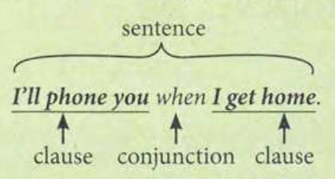
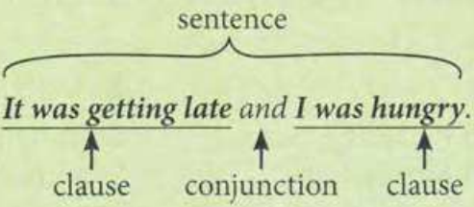

Slide 4
A noun phrase consists of a noun plus any determiners or modifiers directly related to it. Noun phrases always have the grammatical function of nouns in a sentence.
“She gazed lovingly at her sweetly smiling child.”
“The red car belongs to me.”
An adjective phrase is made up of an adjective along with any determiners, modifiers, or adjective complements that modify or complete the adjective’s meaning. The entire phrase functions as an adjective in a sentence, modifying a noun.
“The singer was wonderfully talented.”
“She felt alone in the world.”

Slide 5
An appositive phrase is a noun phrase that serves to describe or rename another noun that appears directly before it in a sentence. Appositive phrases are usually (but not always) non-restrictive, meaning they provide information that is not essential to the meaning of the sentence, and are separated from the rest of the sentence by one or two commas.
“The office, an old Georgian building, badly needed repairs.”
“Janet Smith, a former student of mine, is joining the faculty next spring.”
“Just meet me at my car, the old station wagon parked across the street.”

Slide 6
An adverbial phrase may consist of an adverb plus any determiners and supplemental information, or an adverb plus an adverb of degree, or an adverbial prepositional phrase. (Prepositional phrases are so often adverbial that they are commonly included in definitions of adverbial phrases.)
“My dad swims once a week.”
“Don't run too quickly!”
“We walked down the street.”

Slide 7
Prepositional phrases consist of a preposition and its object. They most commonly function as adverbs, but they can also be adjectival.
“We hung the painting on the wall.” (adverbial prepositional phrase)
“The car in the driveway is my dad’s.” (adjectival prepositional phrase)

Slide 8
Infinitive phrases are composed of the infinitive of a verb (the base form + the particle to) along with any objects or modifiers associated with it. Infinitives and infinitive phrases can function as nouns, adjectives, or adverbs in a sentence.
“We must all try to help one another.” (functions as a noun, the direct object of try)
“This is a good place to stop for today.” (functions as an adjective, modifying the noun place)
“I'm going to the post office to send my brother a letter.” (functions as an adverb, modifying the verb going)

Slide 9
A gerund phrase is formed when a gerund (the “-ing” form of a verb used as a noun) is accompanied by any modifiers and/or objects. The entire phrase functions as a noun, meaning it can be the subject of a clause or an object of a verb or preposition.
“Swimming every day is good for your health.”
“I wouldn't recommend reading books in the dark.”

Slide 10
Participle phrases are created when participles are accompanied by any modifiers or objects. Past and present participles (without modifiers or objects) can be used to create different verb tenses, but they can also function as adjectives. Participle phrases, however, can only function as adjectives in a sentence.
“My car, destroyed in the accident, was taken away by the tow truck.”
“Participants breaking the rules will be removed from the competition.”

Slide 11
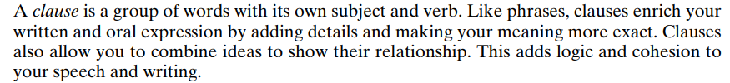
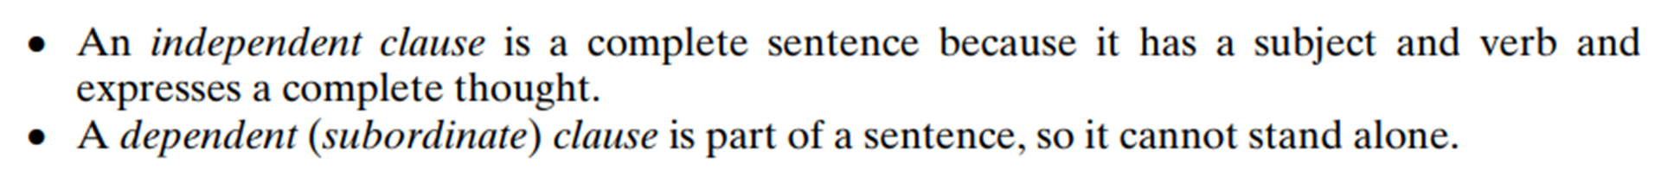
CLAUSES

Slide 12
Four different kinds of main clauses:
declaratives (statements)
interrogatives (questions)
imperatives (orders/instructions)
exclamatives (used for exclamations)
Three different kinds of subordinate clauses:
adverb clauses
adjective clauses
noun clauses

Slide 13
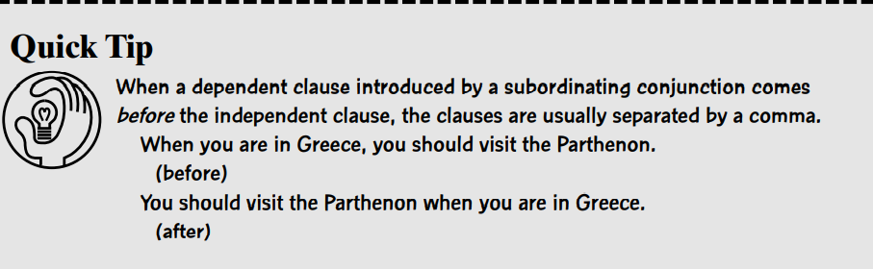

Slide 14
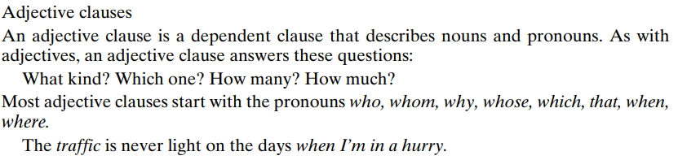
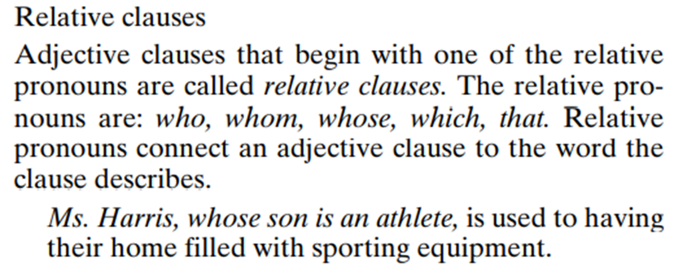

Slide 15
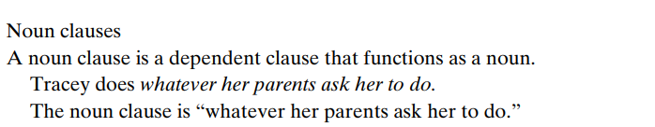
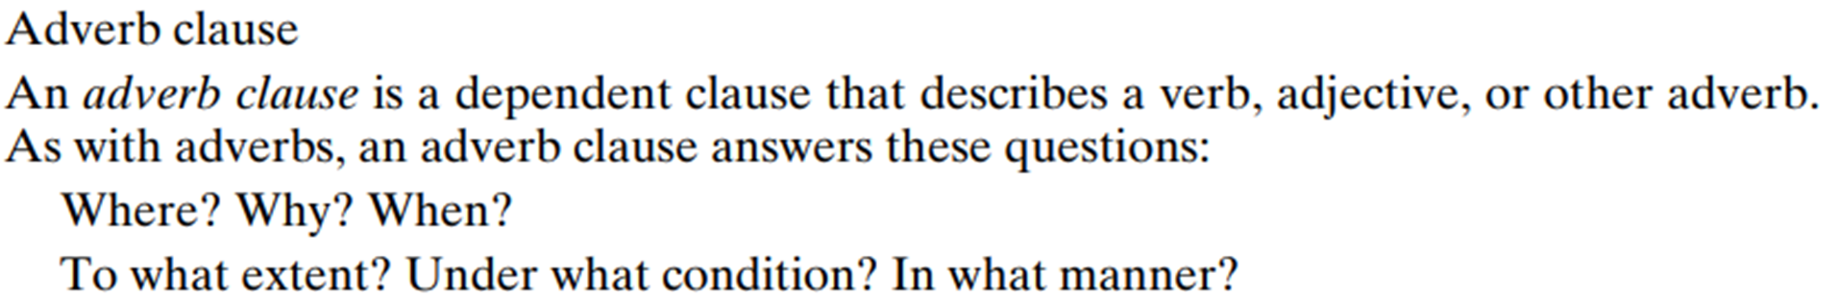
When the sun rises, we’ll start our journey.

Slide 16
PRACTICUM (identify the clause type)
I’m looking for the red book that went missing last week.
Finn is asking for the shoes which used to belong to his dad.
You there, who is sitting quietly at the corner, come here and lead the class out.
I like what I hear.
You need to express that it’s crossing a line for you.
He knows how things work around here.
Alice did the dishes till her legs gave up.
Since you’re here early, we can start now.
He whispered so that he wouldn’t wake the baby.

Slide 17
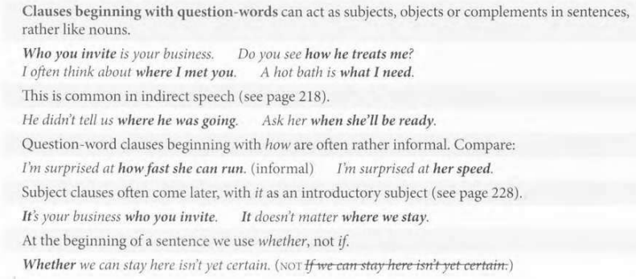
Question-word clauses

Slide 18
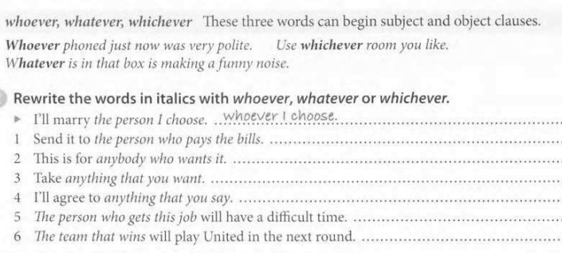

Slide 19
Phrases and clauses (specific problematic points)
Adjective clauses
dropping relative pronouns. We can drop who, which or that when it is the object of the following verb; not when it is the subject:
I found the key (that) I had lost. (that = the key = the object of lost)
This is the key that opens the front door. (that = the key = the subject of opens)
which, that and what. We don’t use what in the same way as which or that.
What replaces noun + which/that: it means something like ‘the thing(s) that’. Compare:
I gave them the money that they wanted. I gave them what they wanted.
(NOT I gave them the money what...)
We normally prefer that, not which, after all, everything, nothing, the only . . . and superlatives. What is not correct in these cases.
I've told you everything that matters. (Not ... everything what matters.)
Is this the only song (that) you can sing? (Not ... what you can sing.)

Slide 20
Reduced relative clauses.
We sometimes leave out who/which/that + is/are/was/were before participles (-ing and -ed forms).
Who is that child throwing stones at our house? (= '... who is throwing ...')
Most of the people invited did not even reply. (= '... who were invited ...')
Books printed before 1600 were rare and valuable. (= '... that were printed ...’)
This also happens with prepositional phrases and some adjectives (e.g. possible, available).
Can you pass me the papers on that table? (=' ... that are on that table?')
Tuesday is the only date possible for the meeting. (= '... that is possible.’)
Note that who/which/that + have cannot be left out in the same way.
We need to talk about some problems that have arisen during the operation.
(Not... some problems arisen during the operation.)

Slide 21
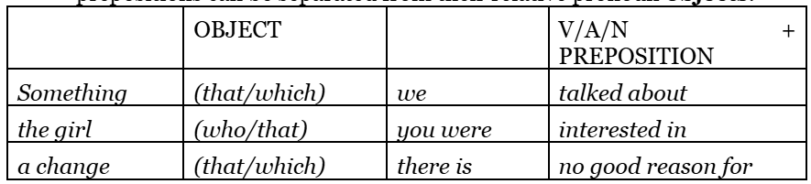
prepositions in relative clauses. In identifying clauses, verb, adjective or noun + preposition combinations usually stay close together. This means that prepositions can be separated from their relative pronoun objects.
A basket is something you can carry shopping in.
Prepositions can also go before their objects, but this is rather formal. After prepositions, we normally use whom, not who.
something about which we talked the people to whom I applied
In non-identifying clauses, prepositions often come before which or whom, especially in a formal style.
There will be a short speech from the President, after which drinks will be served.
In 1956 she met Andrew Carstairs, with whom she later made several films.

Slide 22
which = whole clause. Which can refer back not just to a noun, but also to a whole clause.
We replaced the pump, which wasn't working properly. (which = 'the pump’)
We replaced the pump, which took two days. (which = 'We replaced the pump’)
Note that what cannot be used in this way.
when, where etc. After words for time and place, we can use when and where as relatives.
I'll never forget the day (when) I arrived in Athens. (= '... the day on which ... ')
Do you know a garage where I can get cheap tires? (= '... a garage at which ...’)
We can drop when after common words for time, and we can drop where after somewhere, anywhere, everywhere, nowhere, and place.
the day (when) I arrived that time (when) we went down to Exeter
the year (when) I worked in Egypt somewhere we can get a drink
everywhere she goes a place (where) I can sleep
We use why as a relative after reason. It can be dropped.
I never found out the reason (why) she left. (= '... the reason for which ...')
Note also that in which is often dropped after way.
I didn't like the way (in which) he spoke to me.

Slide 23
Adverb clauses
Participles (-ing and -ed forms) can introduce clauses (without conjunctions). This is rather formal and is more common in writing than in speech.
Looking out of the window, Harry saw that it was snowing again.
Not being a very sociable person, he found a seat where he could be by himself.
Alice had a violent row with Peter, completely ruining the evening.
Having found what I was looking for, I went back home.
Stored in a cool place, this bread will last for weeks.
'misrelated' participles. The subject of a participle clause is normally the same as the subject of the main clause, and it is generally considered incorrect to mix subjects, at least in formal writing. Compare:
Standing by the window, Sue gazed at the mountains. (Sue stood; Sue gazed)
Standing by the window, the mountains seemed very close. (This sounds as if the mountains were standing by the window.)

Slide 24
However, mixed subjects are common when one of them is it or there.
Being French, it is surprising that she is such a terrible cook.
Having so little time, there was not much that I could do.
This also happens with some fixed expressions describing the speaker's attitude
(e.g. generally speaking, judging from…, considering…, taking everything into consideration…)
Generally speaking, men can run faster than women.
Judging from his expression, he was in a bad mood.
If necessary, a participle clause can have its own subject.
Nobody having anything more to say, the meeting broke up.
Some conjunctions and prepositions can introduce participle clauses.
Check the mirror before driving off.
In deciding to spend a year studying Arabic, I made a very wise decision.

Slide 25
On doing something (formal) means 'when/as soon as you do something`
On hearing the fire alarm, go straight to the nearest exit.
Infinitive clauses
Infinitive clauses of purpose are often constructed with in order and so as in a formal style. Compare:
I moved house to be nearer to my work. (normal)
I moved house in order to be / so as to be nearer my work. (more formal)
These structures are very common with negative infinitives of purpose.
I moved house so as not to be too far from my work.
(more normal than I moved house not to be too far from my work.)
(only) to find. . . Infinitive clauses can be used to say what somebody learnt or found out at the end of a journey or task.
I arrived home to find that the house had been burgled.

Slide 26
The idea of surprise can be emphasized with only.
He spent four years studying geology, only to discover that there were no jobs.
To see/hear... can be used to give the reason for a false impression.
To hear her talk, you’d think she was made of money.
To see her look at him, you’d never realize that she hates him.

Slide 27
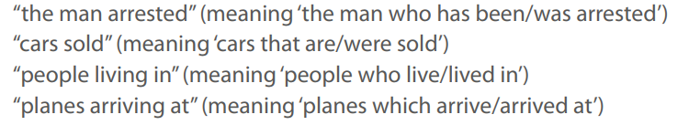
Find one or more sentences on the internet containing these phrases:

Slide 28
Version of a story
Write a short adaptation of a traditional children’s story (e.g. Red Riding Hood), using at least five participle clauses:
‘… Opening the door of her grandmother’s house, the little girl saw at once that it was not her grandmother in the bed, nut the wolf. Taking her mobile phone out of her basket,…’
Participle clause = non-finite clause - They contain a Participle or an Infinitive Verb that makes the Subject and Verb evident even though hidden.

