Slide 1
Agreement:
Matching Sentence Parts
PhD Dorina Macovei

Slide 2
CONTENTS
The Grammatical Subject of Agreement
Collective Nouns and Indefinite Pronouns
Special Problems in Agreement
Agreement of Pronouns and Antecedents

Slide 3
TEST YOUR KNOWLEDGE
Choose the correct verb in these sentences.
The girl or her sisters (watch, watches) television every day.
Rob and his brothers (doesn’t, don’t) like sports.
His classmates or the boy (study, studies) before a test.
One of the biscuits (is, are) missing.
A lady with 10 cats (live, lives) in that big house.
Mumps (is, are) very serious.
Everybody (enjoy, enjoys) a good song.
Either of them (is, are) suitable.

Slide 4
Decide whether the following sentences are correct or wrong:
1. ____Cats and dogs love to run.
___ He don’t like chocolate.
___ Her friends or Sarah excel at volleyball.
___ Each of these have been ruined.
___ Trousers are baggy now.
___ The students, as well as the teacher, are nervous about the test.
___ The news are on at 10.
___ Mathematics is hard for many.
___ The director, with all the cast members, works very hard.

Slide 5
The Grammatical Subject of Agreement
Agreement means that sentence parts match.
Subjects must agree with verbs, and pronouns must agree with antecedents.
If they do not, the sentences will sound awkward and may confuse listeners and readers. Some things just seem to go together well.
This matching of sentence elements is called agreement. It helps to create smooth and logical sentences. Most of the concepts of subject verb agreement are straightforward, yet some aspects of singular and plural usage in English grammar are more complicated.

Slide 6
The basic rule of sentence agreement is simple:
A subject must agree with its verb in number.
1. Singular and plural nouns
The plurals of most nouns are formed by adding -s or -es to the singular form.
bike → bikes; race → races; inch → inches.
Some nouns have irregular plurals, such as
mouse → mice; woman → women, goose → geese /ɡiːs/.
2. Singular and plural pronouns
Pronouns have singular and plural forms, too: I, you, she, he, it we, they.
3. Singular and plural verbs
As with nouns and pronouns, verbs show singular and plural forms. The rule introduced at the beginning of this unit: A subject must agree with its verb in number. All the other rules follow from this one.

Slide 7
A singular subject must have a singular verb
A singular subject must have a singular verb:
She hesitates at all intersections, making the other drivers angry (sing. subject sing. verb). The singular subject she agrees with the singular verb hesitates.
b) Procrastination is the art of keeping up with yesterday (sing. subject sing. verb). The singular subject procrastination agrees with the singular verb is.
2. Two or more singular subjects joined by OR or NOR must have a SINGULAR VERB. This makes perfect sense: You are making a choice between two singular subjects. The OR shows that you are only choosing one:

Slide 8
Either the dog or the cat has to go (sing. subject. or sing. subject sing. verb).
Only one pet will go — the dog or the cat. Therefore, you will only have one pet left. Two singular subjects — dog and cat — joined by or take the singular verb has.
b) Neither Elvis Costello nor Elvis Presley is in the room (sing. subject nor sing. subject sing. verb).
Each subject is being treated individually. Therefore, two singular subjects — Elvis Costello and Elvis Presley — joined by nor take the singular verb is.

Slide 9
3. Subjects that are singular in meaning but plural in form require a singular verb: measles (pojar), civics, social studies, mumps (oreion), molasses (a thick sweet black liquid that is produced when sugar is made pure and is used in cooking), news, economics, physics and mathematics:
The news is on very night at 11:00 P.M. (sing. subject sing. verb). The singular subject news takes the singular verb is.
4. Plural subjects that function as a single unit take a singular verb: a) Spaghetti and meatballs is my favourite dish (sing. subject sing. verb). The singular subject spaghetti and meatballs requires the singular verb is.
b) Bacon and eggs makes a great late night snack (sing. subject sing. verb). The singular subject bacon and eggs agrees with the singular verb makes.

Slide 10
Titles are always singular.
It doesn’t matter how long the title is, what it names, or whether or not it sounds plural— a title always takes a singular verb:
For Whom the Bell Tolls is a story about the Spanish Civil War (sing. subject sing. verb). The singular title For Whom the Bell Tolls requires the singular verb is.
Strangers in a Strange Land was written by Robert Heinlein (sing. subject sing. verb). The singular title Stranger in a Strange Land requires the singular verb was.

Slide 11
Most measurements are singular—even though they look plural. “Half a dollar/ two years/ ten pounds is more than enough” (not “are more than enough”).
6. The following expressions have no effect on the verb:
together with
accompanied by
along with
as well as:
The actress, accompanied by her manager and some friends, is going to a party tonight.

Slide 12
A Plural Subject Must Have a Plural Verb
A plural subject must have a plural verb:
Men are from Earth. Women are from Earth.
On average, people fear spiders more than they do death.
The plural subject people requires the plural verb fear (not the singular verb fears). The plural subject they requires the plural verb do (not the singular verb does).
Facetious and abstemious contain all the vowels in the correct order, as does arsenious, meaning “containing arsenic.”
The plural subject facetious and abstemious requires the plural verb contain (not the singular verb contains.) Think of the conjunction and as a plus sign. Whether the parts of the subject joined by and are singular or plural (or both), they all add up to a plural subject and so require a plural verb.
facetious /fəˈsiːʃəs/ not serious; intended to be funny or humorous
abstemious /əbˈstiːmiəs/ formal taking little food, drink

Slide 13
2. Two or more plural subjects joined by OR or NOR must have a plural verb.
Either the children or the adults are clearing the table
Since both subjects are plural, one of them alone is still plural. Therefore, two plural subjects—children and adults—joined by or take the plural verb are.
b) Neither my relatives nor my friends are leaving any time soon
Since both subjects are plural, one of them alone is still plural. Therefore, two plural subjects—relatives and friends—joined by nor take the plural verb are.

Slide 14
3. A compound subject joined by and is plural and must have a plural verb. The conjunction and acts like a plus (+) sign, showing that 1 + 1 = 2 (or 1 + 1 + 1 = 3, etc.):
Brownies and ice cream are a spectacular dessert (plural subject sing. subject plural verb).
b) Leo and Christopher have donated money to charity (sing. subject sing. subject plural verb). Leo and Christopher = two people. 1 + 1 = 2. Therefore, the verb must be plural: have.

Slide 15
4. Proximity rule. If two or more singular and plural subjects are joined by OR or NOR, the subject closest to the verb determines agreement:
Margery or the twins are coming on the trip to Seattle (sing. subject plural subject plural verb). Since the plural subject twins is closest to the verb, the verb is plural: are.
b) The twins or Margery is coming on the trip to Seattle (plural subject sing. subject sing. verb). Since the singular subject Margery is closest to the verb, the verb is singular: is.

Slide 16
5. If the sentence contains a positive and a negative subject and one is plural, the other singular, the verb should agree with the positive subject:
The department members but not the chair have decided not to teach on Valentine's Day.
It is not the faculty members but the president who decides this issue.
It was the speaker, not his ideas, that has provoked the students to riot.

Slide 17
Collective Nouns and Indefinite Pronouns
A collective noun names a group of people or things. Collective nouns include the words class, committee, government, jury, team, audience, assembly, team, crowd, club. Collective nouns can be singular or plural, depending on how they are used in a sentence. Here are the basic guidelines:
A collective noun is considered singular when it functions as a single unit. Collective nouns used as one unit take a singular verb.
A collective noun is considered plural when the group it identifies is considered to be individuals. Collective nouns that indicate many units take a plural verb.

Slide 18
Difference
Plural forms are common when the group is considered as a a collection of people doing personal things like deciding, hoping or wanting:
My family have decided to move to Brussels.
My firm are wonderful, they do all they can for me.
Singular forms are more common when the group is seen as a impersonal unit:
The average British family has 3 members.
My firm was founded in 1995.
In AmE singular verbs are normally used with most of these nouns in all cases.

Slide 19
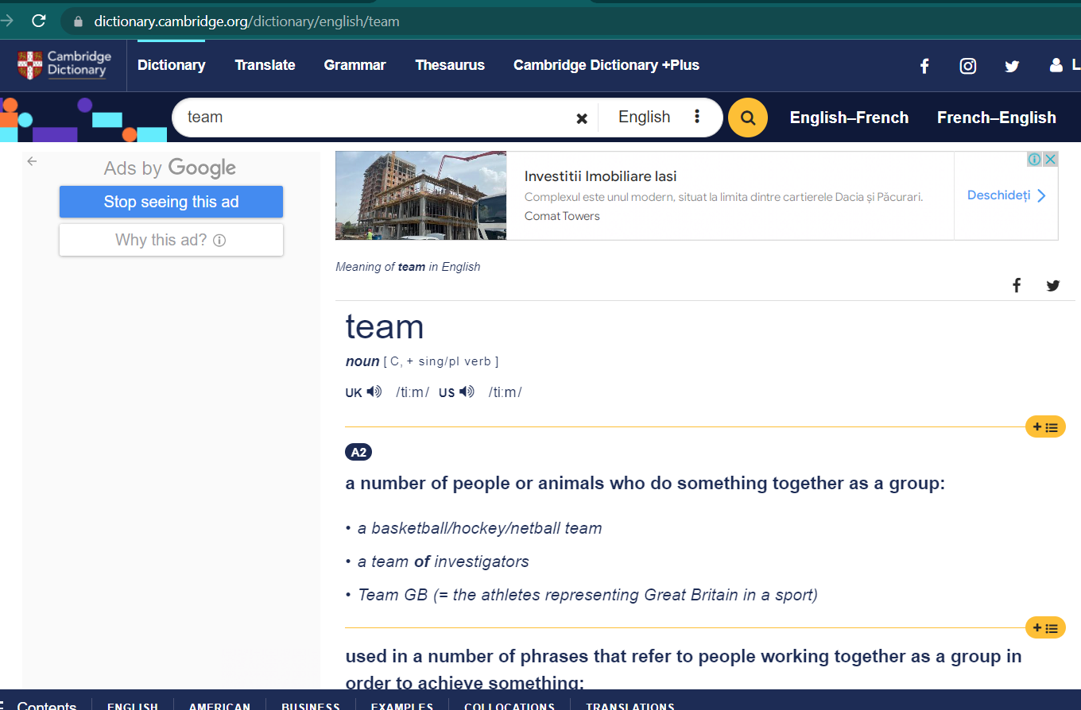

Slide 20
The police is always followed by a plural verb:
The police are busy investigating the burglary.
Majority can be singular or plural. If it is used alone, it can be singular or plural; if followed by a plural noun, it is usually plural:
The majority was/were in favour of banning new coal mines. (Oxford rule)
The majority of the students believe him to be innocent.

Slide 21
Collective nouns indicating time, money and measurements used as a whole are singular:
Twenty-five dollars is too much to pay for that shirt.
Fifty minutes isn’t enough time to finish this test.
A number of/ the number of:
A number of + plural noun + plural verb
The number of + plural noun + singular verb.
A number of students are going to the class picnic (a number of = many).
The number of days in a week is seven.

Slide 22
Fractional expressions such as half of, a part of, a percentage of are sometimes singular and sometimes plural, depending on the meaning.
Sums and products of mathematical processes are expressed as singular and require singular verbs.
The expression "more than one" takes a singular verb: "More than one student has tried this." For example:
A large percentage of the voters are still angry.
A large percentage of the older population is voting against her.
Two-fifths of the troops were lost in the battle.
Two-fifths of the vineyard was destroyed by fire.
Forty per cent of the students are in favour of changing the policy.
Five per cent of the situation is Bob’s faults.
Two and two is four.
Four times four divided by two is eight.

Slide 23
Indefinite pronouns, like collective nouns, can be singular or plural, depending on how they are used in a sentence. Indefinite pronouns refer to people, places, objects, or things without pointing to a specific one. Indefinite pronouns include words such as everyone, someone, all, and more.
Singular indefinite pronouns take a singular verb.
Plural indefinite pronouns take a plural verb.
The following chart shows singular and plural indefinite pronouns.
The chart also shows pronouns that can be either singular or plural, depending on how they are used in a sentence.

Slide 24
Singular | Plural | Singular or Plural
another | both | all
anybody | few | any
anyone | many | more
anything | others | most
each | several | none
either |  | some
everyone |  | no
everybody
everything
little
much
neither
nobody
no one
nothing
one
other
somebody
someone
something

Slide 25
If we look back at the chart, we will see that the following patterns emerge:
1. Indefinite pronouns that end in -body are singular. These words include anybody, somebody, nobody.
2. Indefinite pronouns that end in -one are singular. These words include anyone, everyone, someone, and one.
3. The indefinite pronouns both, few, many, others, and several are plural.
4. The indefinite pronouns all, any, more, most, none, and some can be singular or plural, depending on how they are used.
All the water is gone. (water = uncountable)
All the students are present. (students = countable)
Task: Write your own examples for number 4

Slide 26
5. No can take either singular or plural verb depending on the noun which follows it:
a) No + {singular noun / non-count noun} + singular verb
No example is relevant to this case.
b) No + plural noun + plural verb
No examples are relevant to this case.

Slide 27
Special Problems in Agreement
The rules for agreement are straightforward, but some problems do arise. Here are the two most challenging issues: hard-to-find subjects and intervening phrases.
1. Hard-to-find subjects should be identified. Some subjects can be harder to find than others. Subjects that come after the verb are especially tricky. However, a subject must still agree in number with its verb, as the following examples show:
a) At the bottom of the lake there are two old cars (plural verb+plural subject). The plural subject cars agrees with the plural verb are.
b) There were still half a dozen tyres in the lake, too (plural verb plural subject). The plural subject tyres requires the plural verb were.

Slide 28
2. Intervening phrases should be ignored. Words or phrases that come between the subject and the verb should be disregarded. A phrase or clause that comes between a subject and its verb does not affect subject-verb agreement:
The strongest muscle in the body is the tongue (sing. subject prep. phrase sing. verb). The singular subject muscle agrees with the singular verb is. Ignore the intervening prepositional phrase “in the body.”
b) The captain of the guards stands at the door of Buckingham Palace (sing. subject prep. phrase sing. verb). The singular subject captain agrees with the singular verb stands. Ignore the intervening prepositional phrase “of the guards.”
c) The dog, who is chewing my jeans, is usually very good.
3. When sentences start with “there” or “here,” the subject will always be placed after the verb, so care needs to be taken to identify it correctly.
There is a problem with the balance sheet.
Here are the papers you requested.

Slide 29
Agreement of Pronouns and Antecedents
Like subjects and verbs, pronouns and antecedents (the words to which they refer) must agree. These are the rules that will be followed to make sure that pronouns and antecedents match.
A pronoun agrees (or matches) with its antecedent in number, person, and gender: Jenny gave half her cupcake to Shirley.
Both the antecedent Jenny and the pronoun her are singular in number, in the third person, and feminine in gender. Errors often occur when there are incorrect shifts in person and gender.
Error: Jenny will eat her bran flakes and tofu, which you need to stay healthy.
Correct: Jenny will eat her bran (tărâțe) flakes and tofu, which she needs to stay healthy.
2. A singular personal pronoun is used with a singular indefinite pronoun:
If anyone questions the decision, refer him or her to the boss.
The singular pronouns him or her refer to the singular pronoun anyone.

Slide 30
3. A plural pronoun is used when the antecedents are joined by and. This is true even if the antecedents are singular:
The dog and cat maintain their friendship by staying out of each other’s way
(sing. subject sing. subject plural pronoun). Since the two singular antecedents dog and cat are joined by and, the plural pronoun their is used. This is a case of 1 + 1 = 2 (one dog + one cat = two pets).
4. Proximity rule. Antecedents joined by or, nor, or correlative conjunctions such as either…or, neither…nor agree with the antecedent closer to the pronoun: a) Neither my baby sister nor the twins sleep in their bed
(sing. subject plural subject plural pronoun). The plural pronoun their is used to agree with the plural antecedent twins.
b) Neither the twins nor my baby sister sleeps in her bed.
(plural subject sing. subject sing. pronoun). The singular pronoun her is used to agree with the singular antecedent sister.

Slide 31
5. The pronoun should refer directly to the noun. Confusion occurs when the pronoun can refer to more than one antecedent.
Confusing: Norman saw a coupon in last year’s newspaper, but he can’t find it.
What is it that Norman can’t find: the coupon or the newspaper?
Correct: Norman can’t find the coupon he saw in last year’s newspaper.

Slide 32
6. The need for pronoun-antecedent agreement can create gender problems. If one were to write:
A student must see his counsellor before the end of the semester
when there are female students about, nothing but grief will follow. One can pluralize, in this situation, to avoid the problem:
1. Students must see their counsellor before the end of the semester.
2. A student must see his or her counsellor. . . .

Slide 33
Too many his's and her's eventually become annoying, however, and the reader becomes more aware of the writer trying to be conscious of good form than he or she is of the matter at hand. We can use they, them, their and theirs to refer to both sexes at the same time, even when a singular noun has been used, although some people consider this unacceptable. However, in present-day English, this usage is becoming more accepted:
Every student must show their identity card on entering the examination room.
(preferred to Every student must show his identity card.)
A nurse has to be very open and understanding. They must listen to their patients and respond to them.
(preferred to She must listen to her patients. or He must listen to his patients.)
It is also widely regarded as being correct (or correct enough), at the beginning of the twenty-first century, to say Somebody has left their bag on the floor but many people would object to its being written that way because somebody is singular and their is plural.

