Slide 1
The National Curriculum for Foreign Languages
Oxana Creanga

Slide 2
Conceptual Framework
The Foreign Languages Curriculum is an integral part of the National Curriculum, shaping education from primary to upper secondary school (lyceum education).
Sources:
  National level:
  Education Code (2014, updated) and Education Strategy 2030
  National Curriculum Reference Framework (2025) – the key framework for defining educational outcomes
  National strategies: STE(A)M education and Education for Sustainable Development
European and International Frameworks:
  CEFR Companion Volume (2020)
  Learning Compass 2030 – OECD (Organisation for Economic Co-operation and Development) framework promoting learner agency and autonomy
  GreenComp – European Union Framework for Sustainability Competences
  DigComp – European Union Framework for Digital Competences
  AI Competence Framework for Students – UNESCO (United Nations Educational, Scientific and Cultural Organization) framework supporting the ethical and effective use of AI and emerging technologies.

Slide 3
The curriculum promotes the fundamental principles of education:
  equity
  inclusion
  lifelong learning
  the development of key competences, particularly multilingual, digital, and intercultural competence

Slide 4
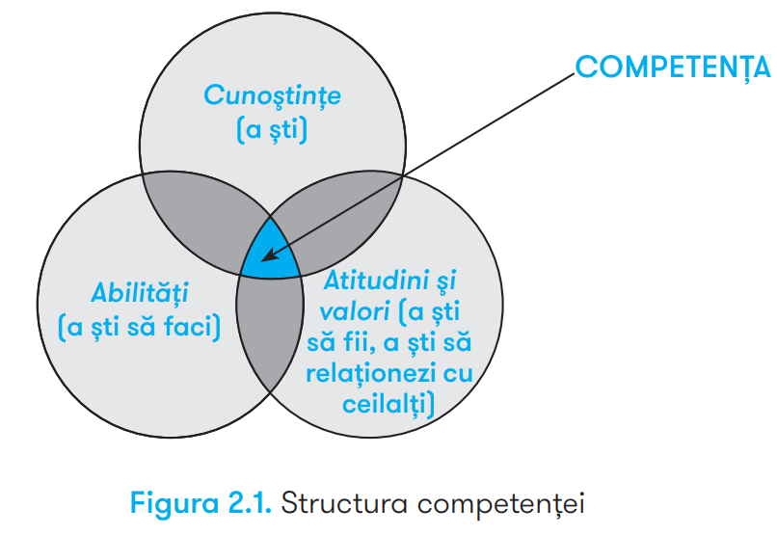
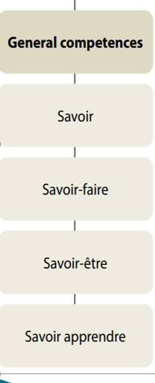
https://mecc.gov.md/sites/default/files/cadrul_de_referinta_final_rom_tipar.pdf, p.19

Slide 5
Status and Structure of FL I and FL II
Compulsory subjects within the common core, integrated into the “Language and Communication” curricular area
FL I: taught from grades II–XII, with progressive CEFR VC targets:
  Primary: A1
  Lower secondary: A2+
  Upper secondary: B1+
FL II: taught from grades V–XII, targeting A1–A2+
The curriculum for FL I and II is developed separately for the primary, lower secondary education (cycle I: gymnasium education) and upper secondary education (cycle II: lyceum education).

Slide 6
Relevance of LS in the Context of Curriculum Reform
Essential for professional, social and cultural integration in a globalised, interconnected world
Shift from grammar-focused, rule-based learning to communication, mediation and collaboration
Supports real-life and career-oriented competences
Promotes interdisciplinary learning through links with science, culture, history and technology
Contributes to learner autonomy, critical thinking, tolerance of diversity and responsible global citizenship.

Slide 7
Key Functions of FLC
Formative function – develops critical and flexible thinking, communication problem-solving, respect for diversity and inclusion, and analytical thinking.
Informative function – provides linguistic, cultural and civic knowledge, including concepts, facts, etc.
Applied function – transfers knowledge to real-life contexts through interviews, formal emails, debates and projects.
Integrative function – combines linguistic, digital, social and civic competences through a holistic, transdisciplinary approach.
Orientational function – supports learners in discovering their own potential and making educational and career choices, including international opportunities.

Slide 8
Distinctive Features of CLS
Action-oriented epistemological approach
  content serves as a means of developing competences through reception, production, interaction and mediation
Social relevance
  addresses current issues such as digital citizenship, cultural diversity, health, environmental sustainability and human rights
Student-centered approach
  positions the learner at the center, with the teacher as facilitator, active learning methods (group projects, debates, role-playing and discovery-based learning)
Curricular flexibility
  allows teachers to adapt activities, tasks and strategies to learners’ interests, pace and local context
Interdisciplinarity and practical application
  connects LS with other fields of knowledge and real-life contexts
Pedagogical innovation through technology
  integrates digital technologies, educational platforms and authentic audio-visual materials into learning.

Slide 9
FLC contributes to the development of autonomous graduates capable of:
  effective communication
    critical thinking
      active participation in a globalised and digitalised society.

Slide 10
Vision
To develop autonomous language users able to communicate effectively, mediate meaning, and participate in plurilingual and pluricultural contexts. Core values: respect for diversity, responsibility and intercultural openness.
Mission
To develop functional, integrative, and transferable communicative competences. Lifelong learning, adaptability to change, and active participation in contemporary society.
Purpose
Development of foreign language communicative competence, integrated with intercultural, social, and digital competences for effective language use in varied life contexts.

Slide 11
The expected progression will be achieved by moving from guided language use in familiar contexts to independent and functional language use in diverse and more complex contexts, with a progressive level of authenticity.
Familiar everyday contexts A1
Varied but predictable contexts A2
Semi-authentic contexts adapted for learning (B1.1)
Quasi-authentic contexts reflecting real-life complexity (B1.2–B1+)
By the end of high school, students will reach level B1+ in FL I and level A2+ in FL II

Slide 12
Action-oriented approach
The language user is a social actor engaged in carrying out authentic tasks in specific contexts
integrates the linguistic,
sociolinguistic, and pragmatic dimensions of communication
multilingualism and multiculturalism
respect for linguistic and cultural diversity, empathy, cooperation, responsibility, openness to intercultural dialogue
the development of a coherent system of knowledge, skills, attitudes, and values

Slide 13
Students’ engagement in activities that involve reception, production, and mediation of messages in authentic communicative contexts
contributes to the development of:
communicative competence
autonomous learning
digital competences,
social and civic competence,
cultural awareness.
Foreign Language Curriculum

Slide 14
CEFR LEVEL | Curricular Progression Sublevels (National Adaptation) | Forms | Application in the Curriculum
A1 | A1.1 • A1.2 • A1.3 | FL I: II–IV FL II: V–VII | Initial stage of foreign language (FL) learning, attainment of A1 level by the end of primary education (FL I) and by the end of Grade 7 (FL II), through the progressive development of basic communicative competences.
A2+ | A2.1 • A2.2 • A2.3 A2.4 • A2+ | FL I: V–IX FL II: VIII–XII | Stage of consolidation and development of communicative competences, attainment of A2+ by the end of lower secondary education (FL I) and upper secondary education (FL II).
B1+ | B1.1 • B1.2 • B1+ | FL I: X–XII | Level of independent development of communication skills, culminating in the attainment of level B1+ by the end of secondary school.

Slide 15
SUBJECT-SPECIFIC COMPETENCES
refers to the sociocultural conditions of language use (rules of politeness, norms governing rela tions between generations, sexes, classes and social groups, linguistic codification of certain fundamental rituals in the functioning of a community)
the functional use of linguistic resources (production of language functions, speech acts), drawing on scenarios or scripts of interactional exchanges; the mastery of discourse, cohesion and coherence, the identification of text types and forms, irony, and parody
flexible use of one’s linguistic and cultural repertoire to communicate, mediate, interpret differences, and adapt to diverse cultural contexts
include lexical, phonological, syntactical knowledge and skills and other dimensions of language as system
Linguistic competence:
Sociolinguistic competence:
Pragmatic competence:
Plurilingual and pluricultural competences:

Slide 16
Competențele specifice disciplinei LS | Ciclul Primar | Ciclul gimnazial | Ciclul liceal
CS 1 Competența lingvistică | utilizarea corectă a resurselor lingvistice de bază în propoziții și mesaje simple, în contexte familiare și uzuale, manifestând curiozitate și respect față de normele limbii. | utilizarea funcțională a resurselor lingvistice extinse în enunțuri și mesaje coerente, în contexte variate și previzibile, demonstrând încredere și responsabilitate în exprimare. | integrarea adecvată a resurselor lingvistice în enunțuri și texte coerente, în contexte variate și cvasiautentice, dovedind siguranță și flexibilitate în utilizarea limbi
CS 2 Competența sociolingvistică | utilizarea convențiilor sociolingvistice de bază în comunicare, în contexte uzuale și familiare, demonstrând responsabilitate și adaptare la reguli simple de politețe. | aplicarea convențiilor sociolingvistice uzuale în comunicare, în contexte cotidiene, variate și previzibile în interacțiuni cu interlocutori diferiți, demonstrând încredere și adaptabilitate. | adaptarea mesajelor la context, interlocutor și scop, prin integrarea adecvată a convențiilor sociolingvistice în comunicare , în contexte variate și cvasiautentice, manifestând autonomie și discernământ.
CS 3 Competența pragmatică | realizarea unor intenții comunicative simple, în contexte uzuale și familiare, demonstrând claritate și coerență în structurarea mesajului. | realizarea unor intenții comunicative uzuale prin organizarea funcțională a mesajelor, în contexte variate și previzibile, demonstrând corectitudine și fluență în procesul comunicării. | realizarea unor intenții comunicative variate prin organizarea coerentă și funcțională a discursului, în contexte variate și cvasiautentice, dovedind eficiență și relevanță.
CS 4 Competența plurilingvă și pluriculturală | explorarea elementelor culturale simple din spațiul limbii studiate, în contexte familiare și apropiate experienței personale, manifestând interes și apreciere. | interpretarea unor aspecte culturale în relație cu propria cultură, prin utilizarea resurselor plurilingve, în contexte variate și previzibile, manifestând deschidere și toleranță interculturală. | valorizarea diversității culturale și lingvistice prin integrarea resurselor plurilingve în comunicare și învățare, în contexte variate și cvasiautentice, manifestând conștientizare interculturală și reflecție critică.

Slide 17
Specific Competence | Primary Education | Lower Secondary Education | Upper Secondary Education
SC 1. Linguistic Competence | Use of basic linguistic resources accurately in sentences and simple messages, in familiar and everyday contexts, demonstrating curiosity and respect for the conventions of the language. | Functional use of an extended range of linguistic resources in coherent utterances and messages, in varied and predictable contexts, demonstrating confidence and responsibility in communication. | Appropriate integration of linguistic resources in coherent utterances and texts, in varied and quasi-authentic contexts, demonstrating confidence and flexibility in language use.
SC 2. Sociolinguistic Competence | Use of basic sociolinguistic conventions in communication, in familiar and everyday contexts, demonstrating responsibility and adaptation to simple rules of politeness. | Application of common sociolinguistic conventions in communication, in varied and predictable everyday contexts and in interactions with different interlocutors, demonstrating confidence and adaptability. | Adaptation of messages to the context, interlocutor, and purpose through the appropriate integration of sociolinguistic conventions in communication, in varied and quasi-authentic contexts, demonstrating autonomy and discernment.
SC 3. Pragmatic Competence | Realisation of simple communicative intentions in familiar and everyday contexts, demonstrating clarity and coherence in structuring messages. | Realisation of common communicative intentions through the functional organization of messages, in varied and predictable contexts, demonstrating accuracy and fluency in communication. | Realisation of varied communicative intentions through the coherent and functional organization of discourse, in varied and quasi-authentic contexts, demonstrating effectiveness and relevance.
SC 4. Plurilingual and Pluricultural Competence | Exploration of simple cultural elements from the context of the target language, in familiar contexts related to learners’ personal experience, demonstrating interest and appreciation. | Interpretation of cultural aspects in relation to learners’ own culture through the use of plurilingual resources, in varied and predictable contexts, demonstrating openness and intercultural tolerance. | Appreciation of cultural and linguistic diversity through the integration of plurilingual resources in communication and learning, in varied and quasi-authentic contexts, demonstrating intercultural awareness and critical reflection.

Slide 18
Specific competences are formulated to contribute directly to a broad range of key competences:
Communication in the mother tongue and multilingualism - addressed through the domain of Communication (linguistic competence) and Culture (plurilingual and pluricultural competence).
Digital competences and responsible use of the online environment - developed through the use of language in contemporary communicative contexts, including digital/online communication, and through reception, production, interaction and mediation activities.
Personal, social and learning-to-learn competences - reflected in the values embedded in each specific competence: autonomy, flexibility, responsibility, interest, curiosity, openness and critical reflection.
Civic, legal, and environmental competences – reflected in the social and relational dimension of communication: observing social conventions, adapting messages to the interlocutor and context, and developing social openness.
Cultural awareness and expression - addressed directly through plurilingual and pluricultural competence, i.e. recognising, understanding, interpreting, analysing and valuing cultural and linguistic diversity; supported by sociolinguistic and pragmatic competence, as appropriate communication requires sensitivity to cultural norms and conventions.

Slide 19
Learning units provide the framework for organising and integrating the development of specific competences
Thematic Units
Speech Acts
Linguistic Content
Learning Outcomes
Within each sublevel/grade, the Learning Outcomes are recurrent, as they express curricular performance that is developed and consolidated through different thematic contexts and communicative situations.

Slide 20
Curricular progression takes place from one grade to the next through:
  expanding and diversifying communicative contexts;
  increasing the complexity of linguistic resources and expected performance;
  increasing the learner’s level of autonomy;
  alignment with CEFR levels (A1–B1+).

Slide 21
The concepts and reference topics indicated in each Learning Unit constitute the minimum compulsory thematic and semantic core required for developing competences and achieving the learning outcomes specified for each grade and sublevel. They do not constitute a rigid sequence of lessons and do not require exhaustive coverage in the order presented. Teachers and textbook authors may adapt:
  the order of presentation;
  the degree of depth;
  examples and texts;
  communicative situations;
  learning activities and products;
according to learners’ age-related characteristics, language proficiency, interests, and educational context, while respecting the minimum core, competences, and curricular aims.

Slide 22
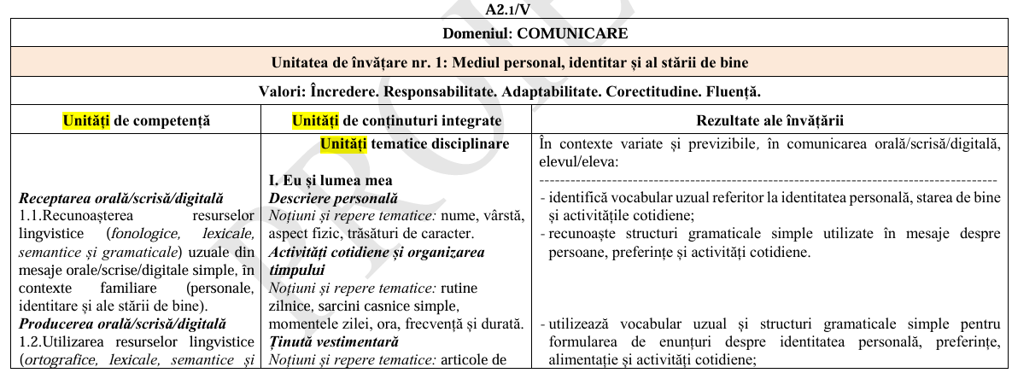

Slide 23
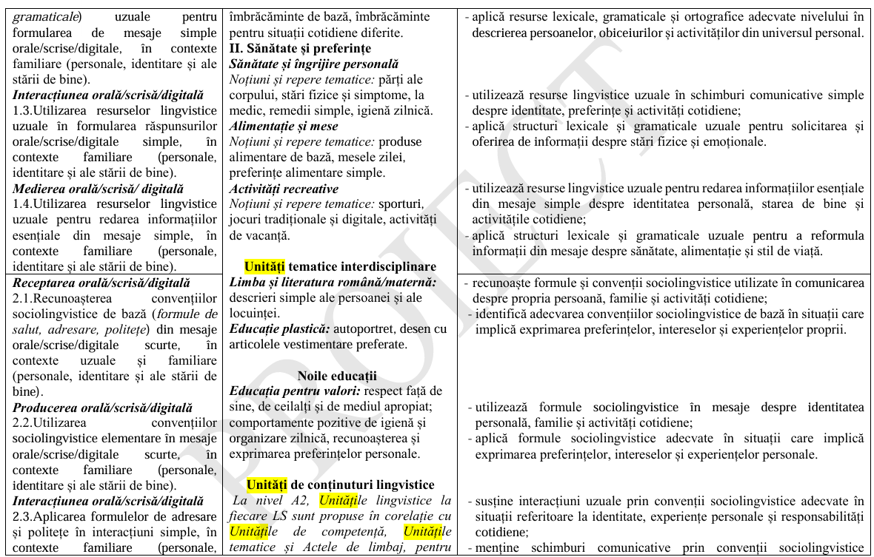

Slide 24
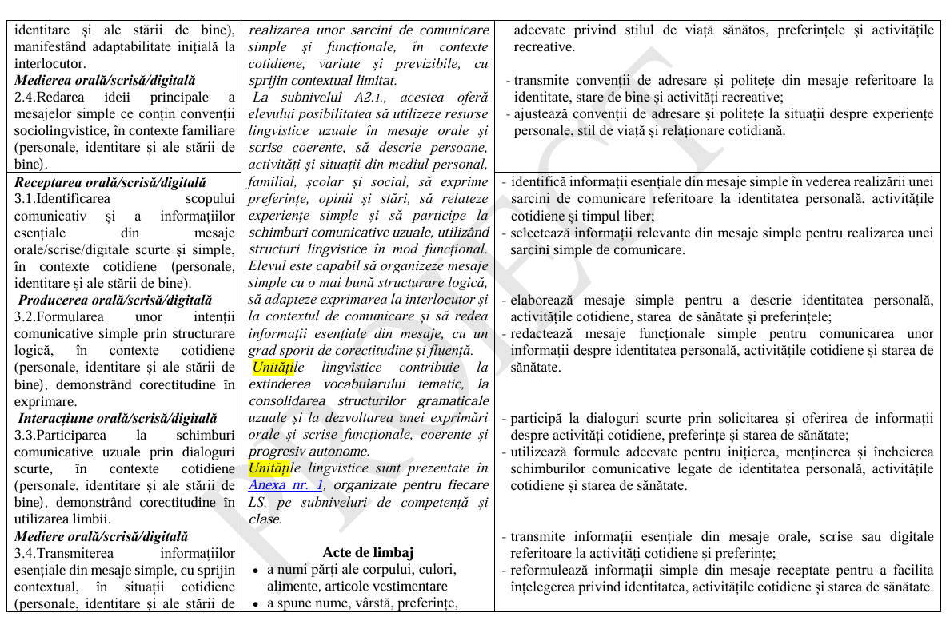

Slide 25
Unități de competență
1.-3. Receptarea orală/scrisă/digitală
1.-3. Producerea orală/scrisă/digitală orală/scrisă/digitală1.-3.
1.-3. Interacțiunea orală/scrisă/digitală. orală/scrisă/digitală1.-3.
1.-3. Medierea orală/scrisă/digitalăorală/scrisă/digitală
Domeniul: COMUNICARE
Unitatea de învățare nr. 1: Mediul personal, identitar și al stării de bine
(Valori: Încredere. Responsabilitate. Adaptabilitate. Corectitudine...)
  Unități de conținuturi integrate
    Unități tematice disciplinare
    Unități tematice interdisciplinare
    Noile educații
    Unități de conținuturi lingvistice
    Acte de limbaj
Unitatea de învățare nr. 2: Mediul familial și comunitar
(Valori: Încredere. Responsabilitate. Adaptabilitate. Corectitudine...)
  Unități de conținuturi integrate
    Unități tematice disciplinare
    Unități tematice interdisciplinare
    Noile educații
    Unități de conținuturi lingvistice
    Acte de limbaj
Unitatea de învățare nr. 3: Mediul școlar, social și civic
Unitatea de învățare nr. 4. Mediul natural și construit
Unitatea de învățare nr. 5. Mediul digital și mediatic
Unități de competență - constituente ale competențelor, etape în achiziționarea competențelor specific./Components of competences, stages in the acquisition of specific competences.

Slide 26
Unități de competență
4. Receptarea orală/scrisă/digitală
4. Producerea orală/scrisă/digitală orală/scrisă/digitală
4. Interacțiunea orală/scrisă/digitală. orală/scrisă/digitală
4. Medierea orală/scrisă/digitalăorală/scrisă/digitală
Domeniul: Cultură
Unitatea de învățare nr. 6: Mediul cultural, intercultural și plurilingv
Valori: Curiozitate. Deschidere interculturală.
  Unități de conținuturi integrate
    Unități tematice disciplinare
    Unități tematice interdisciplinare
    Temă cross-curriculară
    Acte de limbaj
Constituente ale competențelor, etape în achiziționarea competențelor specific./Components of competences, stages in the acquisition of specific competences.

Slide 27
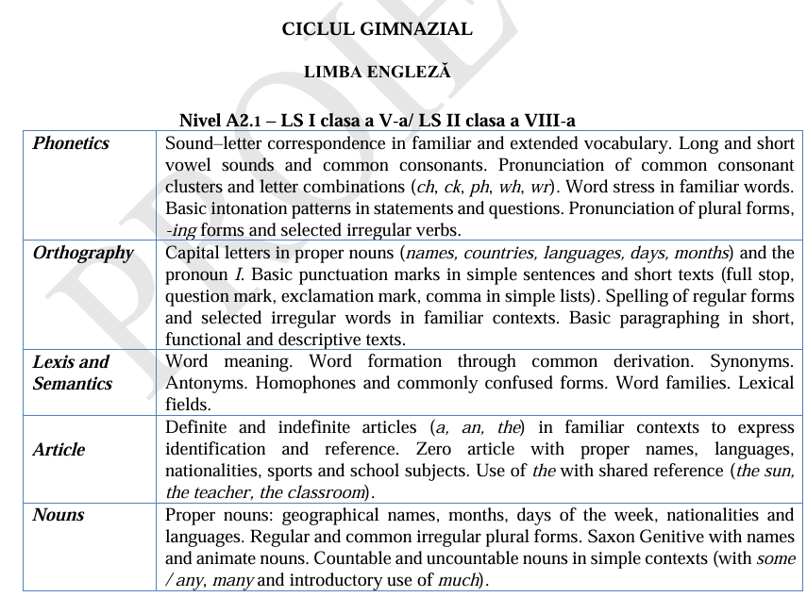
Organizarea progresivă a Conținuturilor lingvistice (lexicale, gramaticale, fonetice și ortografice)

Slide 28
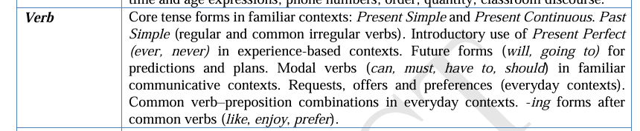
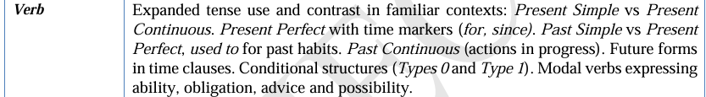
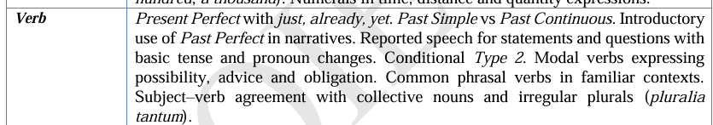
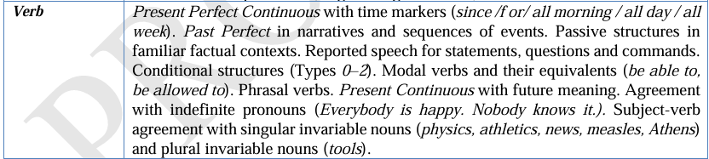
Organizarea progresivă a Conținuturilor lingvistice (lexicale, gramaticale, fonetice și ortografice)
A2.1
A2.2
A2.3
A2.4

Slide 29
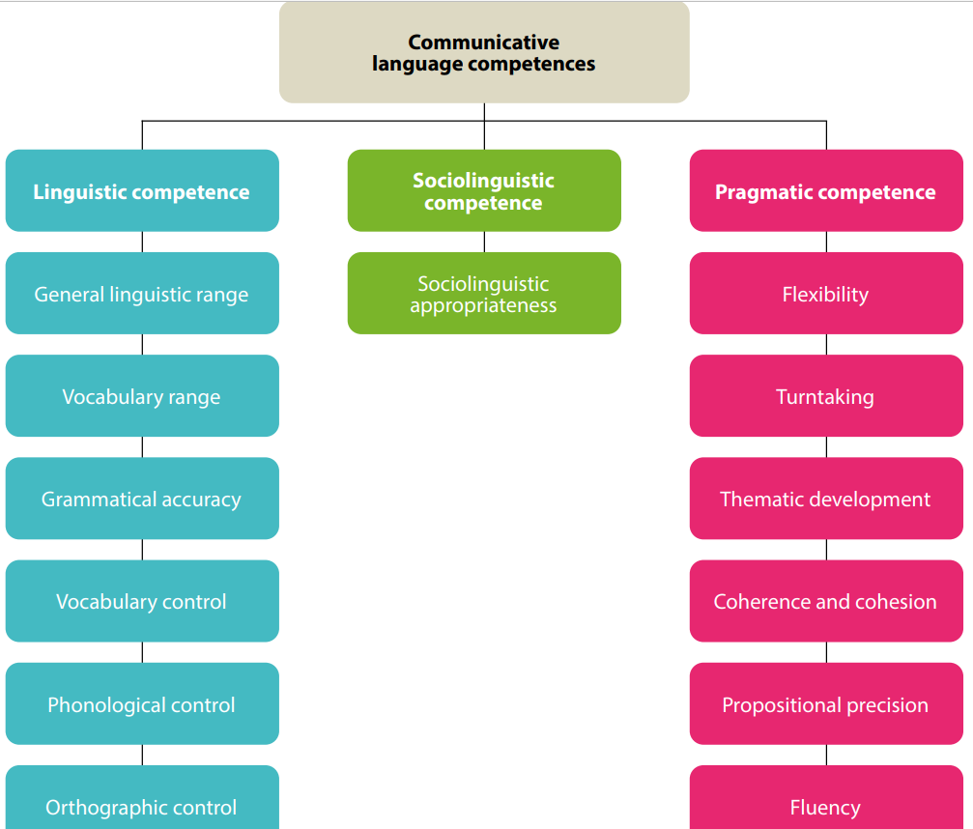
“Linguistic competence”, “Pragmatic competence” and “Sociolinguistic competence” are always intertwined in any language use; they are not separate “components” and cannot be isolated from each other.
COUNCIL OF EUROPE. Common European Framework of Reference for Languages: Learning, Teaching, Assessment. Cambridge: Cambridge University Press, 2001, [online] https://rm.coe.int/1680459f97
THE CEFR ILLUSTRATIVE DESCRIPTOR SCALES: COMMUNICATIVE LANGUAGE COMPETENCEShttps://rm.coe.int/chapter-5-communicative-language-competences/1680a084c3

Slide 30
Linguistic competence | is concerned with language usage (as in ‘correct usage’) and hence with language resources, knowledge of the language as a system.
General linguistic range
Vocabulary range
Vocabulary control
Grammatical accuracy
Phonological control
Orthographic control
Lexical competence;
Grammatical competence;
Semantic competence;
Phonological competence;
Orthographic competence;
Orthoepic competence.
COUNCIL OF EUROPE. Common European Framework of Reference for Languages: Learning, Teaching, Assessment. Cambridge: Cambridge University Press, 2001, [online] https://rm.coe.int/1680459f97

Slide 31
Pragmatic competence | is concerned with the user/learner’s knowledge of the principles of language use according to which messages are: organised, structured and arranged (‘discourse competence’); used to perform communicative functions (‘functional competence’); sequenced according to interactional and transactional schemata (‘design competence’).

Slide 32
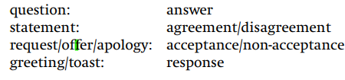
Discourse competence is the ability of a user/learner to arrange sentences in sequence so as to produce coherent stretches of language. It includes knowledge of and ability to control the ordering of sentences in terms of:
• topic/focus;
• given/new;
• ‘natural’ sequencing: e.g. temporal cause/effect.
• ability to structure and manage discourse in terms of:
  thematic organisation;
  coherence and cohesion;
  logical ordering; style and register;
  rhetorical effectiveness;
  text design, etc.
Functional competence is concerned with the use of spoken discourse and written texts in communication for particular functional purposes.
Microfunctions - categories for the functional use of single utterances, usually as turns in an interaction, e.g. imparting and seeking factual information, expressing and finding out attitudes, suasion, etc.
Macrofunctions are categories for the functional use of spoken discourse or written text consisting of a sequence of sentences, e.g.: description, narration, commentary, exposition, exegesis, explanation, demonstration, instruction, argumentation.
Interaction schemata - knowledge of and ability to use the schemata (patterns of social interaction) which underlie communication, such as verbal exchange patterns. Usually they form pairs:
General Schema for purchase of goods or services, p.127 CEFR, 2001.

Slide 33
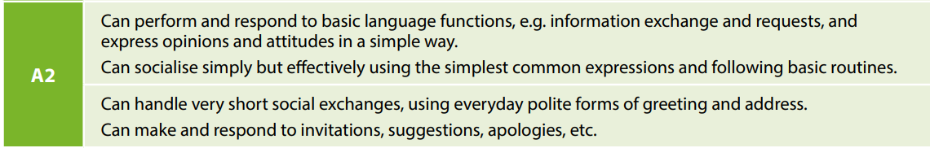
Sociolinguistic competence | is concerned with the knowledge and skills required to deal with the social dimension of language use: linguistic markers of social relations; politeness conventions; expressions of folk-wisdom; register differences; dialect and accent.
E.g. Sociolinguistic appropriateness

Slide 34
Plurilingual and pluricultural competence | - involves the ability to call flexibly upon an inter-related, plurilinguistic and a pluricultural repertoire to: ► switch from one language or dialect (or variety) to another; ► express oneself in one language (or dialect, or variety) and understand a person speaking another; ► call upon the knowledge of a number of languages (or dialects, or varieties) to make sense of a text; ► mediate between individuals with no common language (or dialect, or variety), even with only a slight knowledge oneself; ► bring the whole of one’s linguistic equipment into play, experimenting with alternative forms of expression; recognising and acting on cultural, socio-pragmatic and socio-linguistic conventions/cues; ► recognising and interpreting similarities and differences in perspectives, practices, events; ► evaluating neutrally and critically.

Slide 35
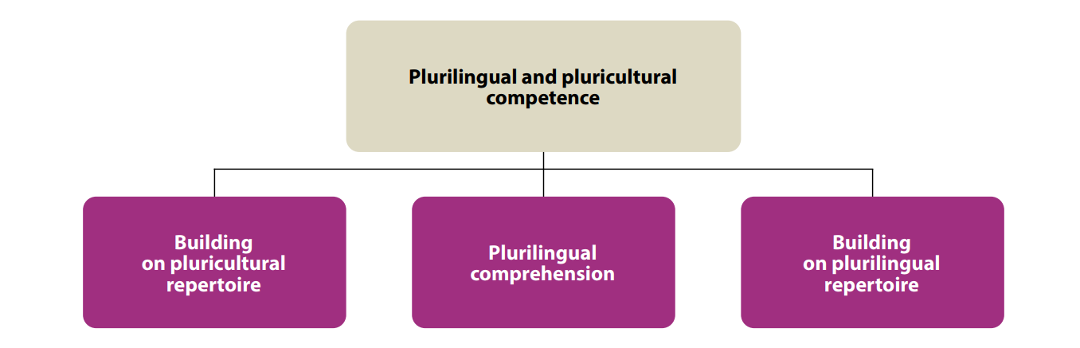
Intercultural competence:
recognising and acting on cultural, socio-pragmatic and sociolinguistic conventions/cues;
recognising and interpreting similarities and differences in perspectives, practices and events;
evaluating neutrally and critically.
The capacity to use knowledge of and proficiency (even partial) in one or more languages as leverage for approaching texts in other languages, in order to achieve a communication goal.
As the social agent is building on their pluricultural repertoire, they are also engaged in exploiting all available linguistic resources in order to communicate effectively in a multilingual context and/or in a classic mediation situation in which the other people do not share a common language.

Slide 36
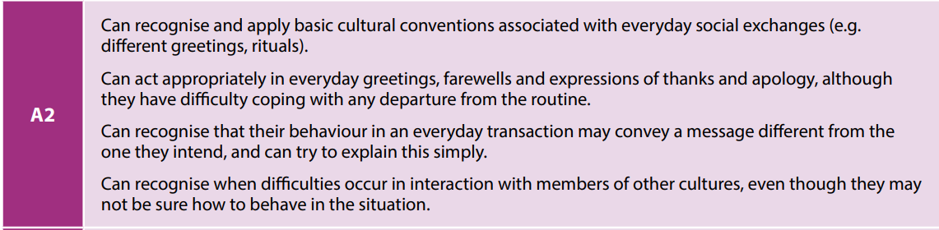
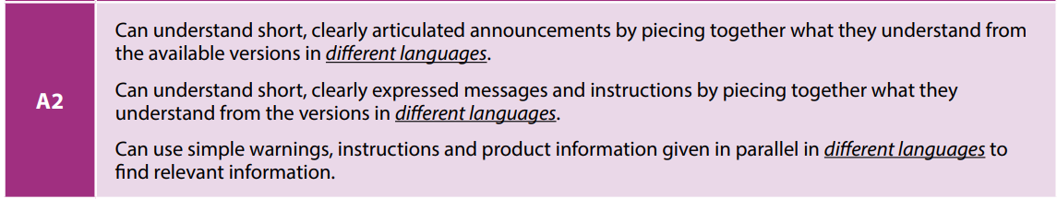
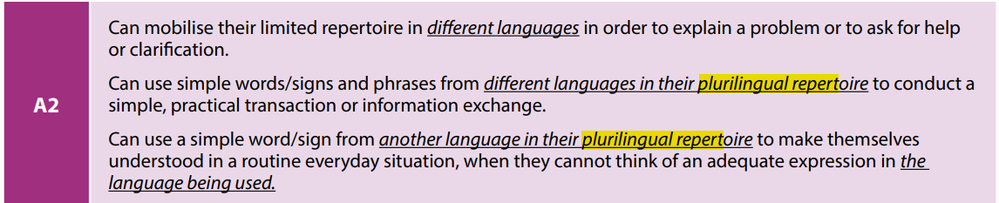
Building on pluricultural repertoire
Pluricultural comprehension
Building on plurilingual repertoire

Slide 37

Example of activity aimed at developing the plurilingual competence:
How many rules of capitalization are illustrated in this text?
In your language, which of these rules are the same and which are different?
Encouraging students to see the differences, similarities, pattern, etc. between the language 1 and the language they are learning is an example of activity meant to develop the plurilingual competence.
Discovering the LOMLOE: Key Competences - Plurilingual Competence

Slide 38
Choose from the list below:
lexical competence; grammatical competence; semantic competence; phonological competence; orthographic competence; sociolinguistic competence, discourse competence, functional competence:
knowledge of, and ability to use, the vocabulary of a language, consists of lexical elements and grammatical elements.
knowledge of, and ability to use, the grammatical resources of a language.
deals with the learner’s awareness and control of the organization of meaning.

Slide 39
Choose from the list below:
lexical competence; grammatical competence; semantic competence; phonological competence; orthographic competence; sociolinguistic competence, discourse competence, functional competence:
knowledge of, and skill in the perception and production of the sound-units of the language and their realization in particular contexts; the phonetic composition of words (syllable structure, the sequence of phonemes, word stress, word tones); sentence stress and rhythm, intonation.

Slide 40
Choose from the list below:
lexical competence; grammatical competence; semantic competence; phonological competence; orthographic competence; sociolinguistic competence, discourse competence, functional competence, orthoepic competence:
is concerned with the use of spoken discourse and written texts in communication for particular functional purposes.

Slide 41
Choose from the list below:
lexical competence; grammatical competence; semantic competence; phonological competence; orthographic competence; sociolinguistic competence, discourse competence, functional competence, orthoepic competence:
is concerned with the knowledge and skills required to deal with the social dimension of language use: linguistic markers of social relations; politeness conventions; expressions of folk-wisdom; register differences; and dialect and accent.

Slide 42
Choose from the list below:
lexical competence; grammatical competence; semantic competence; phonological competence; orthographic competence; sociolinguistic competence, discourse competence, functional competence, orthoepic competence:
is the ability of a user/learner to arrange sentences in sequence so as to produce coherent stretches of language. It includes knowledge of and ability to control the ordering of sentences in terms of:
  • topic/focus;
  • given/new;
  • ‘natural’ sequencing: e.g. temporal;
  • cause/effect;
  • ability to structure and manage discourse in terms of: thematic organization; coherence and cohesion; logical ordering; style and register; rhetorical effectiveness; etc.

Slide 43
Choose from the list below:
lexical competence; grammatical competence; semantic competence; phonological competence; orthographic competence; sociolinguistic competence, discourse competence, orthoepic competence, functional competence.
knowledge of and skill in the perception and production of the symbols of which written texts are composed.
The ability to produce a correct pronunciation from the written form. It involves
  knowledge of spelling conventions
  ability to consult a dictionary and a knowledge of the conventions used there for the representation of pronunciation
  knowledge of the implications of written forms, particularly punctuation marks, for phrasing and intonation
  ability to resolve ambiguity (homonyms, syntactic ambiguities, etc.) in the light of the context

Slide 44
References:
Proiect CURRICULUM la disciplina LIMBA STRĂINĂ I Niveluri de studii: primar, gimnazial, liceal cu profilurile umanist (U), real (R*), general (G**) LIMBA STRĂINĂ https://mec.gov.md/sites/default/files/proiet_curriculum_limba_straina_i_si_iicomponenta_invariabila.pdf
CURRICULUM NAȚIONAL, Învățământul primar, LIMBA STRĂINĂ I. Curriculumul disciplinar, Ghidul de implementare a curriculumului disciplinar, Chișinău, 2018, online https://mecc.gov.md/sites/default/files/curriculum_limba_straina_primar_tipar.pdf?fbclid=IwAR2znxT0x-deshMWRk4pXS2pQ48X8B9tXpol48ahO9ZNV4okMCKqBiKH6tk
CURRICULUM NAȚIONAL, LIMBA STRĂINĂ, Clasele V-IX. Curriculum disciplinar. Ghid de implementare, Chişinău, 2020, online https://mecc.gov.md/sites/default/files/limba_straine_gimnaziu.pdf
CURRICULUM NAȚIONAL LIMBA STRĂINĂ Clasele X-XII. Curriculum disciplinar. Ghid de implementare, Chişinău, 2020, online https://mecc.gov.md/sites/default/files/limba_straine_liceu.pdf

