Slide 1
Coordination and subordination

Slide 2
Coordination
Subordination
Joining two related ideas of equal importance.
Coordination joins two independent clauses that contain related ideas of equal importance.
Joining two related ideas of unequal importance
Subordination joins two sentences with related ideas by merging them into a main clause and a dependent clause.

Slide 3
Coordination.
Four different ways to coordinate sentence parts:
1. Use a coordinating conjunction.
2. Use a pair of correlative conjunctions.
3. Use a semicolon.
4. Use a semicolon and a conjunctive adverb.

Slide 4
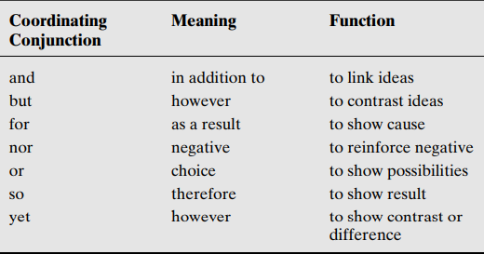
1. Use a coordinating conjunction

Slide 5
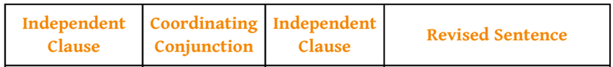
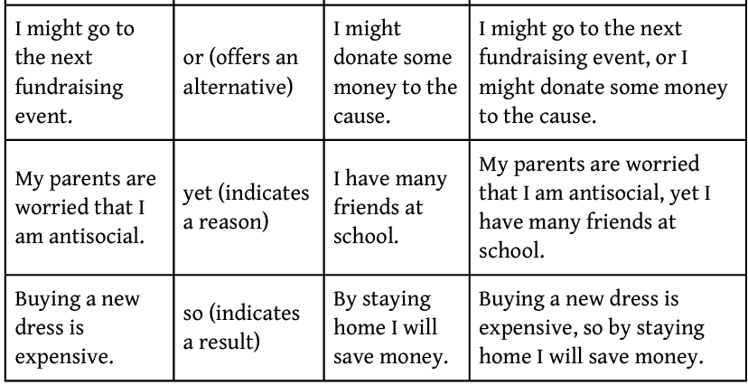

Slide 6
2. Use a pair of correlative conjunctions
Link sentences with a correlative conjunction if you want to show a balance between two independent clauses.
either . . . or
neither . . . nor
not only... but also
both . . . and
Ex. Either I drive to the airport or I get a taxi

Slide 7
3. Use a semicolon
Link independent clauses with a semicolon (;) to show that the ideas are of equal importance.
A cause is what happens; the effect is the result.
The mechanic adjusted the carburetor; Tina’s car now runs smoothly.

Slide 8
4. Use a semicolon and a conjunctive adverb
consequently furthermore therefore
nevertheless as a result for example
however nonetheless in addition
(in spite of that)
A semicolon and a conjunctive adverb together indicate different relationships, depending on the conjunctive adverb. The relationships are chiefly examples, continuation, and contrast.
I adore chili; unfortunately, it doesn’t adore me!

Slide 9
Follow these steps when you coordinate independent clauses:
● Decide which ideas can and should be combined.
● Select the method of coordination that shows the appropriate relationship between ideas.
Keep the “big three” considerations in mind:
● Audience. Your readers and their expectations
● Purpose. Why you are writing (to entertain, instruct, persuade, describe)
● Style. Your personal choices in diction (words) and sentence structure

Slide 10
With practice, you can discover that some sentences are smoother and more logical than other:
Uncoordinated: The dog’s fur was tangled. We took her in for grooming.
Coordinated: The dog’s fur was tangled, so we took her in for grooming.
The dog’s fur was tangled; therefore, we took her in for grooming.
The dog’s fur was tangled; as a result, we took her in for grooming.
Uncoordinated: Jack lost his briefcase. Jack lost his cell phone.
Coordinated: Jack lost both his briefcase and his cell phone.
Jack lost not only his briefcase but also his cell phone.

Slide 11
Uncoordinated: Each year it seems to get harder to pay for a college education. At least $500 million in private-sector money is available to help students pay for their college education.
Coordinated: Each year it seems to get harder to pay for a college education, but at least $500 million in private-sector money is available to help students pay for their college education.
Each year it seems to get harder to pay for a college education; however, at least $500 million in private-sector money is available to help students pay for their college education.

Slide 12
Quick Tip
Be careful not to connect unrelated ideas, establish a vague connection among ideas, or connect too many ideas in one sentence.
These stylistic choices often create confusing sentences.

Slide 13
Subordinating Sentence Parts
Subordination is connecting two unequal but related clauses with a subordinating conjunction to form a complex sentence.
When you subordinate one part of a sentence to another, you make the dependent clause develop the main clause. Subordination helps you develop your ideas, trace relationships among ideas, and emphasize one idea over the other.
Therefore, you will want to use subordination to give your writing (and speech!) greater logic, coherence, and unity.
As with sentence coordination, sentence subordination calls for logic and thought.

Slide 14
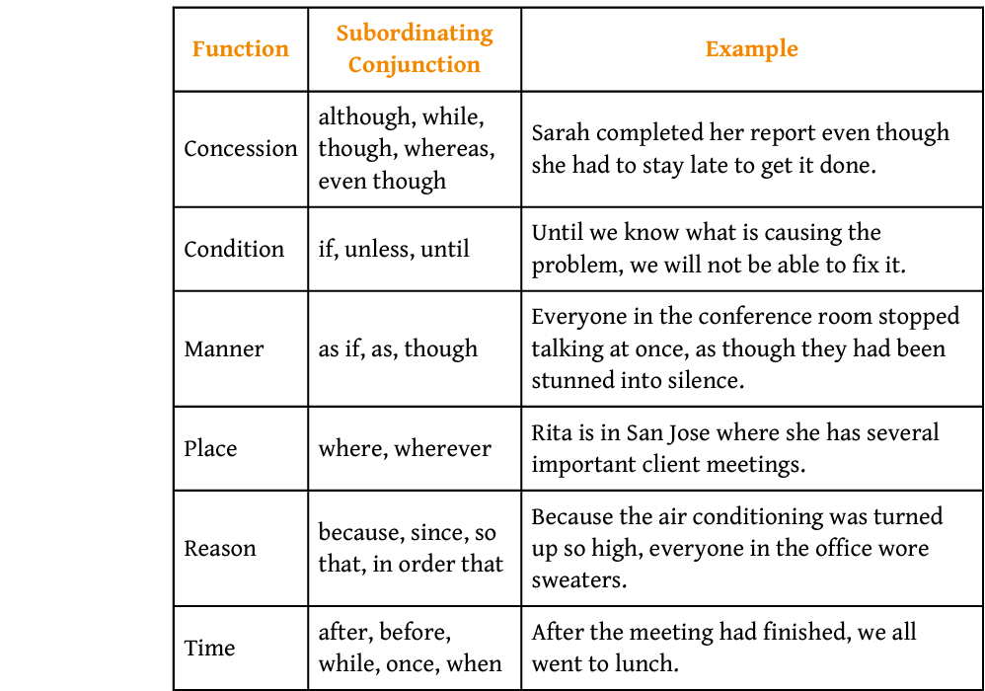

Slide 15
Four steps to subordinate sentence ideas:
1. First choose the idea or clause that you think is the most important.
2. Then make this your main clause by adding a subject or verb, if necessary. Make sure the main clause expresses a complete idea, too.
3. Choose the subordinating conjunction that best expresses the relationship between the main clause and the dependent clause.
4. Decide whether to place the main clause or the dependent clause first. See which order helps you achieve your purpose and appeal to your audience.

Slide 16
Not subordinated: It snowed all night. School was closed the following day.
Subordinated: Because it snowed all night, school was closed the following day.
Since it snowed all night, school was closed the following day.
Not subordinated: About two million dollars had been bet on the Cincinnati Reds to win. The White Sox were favored five to one.
Subordinated: Even though the White Sox were favored five to one, about two million dollars had been bet on the Cincinnati Reds to win.
Although the White Sox were favored five to one, about two million dollars had been bet on the Cincinnati Reds to win.

Slide 17
Not subordinated: A tornado can pick up a house and drop it hundreds of feet away. These are extremely dangerous storms.
Subordinated: Since a tornado can pick up a house and drop it hundreds of feet
away, these are extremely dangerous storms.
Not subordinated: The case was finally tried. The three men denied having made any confessions. They denied having been involved in any way in the crime. There was no proof against them.
Subordinated: When the case was finally tried, the three men denied having made any confessions. They also denied having been involved in any way in the crime because there was no proof against them.
When the case was finally tried, the three men denied having made any confessions and having been involved in any way in the crime because there was no proof against them.

Slide 18
Not subordinated: A tornado is one of the smallest of all types of storms. It is one of the most dangerous of all storms because of its swiftly spinning winds and unpredictable path.
Subordinated: Even though a tornado is one of the smallest of all types of storms, it is one of the most dangerous of all storms because of its swiftly spinning winds and unpredictable path.

Slide 19
Be careful not to switch the main clause and the dependent clause when you subordinate. If you put the main idea in a dependent clause, your sentence will not be logical.
Illogical: Because people stared at her, Rikki wore a see-through blouse.
Cause and effect are reversed, so the sentence doesn’t make sense.
Logical: Because Rikki wore a see-through blouse, people stared at her.

Slide 20
Coordination versus Subordination
● Coordinate when you want to link related independent clauses.
● Subordinate when you want to put the most important idea in the main clause

Slide 21
Two clauses: The ground began to tremble. The air was heavy with fear.
Coordinated:
The ground began to tremble and the air was heavy with fear.
Subordinated:
When the ground began to tremble, the air was heavy with fear.
subordinate clause main clause
The emphasis is on the feeling of fear, the information in the main clause.

Slide 22
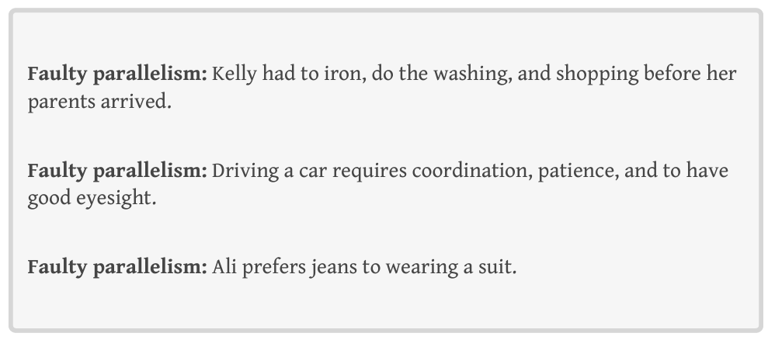
Parallel Structure
Parallel structure means putting ideas of the same rank in the same grammatical structure. Your writing and speech should have parallel words, phrases, and clauses. Parallel structure gives your writing many strengths: tempo, stress, balance, and conciseness.
What is wrong?

Slide 23
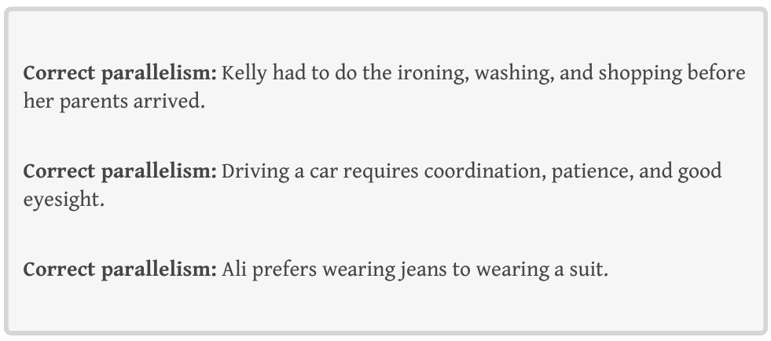

Slide 24
Parallel words share the same part of speech (such as nouns, adjectives, or verbs) and tense (if the words are verbs).
To some people, traveling by air is safe, inexpensive, and convenient.
To others, it’s dangerous, expensive, and inconvenient.
You should eat foods that are nourishing as well as tasty.

Slide 25
2. Parallel phrases contain modifiers.
Polyester shirts wash easily, drip-dry quickly, and wear durably.
Nick took the new job to learn more about finance, make important connections, and get a health plan.
“For taking away our Charters, abolishing our laws, and altering the Forms of our Government . . .” (Declaration of Independence)
3. Parallel clauses can be complete sentences or dependent clauses.
I came, I saw, I conquered.
“Our chiefs are killed; Looking-Glass is dead; Ta-Hool-Shute is dead.” (Chief Joseph’s surrender speech, 1877)

Slide 26
✔ Sentence coordination links ideas of equal importance.
✔ Sentence subordination connects two unequal but related clauses with a subordinating conjunction to form a complex sentence.
✔ Parallel structure means putting ideas of the same rank in the same grammatical structure

Slide 27
Exercise Group 1: Identifying Faulty Parallelism
Which item in the series is not parallel with the others? Underline it.
1. beautiful flowers, swimming at the beach, delicious coffee
2. planned my trip, booked a flight, pack my bags
3. unclear, lengthy, mistakes, inaccurate
4. openminded, patience, trustworthy, caring
5. dress professionally, a positive attitude, strong resume, attractive cover letter

Slide 28
Rewrite the below sentences in parallel structure.
1. I dislike cleaning and to cook.
2. I searched in my bag, on the table, and I checked under the sofa.
3. Surfing, skateboarding and to snowboard require good balance.
4. He was both angry and he was also shocked.
5. She wants to get a job, make some money, and she’d like to buy a car.
6. A good employee should be reliable, work hard, and respectful

Slide 29
Rewrite the below sentences in parallel structure.
1. She learned the value of patience, being committed, and loyalty.
2. They visited the zoo, they ate at restaurants, and stayed in a nice hotel.
3. His story was neither confusing nor did it bore me.
4. You can either come with us or staying home is also an option.
5. William is known for his good looks, sense of humor, and he’s also wealthy.

Slide 30
Fix the faulty parallelism in the below sentences.
1. I was asked for my name, address, and how old I was.
2. The students were told to pick a topic. Then they should do some research, and write an outline.
3. The new analyst is polite, knowledgeable, and he always arrives on time.
4. At the circus, clowns told jokes, musicians played instruments, and tricks were performed by animals.
5. I don’t know who you are, what you want, or the reason you are here.

Slide 31
Bonus Exercises: Parallelism & Writing Concisely
Make these sentences more concise by adding parallelism.
The new boss aimed to raise employee morale and to increase productivity.
2. To succeed in life, people need to work hard. Listening to others is also a good idea. Honesty is also important.
3. The car is advertised as compact, affordable, and it doesn’t use much fuel.
4. Parents are responsible for clothing their children, they must feed their children, and it’s important that they educate their children as well.
5. My qualifications include two years of work experience, an undergraduate degree, and I speak English fluently.

Slide 32
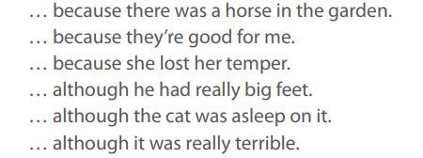

Complete the following sentences as both beginnings and endings:

