Slide 1
Using
PRONOUNS correctly
PhD Dorina Macovei

Slide 2
What is a pronoun?
A pronoun is a word that is used instead of a noun or noun phrase.
Pronouns refer to either a noun that has already been mentioned or to a noun that does not need to be named specifically.

Slide 3
The most common pronouns are the personal pronouns, which refer to
the person or people speaking or writing (first person),
the person or people being spoken to (second person),
other people or things (third person).
Like nouns, personal pronouns can function as either the subject of a verb or the object of a verb: "She likes him, but he loves her."

Slide 4
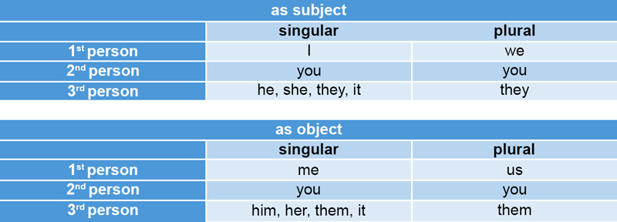

Slide 5
There are a number of other types of pronouns.
The interrogative pronouns —particularly what, which, who, whom, and whose—introduce questions for which a noun is the answer, as in "Which do you prefer?"
Possessive pronouns refer to things or people that belong to someone. The main possessive pronouns are mine, yours, his, hers, its, ours, and theirs.
The four demonstrative pronouns—this, that, these, and those—distinguish the person or thing being referred to from other people or things; they are identical to the demonstrative adjectives.
Relative pronouns introduce a subordinate clause, a part of a sentence that includes a subject and verb but does not form a sentence by itself. The main relative pronouns are that, which, who, whom, what, and whose.

Slide 6
Reflexive pronouns refer back to the subject of a sentence or clause and are formed by adding -self or -selves to a personal pronoun or possessive adjective, as in myself, herself, ourselves, and itself.
Indefinite pronouns, such as everybody, either, none, and something, do not refer to a specific person or thing, and typically refer to an unidentified or unfamiliar person or thing.
A reciprocal pronoun is a pronoun (such as each other) used when its referents are predicated to bear the same relationship to one another

Slide 7
3 cases: nominative, objective, and possessive.
●nominative - the pronoun is used as a subject.
I threw the ball.
●objective - the pronoun is used as an object.
Give the ball to me.
● possessive - the pronoun is used to show ownership.
The ball is mine.

Slide 8
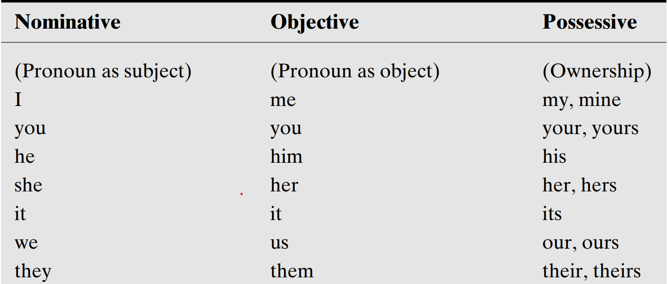
CASE CHART

Slide 9
Using the Nominative Case
For more details and uses
ADVANCED SECTION
1. Use the nominative case to show the subject of a verb.
Father and (I, me) like to shop at flea markets.
Answer: I is the subject of the sentence. Therefore, the pronoun is in the nominative case:
TIP! To help determine the correct pronoun, take away the first subject and try each choice.
See which one sounds better:
I like to shop at flea markets.
Me like to shop at flea markets.
“Father and I like to shop at flea markets.” (is considered more correct)
“Father and me like to shop at flea markets.” (spoken English)

Slide 10
USE THE NOMINATIVE CASE FOR A PREDICATE NOMINATIVE
A predicate nominative - a noun or pronoun that follows a linking verb and identifies or renames the subject. A linking verb connects a subject to a word that renames it.
The salesman of the month was (I, me).
Formal: The salesman of the month was I.
Common: The salesman of the month was me.
Conclusion:
Use “was I” in very formal, academic settings.
Use “was me” in casual speech — it’s widely accepted and understood.

Slide 11
Quick Tip
When you list two or more subjects, always put yourself last.
“Father and I”
“I and Father”

Slide 12
Using the Objective Case
1. Use the objective case to show a direct object.
A direct object is a noun or pronoun that receives the action.
John’s suit no longer fits (he, him).
Answer: John’s suit no longer fits him.
(Who, Whom) did she finally invite to the dinner party?
Answer: “Whom did she finally invite to the dinner party?”
(She is the subject, the person doing the action)
Who did you invite? (Who is also accepted in normal conversation)

Slide 13
Quick Tip
When you have a pronoun combined with a noun (such as we guests, us guests), try the sentence without the noun!
You can usually “hear” which pronoun sounds right.
It is always a pleasure for we/us guests to attend their party.
It is always a pleasure for us to attend their party.
It is always a pleasure for we to attend their party.

Slide 14
2. Use the objective case to show an indirect object.
An indirect object tells to or for whom something is done. You can tell a word is an indirect object if you can insert TO or FOR before it without changing the meaning:
“The book gave (to) my boss and (to) me some new strategies.”
The bill gave (we, us) a shock.
Answer: The bill gave us a shock.
3. Use the objective case for the object of a preposition.
Remember that a preposition is a small word that links a noun or a pronoun following it to another word in the sentence.
Sit by (I, me).
Answer: The pronoun is the object of the preposition me, so the sentence reads:
“Sit by me.”

Slide 15
Using the Possessive Case
1. Use the possessive case to show ownership.
The child refused to admit that the sweater was (her’s, hers).
Answer: Hers is the correct spelling (to express ownership: belonging to her) “The child refused to admit that the sweater was hers.”
2. Use the possessive case before gerunds.
A gerund acts as a noun.
(You, Your) walking in the rain didn’t cause your cold.
Answer: The gerund walking requires the possessive pronoun your:
“Your walking in the rain didn’t cause your cold.”
Do you mind (my, me) borrowing your cell phone?
Answer: Do you mind my borrowing your cell phone? (more formal)
Do you mind me borrowing your cell phone? (more informal)
3. Use some possessive pronouns alone to show ownership.
This cell phone is mine, not yours.

Slide 16
2. Use -self forms correctly with reflexive and intensive situations (reflexive pronouns reflect back to the subject or object)
The child embarrassed himself.
Reflexive pronouns are not preferred in place of subjects and objects.
The boss and (myself, I) had a meeting.
Answer: “The boss and I had a meeting.”

Slide 17
● Use who or whoever when the pronoun is the subject of a verb.
Who won the Nobel Prize this year?
● Use who or whoever when the pronoun is the predicate nominative.
  The winner was who?
● Use whom or whomever when the pronoun is the direct object of a verb or the object of a preposition.
Whom did he fire this week?

Slide 18
Use Correct Pronoun Reference
Last week, a wart appeared on my right thumb, and I want it removed.
(Are you removing the wart or the thumb?)
Guilt and unkindness can be emotionally destructive to you and your friends. You must get rid of them.
(Are you getting rid of the guilt or your friends?)
TIP!
1. A pronoun must clearly refer to a single antecedent.
2. Place pronouns close to their antecedents.
3. Make a pronoun refer to a definite antecedent.

Slide 19
A pronoun must clearly refer to a single antecedent
Guilt and unkindness can be emotionally destructive to you and your friends. You must get rid of them.
Here are two ways you could rewrite this sentence:
Guilt and unkindness can be emotionally destructive to you and your friends. You must get rid of these issues.
Guilt and unkindness can be emotionally destructive to you and your friends. You must get rid of these destructive emotions.

Slide 20
Place pronouns close to their antecedents.
After meeting a few guests, the President entered the reception. At that point, Senator Chin and the other elected officials began to pose for pictures. Even so, he did not join them.
In this sentence he is too far away from its antecedent, the President. One solution is to replace he with the President. The other solution is to rewrite the sentences to move the pronoun closer.
After meeting a few guests, the President entered the reception. At that point, Senator Chin and the other elected officials began to pose for pictures. Even so, the President did not join them.
After meeting a few guests, the President entered the reception. He did not join Senator Chin and the other elected officials, even though they began to pose for pictures.

Slide 21
Quick Tip
When you start a new paragraph, repeat the noun from the previous paragraph rather than using a pronoun in its place.
Repeating the noun (usually a name) can help your reader more easily follow your logic.

Slide 22
Make a pronoun refer to a definite antecedent
Be sure all pronouns refer to only one antecedent. The pronouns it, this, that, and which are especially prone to unclear pronoun reference. Consider the following sentence:
I told my friends that I was going to be a rock star, which annoyed my mother.
The following form is better because it is less ambiguous:
My mother was annoyed because I told my friends that I was going to be a rock star.

Slide 23
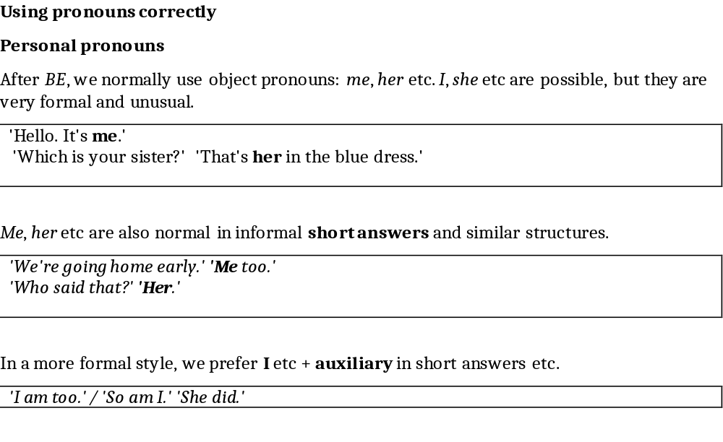
Advanced uses

Slide 24
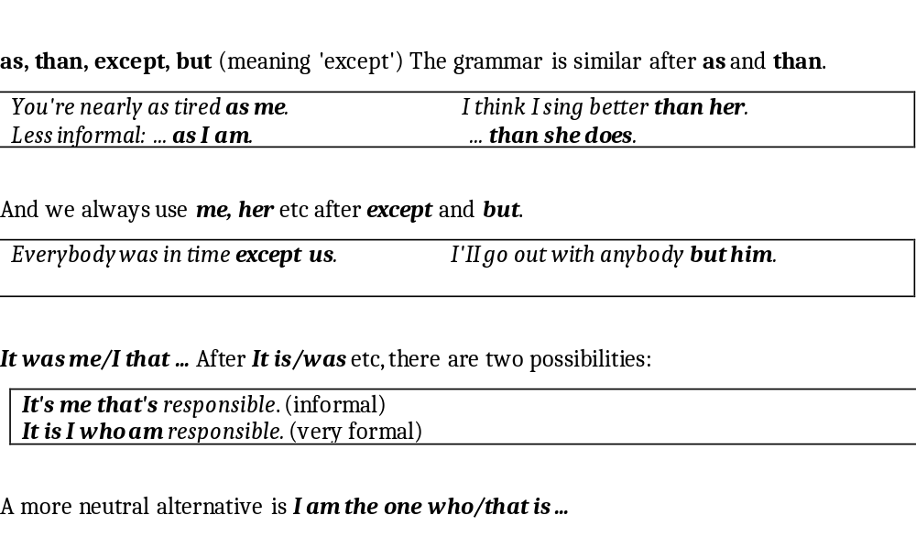

Slide 25
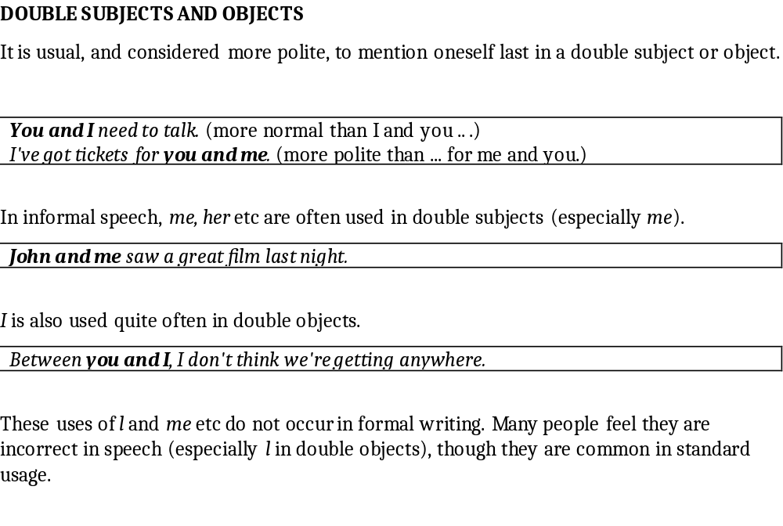

Slide 26
NOTES
noun + pronoun In written English and formal speech, one subject is enough: we don’t repeat a noun with a pronoun.
My parents are retired now. (NOT My parents, they are retired now)
However, structures like this are possible in conversation.
Identifying
Remember that we use it, this or that when we name people.
'Who is the woman in red?' 'It's Claire Lewis.'(NOT She is Claire Lewis)
(on the phone) Hi, this is Mike. (NOT I’m Mike) Isn't that Dr Andrews?
Adjectives can be used with pronouns in a few fixed expressions.
Clever you! Lucky you!

Slide 27
We, us and you can be used before nouns.
We women know things that you men will never understand.
What's the government doing for us workers, then?
He who ... etc These structures are unusual in modern English.
The person who takes the risk should get the profit. (NOT He who…)

Slide 28
REFLEXIVE PRONOUNS
Reflexives have two uses:
1. for an object that is the same person or thing as the subject
He talks to himself the whole time.
The computer switches itself off after half an hour.
2. for emphasis: to say `that person/thing and nobody/nothing else`
I got a letter from the Minister himself.
The restaurant itself is beautiful, but the food isn't much good’
Remember the difference between -selves and each other.
They write to each other every week. (NOT They write to themselves)
One another can be used instead of each other. There is no important difference.

Slide 29
English and other languages:
Note that some verbs (e.g. shave, hurry) are reflexive in some languages, but not in English unless there is a special reason. Compare:
I don't like shaving. (NOT … shaving myself)
He can't shave himself now that he's broken his arm, so I have to shave him'
After prepositions, we use personal pronouns unless reflexives are really necessary.
She always takes her dog with her when she goes out. (NOT … with herself)
BUT He's deeply in love with himself.

Slide 30
By oneself
By myself/ yourself etc. can mean either alone, without company’ or ‘without help’.
I often like to spend life by myself.
‘Do you need help?’ ‘No, thanks. I can do it by myself.’

Slide 31
NOTES
Possessives: Reflexives have no possessive forms. Instead, we use my own etc.
'Do you need a taxi ?' 'No, thanks, I'Il use my own car.'(NOT …myself’s car)
But each other / one another have possessives.
The twins often wear each other's clothes.
`ELEGANT' REFLEXIVES Sometimes reflexives are used instead of personal pronouns simply because people feel they sound good: more elegant, or important, or polite.
This shouldn't be difficult for a clever person like yourself.
'Who's going to be there?' 'Gary, Rosanne and myself.
Some people feel this usage is incorrect; it is better to avoid it in formal writing.
In itself is a useful expression for contrasting theory and practice.
There's nothing wrong with the idea in itself; it just won't work in our situation.

Slide 32
Subjects
Each other / One another are not normally used as subjects, but this sometimes happens in an informal style.
They listened carefully to what each other said.
(More normal: They each listened carefully to what the other said.)
get
Note the use of get + past participle in some structures which have a reflexive kind of meaning, especially in an informal style.
I can get washed, shaved and dressed in five minutes if I'm really in a hurry.
They got married in the village church.
I always get lost when I go walking in the mountains.

Slide 33
ONE, YOU AND THEY (GENERAL MEANING)
One and you can mean 'people in general' (including the speaker and hearer). One is more formal than you, and has a possessive one's.
One/You should always try to keep one's/your promises.
You need / One needs a visa to visit the US.
We don't use one or you to talk about whole groups.
They speak French in Quebec or French is spoken in Quebec. (NOT One speaks French in Quebec)
And one and you are not used if they could not apply to the speaker.
Where Carlos comes from, a child normally starts school at seven.
(NOT Where Carlos comes from, one/you normally …)

Slide 34
THEY (informal) can mean 'the people around' or 'the authorities', 'the government’.
They play a lot of rugby round here. They say she's back in jail.
They're always reorganising. They don't do much for single mothers.

Slide 35
SINGULAR THEY
They/Them/Their(s) have a common singular indefinite use, mostly after nouns referring to unidentified people.
Somebody has left their car outside the office. Would they please move it?

Slide 36
ONE(S)
We can use one(s) to avoid repeating a countable noun.
Another slice of lamb?’ ‘Just a small one, please.'
I'm going to wear my new earrings: the ones I bought in Egypt.
We don't use one for an uncountable noun.
There isn't any brown bread. Would you like white (bread) (NOT … white one)
If there is no adjective, we do not use a with one.
'What sort of computer have you got?' 'One that keeps crashing.' (NOT A one…)

