Slide 1
Assessment
Creanga Oxana

Slide 2
Assessment vs. Testing
Continuous assessment is like a mirror - it allows you to keep checking what you look like, and you can make changes based on what you see. Continuous assessment is ongoing throughout the duration of a course, rather than all at the end of a course. It is often informal and formative, although it may sometimes also contribute to students’ grades.
A test, on the other hand, is like a photograph - it captures one moment.

Slide 3
Forms of assessment
formative assessment | summative assessment
is used to monitor the students’ progress during a course, to check how much they have learnt of what they should have learnt, and then using this information, future teaching might be modified if necessary. can be carried out in the form of informal tests and quizzes and it can be the basis for feedback to the students. | is used at the end of a term, a semester, or a year, to assess how much has been achieved by individuals or groups. is usually carried out by using more formal tests.

Slide 4
Criteria of good tests
Validity - the degree to which the gathered empirical evidence supports the adequacy and appropriateness of the inferences that are made from the scores, i.e. a test is said to be valid to the extent that is measures what it is supposed to measure. Content validity - test contains a representative sample of the relevant lge skills.
Reliability -good test questions contribute to the reliability of the test because they produce consistent results, i.e. consistency from person to person, time to time or place to place. It means that tests are to be constructed, administered and scored in such a way that the scores obtained on a test on a particular occasion are likely to be very similar to those which would have been obtained if it had been administered with the same students with the same ability, but at a different time.

Slide 5
Criteria of good tests
Clarity in the formulation of items.
“Doable” - with no trick questions.
“Marking”-decide how exactly you will assess each section of the text. Inform the students, write the number of points assigned for each section.

Slide 6
Test types
  Placement tests
  measure the students’ general knowledge of the lge,
  measure their previous lge-learning experience in order to separate them into different levels of lge proficiency so that they can be arranged in groups or lge classes of the appropriate level,
  are administered at the start of a new lge course or phase of a lge course,
  aim to make only a rough estimate of lge proficiency, most commonly used areas are grammar and vocabulary,
  rely on objective techniques for reasons of reliability and practicality.

Slide 7
Test types
  Achievement tests
  check how much of the lge syllabus has been acquired by the students, whether they have achieved the course objectives;
  are used for certification or promotion to a more advanced course, or as an entry qualification for higher education;
  are always based on the taught syllabus and the teaching methods used in the course;
  typical examples of achievement tests are end-of-term tests,
  they are summative in nature, and are administered at the end of the course.

Slide 8
Test types
Progress tests
  are very similar to achievement tests, in as much that they assess how much of what has been taught has been learnt, but they look back to a shorter period e.g. a teaching unit, they intend to measure the progress that the students are making;
  their content is based on the course material, but they cover only one and two lge points and assess whether the students have mastered these points adequately;
  are formative in nature, and given during the course, at the end of a unit of lge teaching;
  they are informal tests, set by the teacher, with the purpose of obtaining information about which areas need further attention in order to plan future teaching.

Slide 9
  Test types
  Diagnostic tests
  are used to identify students’ lge problems, weaknesses with the purpose of obtaining information of which lge areas require further teaching in order to plan future teaching priorities.
  results can be used to design a syllabus;
  are usually administered at the start of a new phase of lge teaching (e.g. the start of a new school year).

Slide 10
Proficiency tests
  are designed to measure the test takers’ ability in a lge, their present level of mastery regardless of any previous training.
  proficiency test is not based on the content, syllabus or objectives of lge courses; it is rather based on a specification of what test takers have to be able to do in order to be proficient.
  are large scale, complex tests, covering a wide range of lge and they look forward to lge applications in the real world;
  are summative, and try to simulate the target lge tasks and cover relevant lge skills in an authentic way;
  the main function is to test if the test takers have the necessary lge skills or the degree of mastery of these skills. Proficiency tests are usually devised and administered by external testing bodies.
Proficiency can refer to the present level of the learner’s mastery, i.e. a complex combination of various skills - reading, listening, speaking, writing, grammatical knowledge, etc.

Slide 11
Washback
is the influence of testing on teaching and learning
it can be positive or negative
In lge education, positive washback encourages lge learning.
A test has positive washback when test-preparation activities are the same as lge learning activities, e.g., doing a pairwork speaking activity before a speaking test.
Negative washback limits students’ learning. Teachers and learners sometimes do activities which are not helpful for learning the lge.

Slide 12
Traditional lge Testing
Focus on lge forms
Learner produces isolated bits of lge that can be scored as right or wrong
Highly objective scoring
Decontextualized test tasks focused on the right answer.
Current Approaches to lge Testing
Focus on communicative effect
Integration of skills
Includes process and product
Clear criteria for guiding scoring
Open-ended answers
Attention to context.

Slide 13
Direct test items
Requires of candidates to perform the communicative skill which is being tested.
Try to be as much like real-life lge use as possible.
Indirect Test Items
Measure the students’ knowledge and ability by getting at what lies beneath their receptive and productive skills.
Try to find about students’ lge knowledge through more controlled items, i.e. multiple choice, grammar transformation, etc.
Are quicker to design,
Easier to mark
Produce greater score reliability.

Slide 14
Testing Techniques
Objective
have specific correct answers, free from bias
belong to the category of discrete point test (testing single, separate element of the lge)
focuses on particular level of the lge, i.e. grammar, vocabulary, phonology.
  true/False,
  multiple choice,
  matching,
  completion,
  rearrangement/transformation
Subjective
marking is impressionistic, biased
integrative /ˈɪntəɡrətɪv/ in nature
tries to assess learner’s capacity to use many bits simultaneously.
  short answers
  essays
  interviews

Slide 15
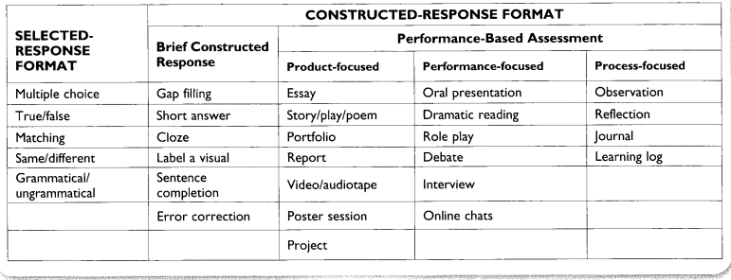

Slide 16
Awareness of the grammatical features of the lge can be measured by objective test items, each of which is testing one distinct element of the lge, one grammatical rule or structure.
  Multiple choice items - consist of the stem, which presents the problem clearly and concisely and there are three or four options given. The stem can be an incomplete statement, a complete statement and a question.
    E.g.: The police charged the man ……. robbing the bank. A. for B on C with D at
  Rearrangement items - test taker has to unscramble the sentence and write out the sentence by putting the words in their correct order.
  Completion items- involve production not mere recognition, as they test the ability to put the most appropriate word in the blanks in the sentences, or in a text
  E.g.: That car belongs ………… my brother. (blank completion)
She ……….. (come) home late yesterday (blank and cue)

Slide 17
Transformation items - there are two alternatives; the sentence has to be changed according to a given
pattern or by using selected words:
  E.g.: I haven’t seen her for a year.
  It’s a year ……………………..
  It’s no use calling her now, she’s on holiday. (point)
  ………………………………………………………………………
Joining elements (combination items)- a pair of sentences is to be joined using the word given.
E.g.: Some questions were difficult. They weren’t answered by several candidates. (WHICH)
Addition items - students are to insert the given word in the most appropriate place in the sentence.
E.g.: The children were alone at home in the evenings (OFTEN)

Slide 18
Cloze procedure – is considered an integrative /ˈɪntəɡrətɪv/ or global technique the test taker to combine many elements of the lge to perform the task. A text is taken and words are deleted form it at intervals. The test taker is to restore the missing part. It can be regarded integrative because each cloze test can contain a large number of items, it operates beyond sentence level and gives a full context for each item, and the test taker has to employ a wide range of lge skills (lexical, grammatical, cohesive, semantic, contextual and predictive) to fill in the missing item.

Slide 19
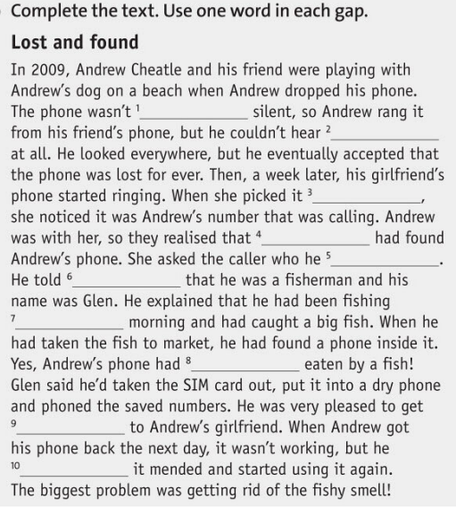

Slide 20
Different forms of cloze procedure:
  Traditional (also called mechanical deletion) cloze - words are deleted at regular intervals, every sixth, seventh or eighth word.
  Modified (also called selected deletion) cloze - the words are deleted at irregular intervals depending on the test focus. All deletions may focus on the same lge point or different but specific lge points e.g. past tense forms, prepositions.
  Multiple-choice cloze, which is an easier version of a traditional or modified cloze, where several options are offered for each gap.
  Authentic cloze, which is a version of a traditional cloze, where a number of letters are cut off from the beginning or/and of each line

Slide 21
Test’s Construct - the set of student abilities that the test measures
There are two main problems with test construct that can produce negative washback:
1) The construct can be too narrow, so only a small number of specific skills or abilities are tested. This may cause teachers and learners to restrict what they learn.
  E.g., if speaking is not tested, teachers and learners may choose not to practise speaking in class, even though it would be a useful skill in real-life. To avoid this kind of negative washback, we need to include a wide range of skills and abilities in our test construct.
2) Sometimes lge skills and abilities are tested, but they are not connected to real-life abilities which we need to learn. When the test is not relevant in this way, negative washback can happen.
  E.g., if a speaking test includes a memorised speech, students may spend more time trying to memorise the speech than developing their speaking skills. To avoid this kind of negative washback, it is important for tests to focus only on the lge ability being tested.

Slide 22
Formats, tasks and settings - ways in which we can try to reproduce the conditions of real life lge use.
Common formats for speaking tests include:
Interview: This has the advantage of being interactive, but is not like a real conversation because one person usually asks all the questions and the other answers them.
Oral presentation: Presentations can be useful in business or academic situations, but they are not very interactive.
Interactive task: When two or more students work together, it encourages natural student interaction and genuine communication. However, one student’s performance might affect the other’s.
Group discussion: This can work well with large classes because it saves time by assessing students together. However, teachers need to be careful not to allow any students to dominate while others say very little.

Slide 23
Tasks
Speaking tasks commonly used in assessment include:
Describing something: e.g., describing a picture. This gives students something to talk about, and it doesn’t require students to read anything.
Comparing things: This is similar to describing something, but can be more demanding. It encourages students to compare and contrast two different things.
Telling a story: This is a very natural speaking activity. Stories can be based on pictures. Alternatively, students can tell their own stories, but some students might find it difficult to think of a story to tell.
Giving some personal information: This is also a natural speaking activity, and focuses on personal topics that students are familiar with. In addition to basic information, it can include talking about personal experiences and opinions.

Slide 24
Settings
Recorded: This allows lots of students’ speaking performances to be recorded at the same time, and it also means that markers can listen more than once. However, it means that markers need time to listen to the recordings after the test.
Face-to-face: This might be considered more realistic, but it means that the marker and the students need to be in the same place for the test.
Remote (via internet): This may feel different from face-to-face communication, but it can make tests easier to access, especially for students in remote locations.

Slide 25
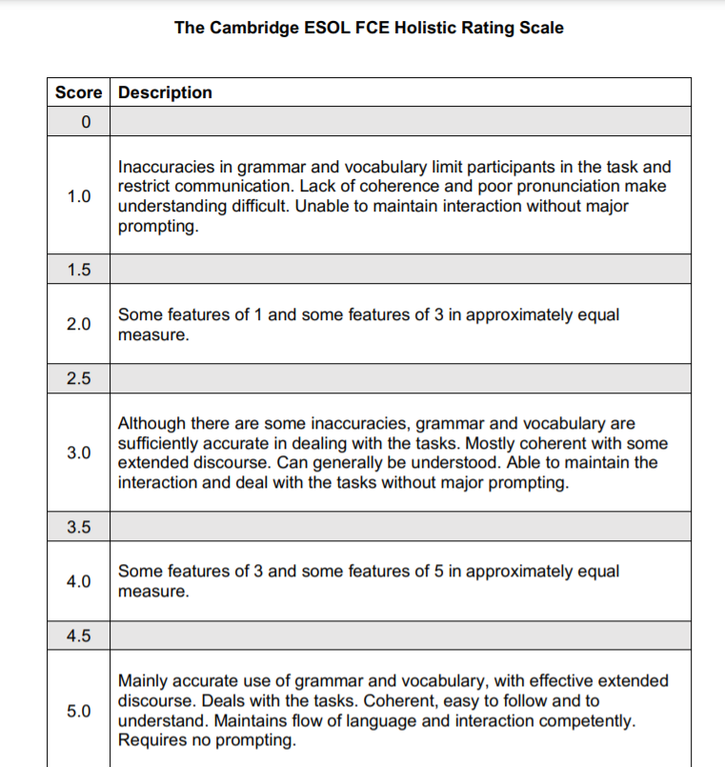
Scoring speaking:

Slide 26
Writing
Like speaking, writing is usually assessed using a rating scale.
Rating scales give students credit for what they do well, rather than penalising them for making mistakes. This approach can feel more positive and motivating for students.
Holistic (global) rating scales give one overall score for a piece of writing or speaking. Holistic scales are often easier for teachers to use, and can produce more consistent marking.
Analytic rating scales give separate scores for different aspects of writing or speaking, such as task achievement, vocabulary, and grammar, for example. Analytic rating scales can be useful for formative assessment, because they give learners more detailed information about the strengths and weaknesses of their writing.
https://ugc.futurelearn.com/uploads/files/a9/da/a9dacc3a-4fd1-4dcb-8841-6da3a4f72d5f/Aptis_writing_rating_scales.pdf
Aptis is an English test for adults (16+), which can be used to assess ability in all four English skills - speaking, listening, reading and writing.

Slide 27
Reading in the CEFR
Looking at the Overall Reading Comprehension Scale, we can see the progression of reading skills, which means that students will move:
  from individual words (Pre-A1) to texts (A1 - C2)
  from very short (A1) and short (A2) to long texts (C1 - C2)
  from simple (A1 - A2) to complex messages (C1 - C2)
  from concrete information (A2) to abstract concepts (C2)
  from standard high-frequency lge (A2) to idioms (B2) and colloquialisms (C2)
  from familiar matters (A2) to topics of interest (B1) and specialised subjects (C1).

Slide 28
Tasks for assessing reading:
Multiple choice questions consist of a short text (usually a sentence or part of a sentence), the ‘stem’, and a list of options or alternatives, which includes the correct answer (the ‘key’) and a few incorrect ones, called ‘distractors’. One of the challenges of this task type is to come up with distractors that are credible enough, but not too challenging for our students.
True/False questions have only two options (generally True/False, Yes/No). This means that test takers have a 50% chance of getting them correct, regardless of their understanding. To limit the guessing, we might add a third option (e.g. Not mentioned), although sometimes it can be difficult for students to distinguish between ‘false’ and ‘not mentioned’, so it is important to train our students in this type of task if we want to use them in a test. Alternatively, we might ask them to locate the answer in the text (i.e. write the number of the paragraph where the answer is located), although this doesn’t work very well if we are testing global reading.

Slide 29
Tasks for assessing reading:
Matching tasks take the form of matching texts with appropriate headings (or paragraphs within a text with appropriate subheadings) or matching the first part of a text with its second part. It is good practice to include a few extra distractors in the list of options (e.g. to have 7 subheadings and only 5 paragraphs), in order to limit guessing.
Gap fill and cloze are tasks where a few words have been taken out and substituted with blanks. Test takers are expected to fill in the blanks with the missing word(s). This type of task requires not only reading skills, but also textual and lge skills, as test takers are expected to fill in the blanks with a word that fits within the text and is grammatically correct. Common variants of this task include the ‘banked cloze’, where students have to choose the right answer from a list of options, and the ‘cloze elide’, where students have to put whole sentences back into a text.

Slide 30
Tasks for assessing reading:
Short answer questions. They usually pose less of a challenge when it comes to scoring because it is easier to predict the answers test takers will come up with, and decide in advance which are acceptable and which are not.
Information transfer are tasks where candidates are expected to fill in charts, tables or diagrams based on the information they read in a text. This kind of task is often used in academically oriented lge tests.

Slide 31
Ordering tasks are tasks where candidates need to put sentences or paragraphs of a text in the right order. It is particularly important to pilot this type of task because they are apparently easy to build from authentic texts, but often students come up with different solutions we had not thought of (and which are also perfectly acceptable).
Integrated tasks: These are tasks that require the use of a different skill (usually a productive one, like speaking and/or writing). Examples can be summary tasks, making notes from a text, paraphrasing, etc.
  They can be very challenging to score because it can be hard to build a scale of criteria that takes into account both reading and writing (or speaking) skills, and sometimes it’s not so straightforward to determine whether an error depends on poor reading or on the lack of productive ability. However, these tasks can be more authentic than non-integrated tasks.
It’s important to keep in mind that each task type will have advantages and disadvantages, therefore, including a number of different task types is probably the safest approach.

Slide 32
More tips on assessing reading:
Decide which sub-skills you wish to test e.g. skimming, scanning, making inferences.
Choose suitable reading texts and task types. Ideally your texts will be interesting and similar to the reading your students need to do in real life.
Make sure you test a range of reading skills and include a variety of tasks.
Give the test to someone else to try first. Did you expect the same answers? Can you improve the test?
Write tests in teams of people wherever possible. Two heads are better than one, as they say!

Slide 33
Different types of listening (listening behaviours)
Each of these different listening behaviours is generally called a listening sub-skill, and we commonly distinguish five of them.
Listening for gist - Gist is a general understanding. Students do not have to understand every word because the idea is clear enough.
Listening for specific information - Listening for keywords and important ideas. Students focus more on the main points and should be ready to note down answers.
Listening for detail - Listening to someone speaking and trying to get as much information as you can.
Listening for inferred meaning - Students guess the real meaning from what someone has said. The answer may not be clear, so they are paying attention to cues.
Listening for attitude - Focusing on the tone and on some keywords, listeners try to work out the behaviours and feelings of the speakers (e.g. whether they are enthusiastic or annoyed, bored or interested, kind or aggressive, etc.).

Slide 34
Listening skills in the CEFR
The progression of listening skills can be observed as learners move up through the levels:
from the individual word level (Pre A1) to extended speech (C1 - C2)
from very short questions (Pre A1) to short narratives (B1) to any kind of spoken lge (C2)
from needing visual aids or gestures to support understanding (Pre A1) to understanding with ease any kind of lge live or broadcast (C2)
from very slow delivery and careful articulation (Pre A1 - A1) to clear standard speech (B1 - B2) and dealing with unfamiliar accents (C1) and fast natural speed (C2)
from understanding concrete information on everyday topics (A2) to the main points of complex lines of argument on familiar (B2) and unfamiliar subjects (C1)
from standard high-frequency lge (A2) to a wide range of idioms and colloquialisms (C2).

Slide 35
Common Task Types to Assess Listening:
Multiple choice questions and True/False questions normally consist of a ‘stem’, and a list of options, which includes the correct answer(s) (the ‘key’) together with a few ‘distractors’. Two common variations of this type of task are matching tasks (e.g. tasks that require candidates to identify who says what) and ordering tasks (e.g. tasks where candidates need to order information or parts of a dialogue).
Gap fill and cloze are texts where a few words have been taken out and substituted with blanks. Test takers are expected to listen to a text and fill in the blanks with the missing word(s). In this case, textual and lge skills might compensate for a lack of listening skills (e.g. even if a student hasn’t listened properly, he might still be able to fill in the blank with an appropriate word).
Short answer questions can be considered a type of open question where test takers are required to use a specific number of words. This type of task can be difficult to score because we’ll need to decide in advance how to deal with grammatical and spelling mistakes.
Information transfer are tasks where candidates are expected to listen to a text and fill in a table, or label charts and diagrams based on the information they receive.

Slide 36
Common Task Types to Assess Listening:
Integrated tasks require the use of a different skill (usually a productive one, like speaking and/or writing). Examples can be summary and note-taking tasks, etc. When scoring this kind of task, we’ll need to take into account to what extent productive skills are required and how they can impact the students’ performances.
Dictation is a task that nowadays is often frowned upon, although, it can have its merits, especially if used in combination with other tasks.
The choice of tasks will depend: Why do the students need English? What kind of listening will they be doing? How do you use that information to produce a task that they can do?
It is very important to try and mimic a real-life activity and to include a variety of task types and of listening sub-skills (listening for specific information, listening for detail, etc.), targeting both higher and lower level processing so that we can really get a picture of what students can do with their lge skills.
When designing a test, we should always consider going from easier to more difficult (and finishing off with something slightly easier). Students often need some time to start listening properly and concentrate, so having a difficult item at the beginning might be problematic. As the test progresses, the students concentrate more and will begin to listen better. Towards the end, again, they might be a bit tired, or they might not have enough time to listen properly, so it’s better to have something slightly easier again.

Slide 37
Monitoring and evaluating a test
After using a test, it is a good idea to analyse the results.
  To find out how easy a question was, we can calculate the proportion of students who got a question right. Simply divide the number of students who got it right by the total number of students who took the test.
  0.0 means that nobody got the question right, so the question was very difficult for these students.
  1.0 means that everybody got the question right, so this question was very easy for these students.
  For example, if 32 students take a test, and 24 of them get it right:
  24/32 = 0.75
If your test is an achievement test to check students’ learning on the course, you might expect most students to get questions right.
If, on the other hand, your test is an end-of-year test to decide students’ grades, questions that are too easy or difficult are not very helpful. Values in the range of 0.25 - 0.75 are probably the most helpful for this sort of test. Below 0.25 is too difficult, and above 0.75 is too easy.

Slide 38
Another way we can evaluate test questions is to look at who answered correctly and incorrectly.
If a test question is working well, we would expect stronger students to answer correctly more often than weaker students. We can find out whether this is happening by comparing the top third of the class with the bottom third.
First, calculate students’ test score for the whole test component (e.g. all grammar items) and put them in order from highest total score to lowest total score.
Now, split the class into thirds (approximately), so that the highest scoring students are in the top third and the lowest scoring students are in the bottom third. If the total number of students cannot be divided by three, make sure that the top and bottom thirds have equal numbers.
For the top third and bottom third of the class, calculate the facility value for each question, the same way we did in the previous step: number of students who answered correctly divided by the total number of students in that group.

Slide 39
  For example, in a class of 30, there would be 10 students in each third.
  In the upper third of the class, 8 students answered Question 1 correctly, so the facility value is 8/10 = 0.80
  In the lower third of the class, 5 students answered Question 1 correctly, so the facility value for this third is 5/10 = 0.50
  More students answered correctly in the upper third than the lower third. This is what we would expect, so Question 1 seems to be working well.
  If the values are the same for both groups, it may mean that students are guessing.
  If more students answer correctly in the lower third, it may mean that there is a problem with the question. For example, the answer key might be wrong, or the question might be confusing.

Slide 40
Guidelines for Developing a Scoring Rubric
Step 1: Select a project/assignment for assessment.
  Example: Work in small groups to write and present a collaborative paper.
  Step 2: What performance skill(s) or competency(ies) are students demonstrating through their work on this project?
  Example: Ability to work as part of a team.
  Step 3: List the traits you'll assess when evaluating the project--in other words, ask: "What counts in my assessment of this work?" Use nouns or noun phrases to name traits, and avoid evaluative lge. Limit the number of traits to no more than seven. Each trait should represent a key teachable attribute of the overall skill you're assessing.
    Example:
    Content
    Coherence and Organization
    Creativity
    Graphics and visuals
    Delivery

Slide 41
Guidelines for Developing a Scoring Rubric
Step 4: Decide on the number of gradations of mastery you'll establish for each trait and the lge you'll use to describe those levels.
Step 5: For each trait write statements that describe work at each level of mastery. If, for example, you have seven traits and five gradations, you'll have 35 descriptive statements in your rubric. Attempt to maintain a balance between over-generalizations and task-specificity.
Step 6: Design a format for presenting the rubric to students and for scoring student work.
Step 7: Test the rubric and fine tune it based on feedback from colleagues and students.
http://rubistar.4teachers.org/index.php?screen=NewRubric&section_id=5#05

Slide 42
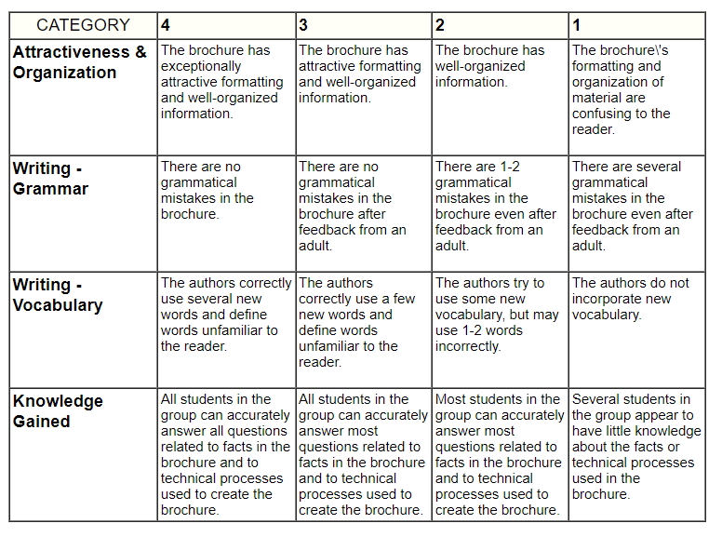
Example:
Making A Brochure
http://rubistar.4teachers.org/index.php?ts=1702393983

